Slide 1
Food Tourism
Notes:
NOTE: To replace a picture, just select and delete it. Then use the Insert Picture icon to replace it with one of your own!

Slide 2
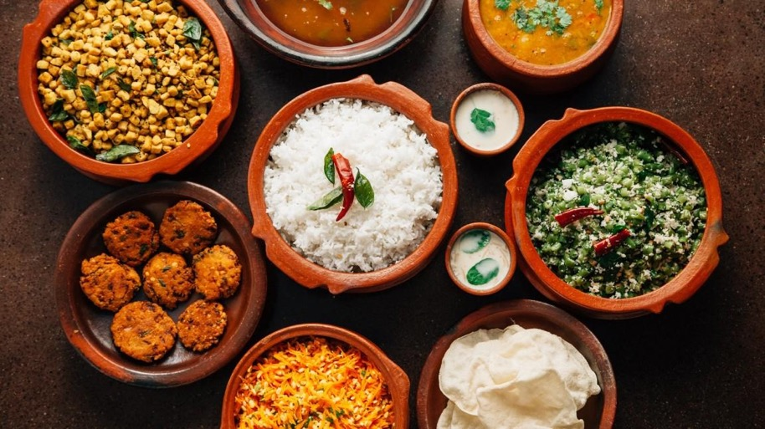
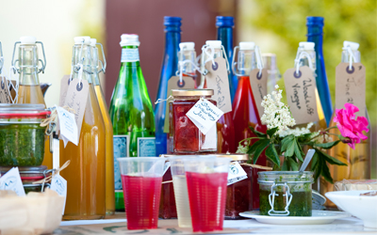
Food Tourism Definition
UNWETO: “Visitation to primary and secondary food producers, food festivals, restaurants and specific locations for which food tasting and/or experiencing the attributes of specialist food production regions are the primary motivating factors for travel”
McCabe Travel Group: “ culinary travel is about being able to touch, breath, taste and understand food and how it relates to a particular region.”

Slide 3
History of Food Tourism
Started with prehistoric hunters- i.e. following herds of animals
Columbian Exchange-
Brought to America: oranges, pepper
Brought to Europe: chocolate, corn, tomatoes, potatoes, tobacco
Leisure travel begins in England during the Industrial Revolution
Immigration to the United States (Late 1880’s-1920’s)-
Irish- Potato Famine
Italians- escaping overpopulation
Chinese- Gold Rush

Slide 4
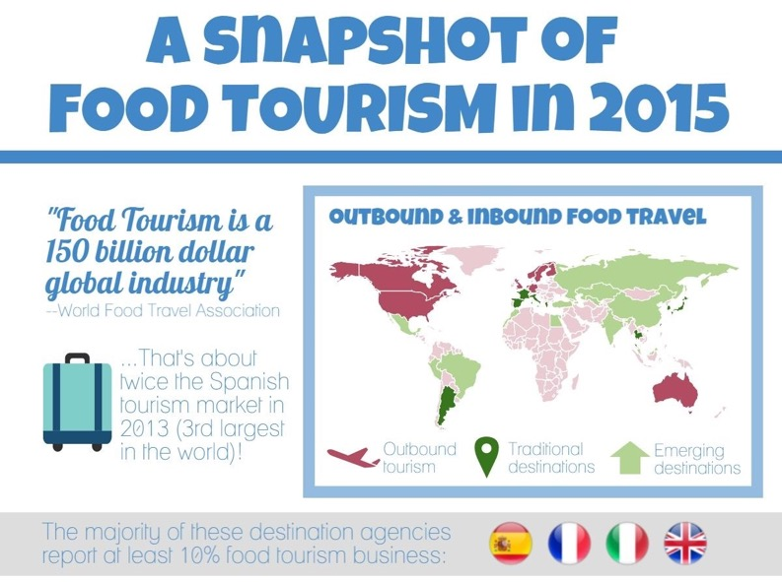
Food Tourism Charts

Slide 5
Food Tourism in the United States
Grew from 40%-51% from 2006 to 2013
In 2015, ¼ of U.S. travel income came from the food tourism sector
Common “American” foods:
Hot dogs, hamburgers, fried foods, apple pie, sub sandwiches
World Food Travel Association
Erik Wolf 2001

Slide 6
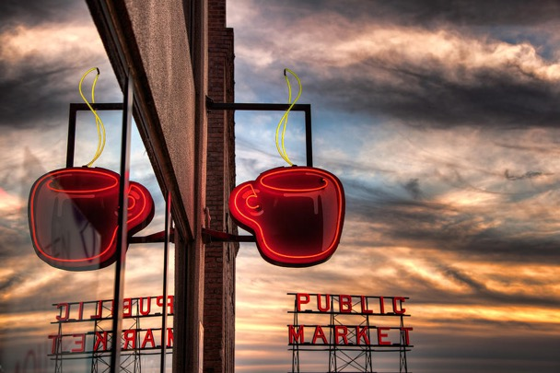
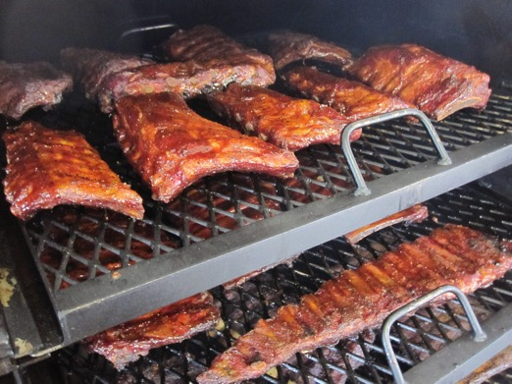
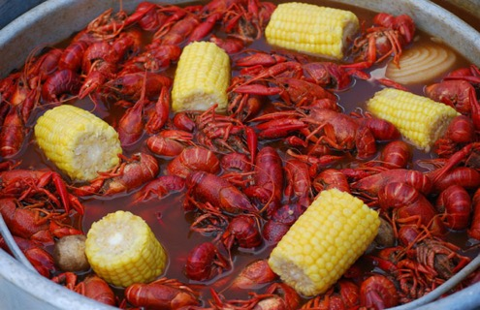
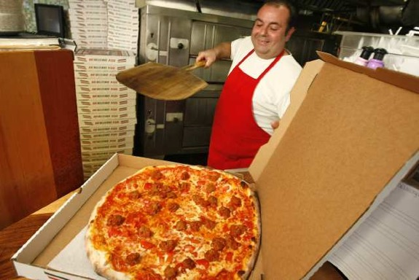
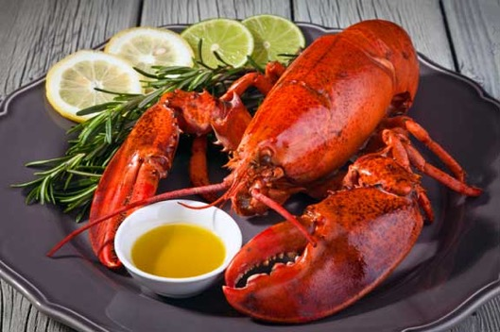
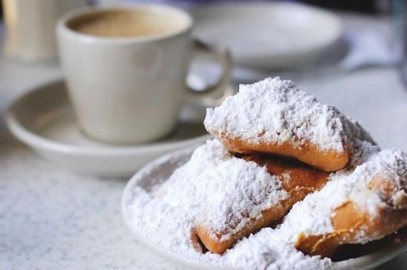
Most Popular Food Tourism in the US
New Orleans: Crawfish and Beignets
Seattle: Coffee
Texas: Barbecue
New York: Pizza
Maine: Lobster

Slide 7
Food Tourism Around the World
India is the most visited country for culinary tourism.
Spice Tour in India
Largest exporters of crops- United States, Netherlands, and China.
76% of Americans surveyed in 2013 said they would likely travel to Europe for culinary tourism than any other continent.
Americans Try International Combinations

Slide 8
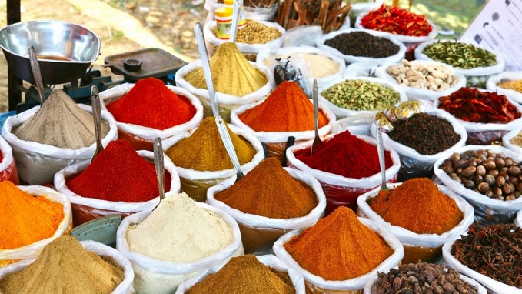
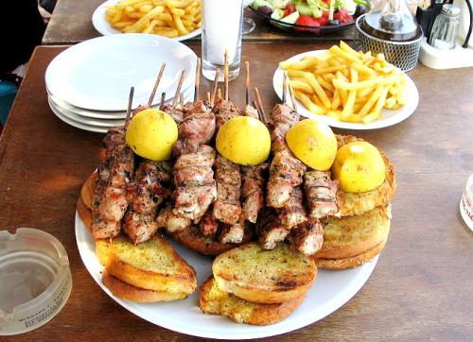
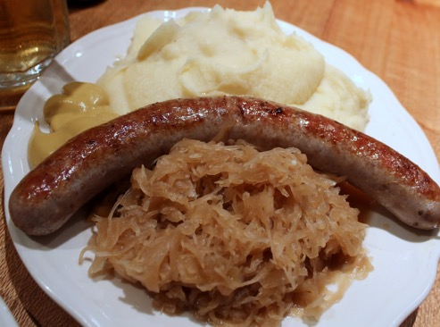
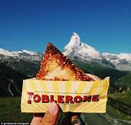
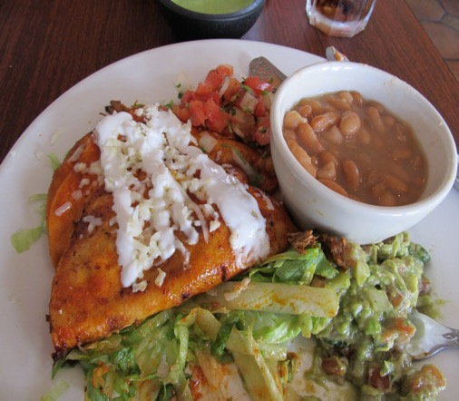
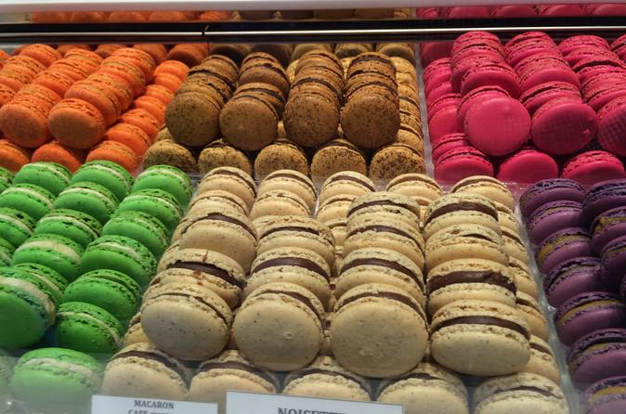
Food Tourism Around the World
India’s Spice Market Greek Lamb Kabobs German Bratwurst and Sauerkraut
Swiss Toblerone Pastry
Traditional Mexican Meal
French Macaroons

Slide 9
Food Festivals
Food and Wine Festival
Melbourne, Australia
Chocolate Festival
London, England
Peanut Festival
Dothan, Alabama
Mooncake Festival
China
Bacon Fest
Sacramento, California

Slide 10
Advantages of Food Tourism
Helps preserve cultural aspects of societies
Education and relationship experiences with tourists
New sales opportunities, potential agricultural growth
Market intelligence on products
A differentiated experience

Slide 11
Disadvantages of Food Tourism
Seasonality issues
Food safety issues
Dietary needs/food allergies
Inability to significantly impact
Low opportunity costs

Slide 12
“Food Travelers are Hungrier than Ever”
By: Valerie Chen
52% of millennials interviewed said the food in an area motivated how strongly they wanted to visit
Adults 50-69 surveyed only 35% said food motivated their trips
"As millennials continue to focus on health and treating their bodies with respect, there will be a shift in better understanding the ingredients they are eating, the origins and the benefits.”

Slide 13
Wine Tourism
Wines of Balkans definition: “Tourism whose purpose is or includes the tasting, consumption, or purchase of wine, often at or near the source of production.”
45% of wine revenue for Napa County occurs directly in Napa, which means from tours, private tasting, and souvenir bottles
Some of the most popular wineries in the world include:
Mission Hill Winery- Canada
Darioush Winery- Napa
Marques De Riscal- Spain
Ceretto Aziende Vitivinicole, Italy
Villa Vignamaggio, Tuscany, Italy

Slide 14
Other Popular Alcohol Tourism
Bourbon Street, New Orleans
6th Street Block, Austin, Texas
St. Patrick’s Day Festival in Dublin, Ireland and Savannah, Georgia
Oktoberfest in Germany
The Great British Beer Festival, London, England
Hopscotch Festival, Kelowna, Canada

Slide 15
Impacts from Food Tourism
United States
Worldwide
Popularity of international restaurants
Chinese delivery, Hibachi restaurants, Brazilian steakhouses
One fourth of revenue from the tourism sector is believed to be from the dining market alone
Has allowed third world countries a contribution to the tourism sector
Higher level of international produce sold/traded

Slide 16
Sources
https://healthisinternational.com/food-tourism-and-culinary-tours/
http://www.huffingtonpost.ca/parmjit-parmar/the-rise-of-culinary-tourism_b_7596704.html
http://www.foodtourism.com/
https://drprem.com/travel/history-of-culinary-tourism/
https://research-methodology.net/food-tourism/
http://www.travelmarketreport.com/articles/Culinary-Travel-Puts-Revenue-on-the-Table
Chen, V. (2017, February 13). “The bread and butter of culinary tourism: foodie travelers are hungrier than ever, and these trend are on the menu.” TravelAge West, 52(4), 14+. Retrieved from http://link.galegroup.com.libproxy.troy.edu/apps/doc/A485972110/PPTH?u=troy25957&sid=PPTH&xid=4f615a39

