Slide 1
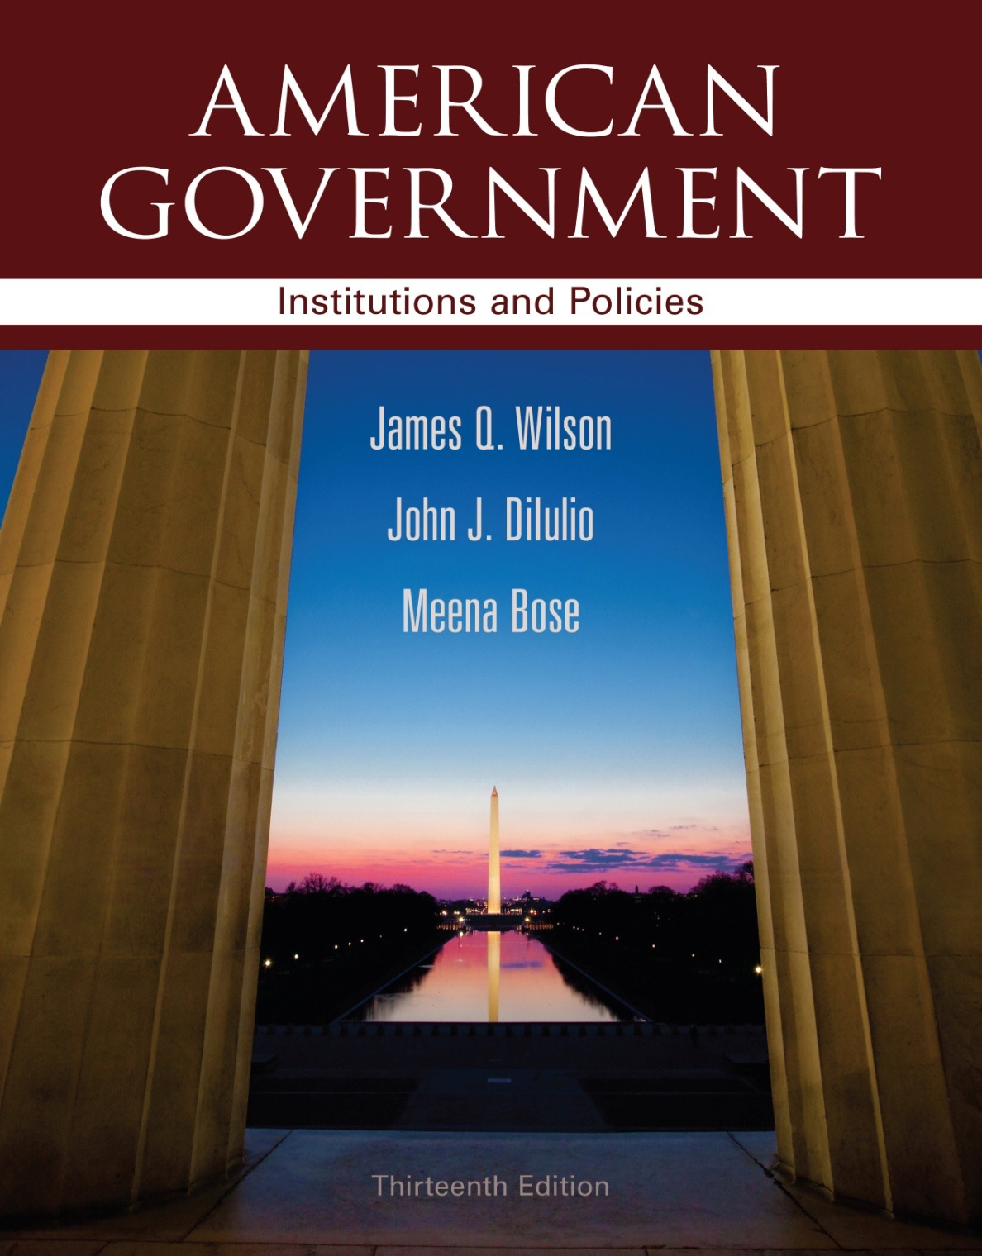
Chapter 10 Elections and Campaigns

