Slide 1
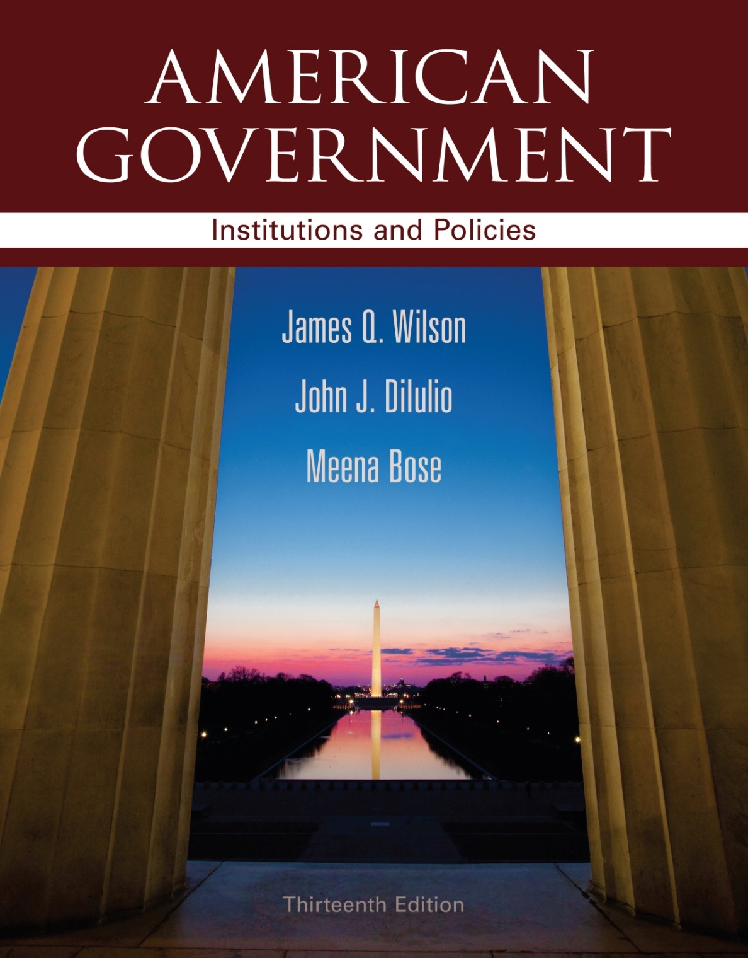
Chapter 7 Public Opinion

Slide 6
Do We Really Know What The Public Thinks?
It is not easy to know what the public thinks.
A few simple, clear-cut and widely discussed issues may allow for some degree of certainty.
But, with many lesser-known issues that certainty may be missing.
Copyright © 2013 Cengage

