Slide 1
Introduction to Drugs and Society Chapter 1

Slide 2
Key Concerns
What constitutes a drug?
What are the most commonly abused drugs?
What are designer drugs?
How widespread is drug use?
What is the extent and frequency of drug use in our society?
What are the current statistics and trends in drug use?

Slide 3
Key Concerns (continued)
What types of drug users exist?
How does the media influence drug use?
What attracts people to drug use?
When does drug use lead to drug dependence?
When does drug addiction occur?
What are the costs of drug addiction to society?
What can be gained by learning about the complexity of drug use and abuse?

Slide 4
Drug Use Causes Three Major Simultaneous Changes in the User
1. The social and psychological rewards from the effects of the
drug “high” results in the illusion of temporary satisfaction and
postponement of social pressures and anxieties leading to a superficial belief that problems and/or concerns are nonproblematic.
2. Pharmacologically, the nonmedical use of most drugs alters body chemistry largely by interfering with (affecting) its proper (homeostatic) functioning. Drugs enhance, slow down, speed-up, or distort the reception and transmission of reality.
3. Using a particular drug may satisfy an inborn or genetically programmed need or desire.

Slide 5
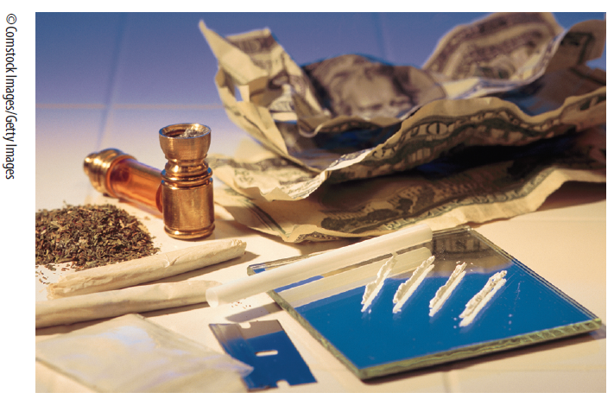
Drug Use
Drug users are found in all occupations and professions, at all income and social class levels, and in all age groups.
No one is immune to drug use, (that often leads to drug dependence). Drug use is an equal-opportunity affliction.

Slide 6
Four Principle Factors That Affect Drug Use
Biological, Genetic, and Pharmacological Factors: Substance abuse and addiction involve biological and genetic
factors. The pharmacology of drug use focuses on how the
ingredients of a particular drug affect the body and the nervous
system, and in turn, a person’s experience with a particular drug.
Cultural Factors: How do societal views, determined by custom
and tradition, affect our initial approach to and use of a drug?
Social Factors: What are the specific reasons why a drug is taken (e.g., curing an illness, self-medicating, escape from reality, peer pressure, family upbringing, membership in drug-abusing subcultures)?
Contextual Factors: How do physical surroundings (music concerts, bars, nightclubs, or fraternity and sorority parties) affect the amount of drug use?

Slide 7
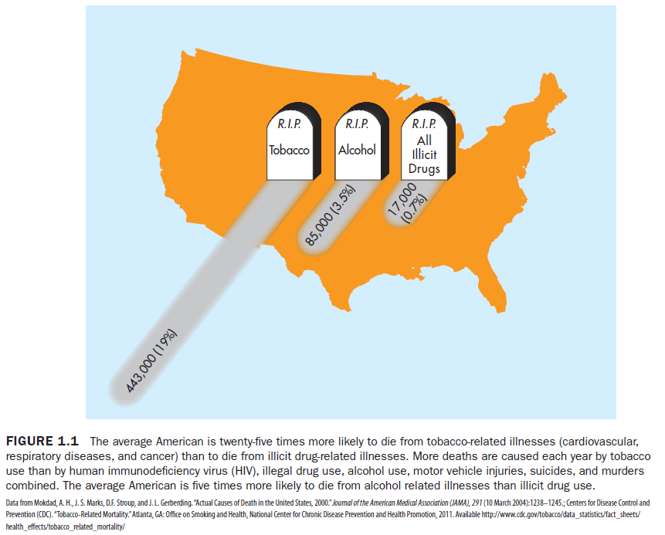

Slide 8
The Dimensions of Drug Abuse
Q: What is a drug?
A: Any substance that modifies (enhances, inhibits, or distorts) mind and/or body functioning.
Q: What are psychoactive drugs?
A: Drug compounds (substances) that affect
the central nervous system and/or alter
consciousness and/or perceptions.

Slide 9
Psychoactive Drugs
Psychoactive drugs are classified as either:
Licit (Legal): Examples may include coffee, tea, alcohol, tobacco, and over-the-counter drugs.
Illicit (Illegal): Examples may include marijuana, cocaine, and LSD.

Slide 10
Major Types of Commonly Abused Drugs
Alcohol (ethanol)
Nicotine (all forms of tobacco)
Prescription drugs (many drugs that are prescribed by a physician)
Stimulants
Major stimulants: amphetamines, cocaine, and crack
Minor stimulants: nicotine, caffeine, tea, and chocolate
Hallucinogens/psychedelics: LSD, mescaline, peyote, and psilocybin (“magic mushrooms”)

Slide 11
Major Types of Commonly Abused Drugs (continued)
Bath salts (a designer drug)
Depressants: barbiturates, benzodiazepines, valium, and alcohol
Cannabis: marijuana and hashish
Anabolic steroids: a synthetic form of the male hormone testosterone
Inhalants/organic solvents: inhalants like gasoline, model glue, paint thinner, certain foods, herbs, and vitamins
Narcotics/opiates: opium, morphine, codeine, and heroin

Slide 12
Designer Drugs/Synthetic Drugs or Synthetic Opioids
Structural analogs are drugs that result from altered chemical structures of current illicit drugs. It involves modifying the basic molecular skeleton of a compound to form a new molecular species.
Designer Drugs /Synthetic Drugs or Synthetic Opioids
New categories of hybrid drugs like Ecstasy and Demerol.
These relatively recent types of drugs are created as structural analogs of substances already classified under the Controlled Substances Act.

Slide 13
Category by Legal Definition
Prescription
Over the Counter (OTC)
Commercial
Recreational
Herbal
Illegal

Slide 14
Gateway Drugs
Gateway drugs are types of commonly used drugs that are believed to lead to the use of other more powerful mind-altering and addictive drugs, such as hallucinogens, cocaine, crack, and heroin.
Alcohol, tobacco, and marijuana are the most commonly used gateway drugs.

Slide 15
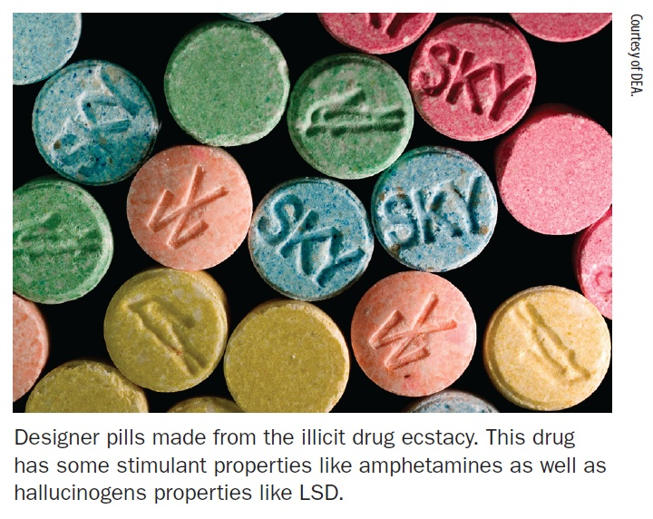
Drug Misuse
Drug misuse is the unintentional or inappropriate use of prescribed or over-the-counter (OTC) types of drugs.

Slide 16
Six Examples of Drug Misuse
Taking more drugs than prescribed
Using OTC or psychoactive drugs in excess without medical supervision
Mixing drugs with alcohol or other types of drugs
Using old medicines to self-treat new symptoms of an illness
Discontinuing prescribed drugs at will and/or against physician’s orders
Administering prescribed drugs to a family member without medical consultation and supervision

Slide 17
Dimensions of Drug Abuse
Drug abuse is also known as chemical or substance abuse and is the willful misuse of either licit or illicit drugs for the purpose of recreation, perceived necessity, or convenience.
Drug abuse refers to a more intense misuse of drugs—often to the point of addiction.
Also known as chemical or substance abuse.

Slide 18
Erich Goode’s Four Types of Drug Use
Legal instrumental use: Taking prescribed drugs or OTC drugs to relieve or treat mental or physical symptoms
Legal recreational use: Using licit drugs like tobacco, alcohol, and caffeine to achieve a certain mental state
Illegal instrumental use: Taking nonprescribed drugs to achieve a task or goal
Illegal recreational use: Taking illicit drugs for fun or pleasure

Slide 19
Drug Use: Statistics and Trends
Social Drugs
$90 billion for alcohol
$51.9 billion for cigarettes
$2 billion for cigars, chewing tobacco, pipe tobacco, roll-your-own tobacco, and snuff
$5.7 billion for coffee, teas, and cocoa
Prescription Drugs
$950 billion worldwide in 2012.
$237.5 billion in the United States

Slide 20
Drug Use: Statistics and Trends (continued)
OTC Drugs
$23.5 billion
Nonmedical Use of Prescription Drugs
In 2008, 51.9 million Americans age 12 or older had used prescription-type drugs nonmedically at least once in their lifetime.
Miscellaneous Drugs
Examples include inhalants, nutmeg, and morning glory seeds
Extent of use cannot be verified

Slide 21
Drug Quiz
Q: How many Americans, age 12 and up, have used alcohol in the past month?
A: 125 million
Q: How many Americans in the past month have smoked tobacco?
A: 61.5 million

Slide 22
Drug Quiz (continued)
Q: How many Americans use or have used marijuana/hashish in their lifetime?
A: 107,842 million (41.9%)
Q: How many drugs can be found in the average household?
A: 50 drugs (40% prescriptions, 60% OTC)

Slide 23
National Household Survey on Drug Abuse, 2011
82.2% (211.7 million) Americans used alcohol during their lifetime
62.8 (161.7 million) Americans used cigarettes
47% (117 million) Americans used any illicit drug(s)
Most commonly used illicit drugs (Lifetime Use):
107.8 million (41.9%) used marijuana/hashish
51.3 million (19.9%) used nonmedical use of any psychotherapeutics, such as pain relievers, tranquilizers, stimulants, or sedatives (does not include OTC drugs)
36.3 million (14.3%) used cocaine
36.3 million (14.4) used hallucinogens
34.2 million (13.3%) used pain relievers

Slide 24
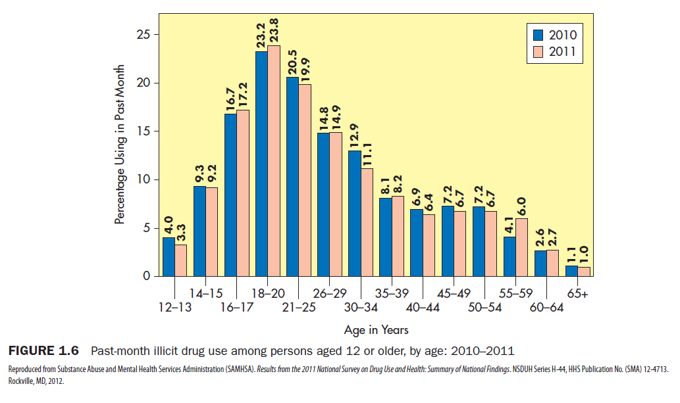

Slide 25
Age Patterns: 18–20 age category report the most illicit drug use Racial and Ethnic Differences: (rates of use, past month, 2002-2011) Two or more races 13.5% American Indian/Alaska Natives 13.4% Black/African American: 10% Whites: 8.7% Hispanic or Latino: 8.4% Asians: 3.8%
Drug Use: Additional Findings

Slide 26
Drug Use: Additional Findings (continued)
Gender
Males were more likely than females among persons age 12 or older to be current illicit drug users (11.1% vs. 6.5%).
The rate of past-month marijuana use for males was about twice as high for males as the rate for females (9.3% vs. 4.9%).
Pregnant Women
Pregnant women are less likely to use drugs than similar age women who are not pregnant.

Slide 27
Education: College graduates (5.4%) had the lowest rate of current illicit drug use, while those who did not complete high school (11.1%) had the highest use of illicit drugs. Past-month alcohol use increased with higher levels of completed education (35.1% with less than high school vs. 68.2% of college graduates .Employment: Unemployed persons (17.2%) have a greater tendency to use more illicit-types of drugs than people gainfully employed (8% full-time and 11.6% part-time workers).
Drug Use: Additional Findings (continued)

Slide 28
Drug Use: Additional Findings (continued)
Geography: The rate of past-month illicit drug use was 9.2% in large metropolitan counties, 8.7% in small metropolitan counties, and 5.7% in nonmetropolitan counties.
Criminal Justice: 33% of state prisoners and 25% of federal prisoners reported that they had committed their offenses while under the influence of drugs. In 2008, an estimated 333,000 prisoners were arrested for drug law violations—20% of state and 52% of federal inmates (Sabol and Cooper 2009).

Slide 29
Three Types of Drug Users
Experimenters: Begin using drugs largely because of peer pressure and curiosity, and they confine their use to recreational settings
Compulsive users: Devote considerable time and energy into getting high, talk incessantly (sometimes exclusively) about drug use, and become connoisseurs of street drugs
Floaters or “chippers”: Focus more on using other people’s drugs without maintaining as much of a personal supply

Slide 30
Media Influence on Drug Use
Each year, the alcohol industry spends more than $1 billion on advertising (television, radio, print, and outdoor ads) (FTC 2007).
Drug companies spent $1.6 billion a year on televised commercials for Viagra, Claritin, Allegra, and other drugs.
The advertising budget for Budweiser beer exceeds the entire budget for research on alcoholism and alcohol abusers.
Alcohol companies spent $4.9 billion on television advertising between 2001 and 2005.
Teens viewing photos of inebriated friends posted on social media, such as MySpace for example, are four times more likely to have used marijuana and three times more likely to have used alcohol and tobacco.

Slide 31
Why Are People Attracted to Drugs?
People use drugs as a means to temporarily:
Experience pleasure or heighten good feelings
Relieve stress, tension, or anxiety
Forget one’s problems and avoid or postpone worries
Relax after a tension-filled day of work
Fit in with peers or as a rite of passage
Enhance religious or mystical experiences
Relieve pain and some symptoms of illness

Slide 32
When Does Use Lead to Abuse?
The amount of drug taken does not necessarily determine abuse.
The motive for taking the drug is the most important factor in determining presence of abuse.
Initial drug abuse symptoms include:
Excessive use
Constant preoccupation about the availability and supply of the drug
Refusal to admit excessive use
Reliance on the drug

Slide 33
Drug Dependence
Both physical and psychological factors precipitate
drug dependence:
Physical dependence refers to the need to continue taking the drug to avoid withdrawal symptoms, which often include feelings of discomfort and illness.
Psychological dependence refers to the need that a user may mentally feel about continuing the use of a drug to experience its effects and/or relieve withdrawal symptoms.

Slide 34
Stages of Drug Dependence
Relief: Satisfaction from negative feelings in using the drug
Increased Use: Involves taking greater quantities of the drug
Preoccupation: Consists of a constant concern with the substance
Dependency: A synonym for addiction, is when more of the drug is sought despite the presence of physical symptoms
Withdrawal: The physical and/or psychological effects from not using the drug

Slide 35
Costs of Drug Use to Society
Illnesses
Shortened lifespans
Marital and family strife
Fetal alcohol syndrome
Criminalistic behavior
Drugs in the workplace/disruption of careers and professions
Cost of assistance programs (e.g., Employee Assistance Programs [EAPs])

Slide 36
Costs of Drug Use to Society: Statistics
The National Institute on Drug Abuse (NIDA) estimates that the typical narcotic habit costs $100/day.
A heroin addict must steal three to five times the actual cost of the drugs to maintain a habit—about $100,000 per year.
Three out of four prostitutes in major cities have a serious drug dependency.

Slide 37
Drugs, Crime, and Violence
Regarding the connection between drug use and crime, the following findings can be summarized:
Drug users in comparison to non-drug users are more likely to commit crimes.
A high percentage of arrestees are often under the influence of a drug while committing crimes.
A high percentage of drug users arrested for drug use and violence are more likely to be under the influence of alcohol and/or stimulant-types of drugs such as cocaine, crack, and methamphetamines.

Slide 38
Drugs in the Workplace
In the U.S., alcohol and drug use and their related problems costs employers and tax payers billions of dollars per year.
The National Household surveys found significant drug use in the workplace with 64.3% of full-time workers reported alcohol use (7% to 9% drinking while working) and 6.4% reported marijuana use within the past month (SAMHSA 2012).

Slide 39
Drugs in the Workplace (continued)
Among the 19 major industry categories, the highest rates of past month illicit drug use among full-time workers aged 18 to 64 were found in accommodations and food services (16.9%), construction (13.7%), and arts, entertainment, and recreation (11.6%); (see Figure 1.10).
The industry categories with the lowest rates of past month illicit drug use were utilities (3.8%), educational services (4%), and public administration (4.1%).

Slide 40
Drug Testing
Used to identify those who may be using drugs
Urine, blood screening, or hair analysis
Duration of Detection /“Cut-Offs” for Urine Analysis:
Amphetamines: 24–72 hours
Cocaine/metabolite: 24–72 hours
Opiates: 24–72 hours
PCP: 24–96 hours
THC/metabolite: 24 hours–3 weeks (depends on frequency of use)
Note: Hair analysis 1 to 3 months for all drugs listed above

Slide 41
Drug Testing (continued)
Approximately 70% of large companies,50% of medium companies, and 22% of small companies drug test.
Over 90% use urine analysis, less than 20% use blood analysis, and less than 3% use hair analysis.
Most drug-using youth do not cease drug use when they begin working.

Slide 42
Holistic Self-Awareness Approach
Holistic philosophy that advocates that the mind, body, and spirit work best when they are drug-free.

