Slide 1

8D Corrective Action & Root Cause Analysis
Notes:
Tips:
Title on this slide should be kept short.
Transparency bar should be set on own. Please copy and paste the one in this slide to re-create.
Headlines should be set with an initial cap (sentence case) and the rest in lower case. Only product names or acronyms in the headline should begin with a capital letter.

Slide 2
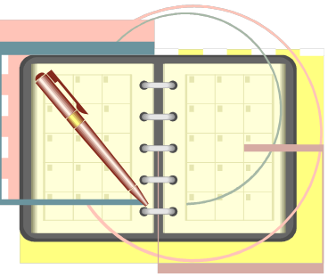
Agenda
Overview of 8D
Definitions
Review of 8D steps
Review of examples of 5-Why
Questions
Notes:
To insert a new slide with this template, go to the Home tab (up top), click New Slide and select the one that says Impactful Slide.
Tips:
We recommend that the text is white or yellow (or another light color from the palette on slide 12)
The background should always be Eaton Blue (R=0, G=103, B=198)
See slide #12 for PowerPoint color palette and definition of RGB.
Arial font at 44 pt. size or bigger
Please avoid using this slide style too often in your presentation. It is meant to help get strong messages across and/or to help separate sections within your presentation.

Slide 3

Steps in an 8D
The steps in 8D:
  D#1 Establish the team
  D#2 Define the problem
  D#3 Take Short Term Action (Containment)
  D#4 Determine Root Cause
  D#5 Develop/Verify Corrective Action
  D#6 Implement/Validate Corrective Action
  D#7 Prevent Recurrence/Share the Solution
  D#8 Recognize the Team
Day 1
24 – 48hrs
2 weeks
30 days
Notes:
To insert a new slide with this template, go to the Home tab (up top), click New Slide and select the one that says Title and Content.
Tips:
Headlines should be set with an initial cap (sentence case) and the rest in lower case. Only product names or acronyms in the headline should begin with a capital letter.
Don’t load too much text onto slides. People are more interested in seeing visuals than reading what you are presenting on. We recommend that you keep your talking points in this notes section for all slides, or on a separate Word document that can be passed out after the presentation.

Slide 4
Vocabulary
Containment – Actions taken to isolate the problem from any internal/external customer. Usually expected to be completed within a 24hr – 48 hour period.
Corrective Action – The action taken to eliminate the cause of the nonconformity.
Error proofing – When a process is designed to prevent an error from occurring.
Preventive Action – The action that is taken to eliminate conditions that could produce a nonconformity.
Root Cause – At its simplest form, you can turn off and on the problem in a controlled environment. The root cause should explain 100% of the unwanted problem/defect and that there are no additional reasons that the problem exists.
Notes:
To insert a new slide with this template, go to the Home tab (up top), click New Slide and select the one that says Title and Content.
Tips:
Headlines should be set with an initial cap (sentence case) and the rest in lower case. Only product names or acronyms in the headline should begin with a capital letter.
Don’t load too much text onto slides. People are more interested in seeing visuals than reading what you are presenting on. We recommend that you keep your talking points in this notes section for all slides, or on a separate Word document that can be passed out after the presentation.

Slide 5

8D – Eight Disciplines to Problem Solving
8D, which was initiated in the automotive industry, is a structured problem solving method for product and process improvement.
8D is short for “8 Disciplines”
The steps do not all start with “D”
8D is structured in 8 steps and emphasizes
Team problem solving (closure within 30 days)
Ford’s Motor Company’s Team Oriented Problem Solving (TOPS) systems was the precursor to 8D
Team work and not skipping steps is critical!!!
Notes:
To insert a new slide with this template, go to the Home tab (up top), click New Slide and select the one that says Title and Content.
Tips:
Headlines should be set with an initial cap (sentence case) and the rest in lower case. Only product names or acronyms in the headline should begin with a capital letter.
Don’t load too much text onto slides. People are more interested in seeing visuals than reading what you are presenting on. We recommend that you keep your talking points in this notes section for all slides, or on a separate Word document that can be passed out after the presentation.

Slide 6
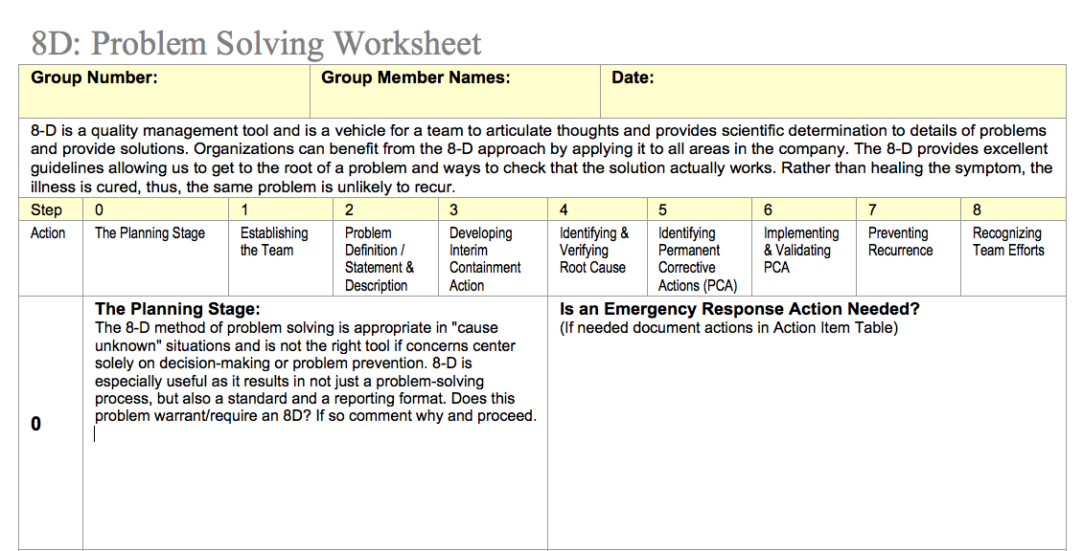
8D-Problem Solving Worksheet
Download from Module 7

Slide 7
Steps in an 8D
The steps in 8D:
  D#1 Establish the team
  D#2 Define the problem
  D#3 Take Short Term Action (Containment)
  D#4 Determine Root Cause
  D#5 Develop/Verify Corrective Action
  D#6 Implement/Validate Corrective Action
  D#7 Prevent Recurrence/Share the Solution
  D#8 Recognize the Team
Day 1
24 – 48hrs
2 weeks
30 days
Notes:
To insert a new slide with this template, go to the Home tab (up top), click New Slide and select the one that says Title and Content.
Tips:
Headlines should be set with an initial cap (sentence case) and the rest in lower case. Only product names or acronyms in the headline should begin with a capital letter.
Don’t load too much text onto slides. People are more interested in seeing visuals than reading what you are presenting on. We recommend that you keep your talking points in this notes section for all slides, or on a separate Word document that can be passed out after the presentation.

Slide 8
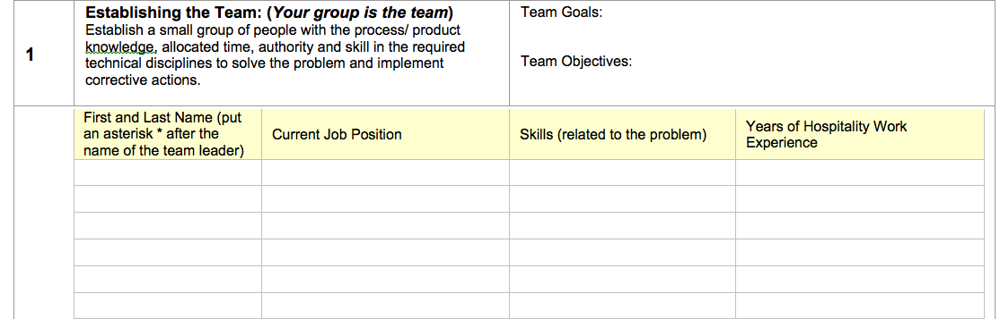
D1 Establish The Team
It is critical to have the right people on the team

Slide 9
8D – Establish Team (D#1)
Typically the Manager act as leader or will assign a person responsible to lead the corrective action. That Team Leader will then select the team members.
The Team should include all functions with knowledge of the problem (including “process owner”).
Team Leader should train team members as needed, but leading the team through the process is the best form of training.

Slide 10

D1 Checklist
D1: Establish the Team
  Checklist :
    Are the people affected by the problem represented?
    Does each individual have a reason for being on the team?
    Is the team large enough to include all necessary input, but small enough to act effectively?
    Is the team cross-functional?
    Who is team leader?
    Are all team members responsibility’s clear?

Slide 11
Steps in an 8D
The steps in 8D:
  D#1 Establish the team
  D#2 Define the problem
  D#3 Take Short Term Action (Containment)
  D#4 Determine Root Cause
  D#5 Develop/Verify Corrective Action
  D#6 Implement/Validate Corrective Action
  D#7 Prevent Recurrence/Share the Solution
  D#8 Recognize the Team
Day 1
24 – 48hrs
2 weeks
30 days
Notes:
To insert a new slide with this template, go to the Home tab (up top), click New Slide and select the one that says Title and Content.
Tips:
Headlines should be set with an initial cap (sentence case) and the rest in lower case. Only product names or acronyms in the headline should begin with a capital letter.
Don’t load too much text onto slides. People are more interested in seeing visuals than reading what you are presenting on. We recommend that you keep your talking points in this notes section for all slides, or on a separate Word document that can be passed out after the presentation.

Slide 12
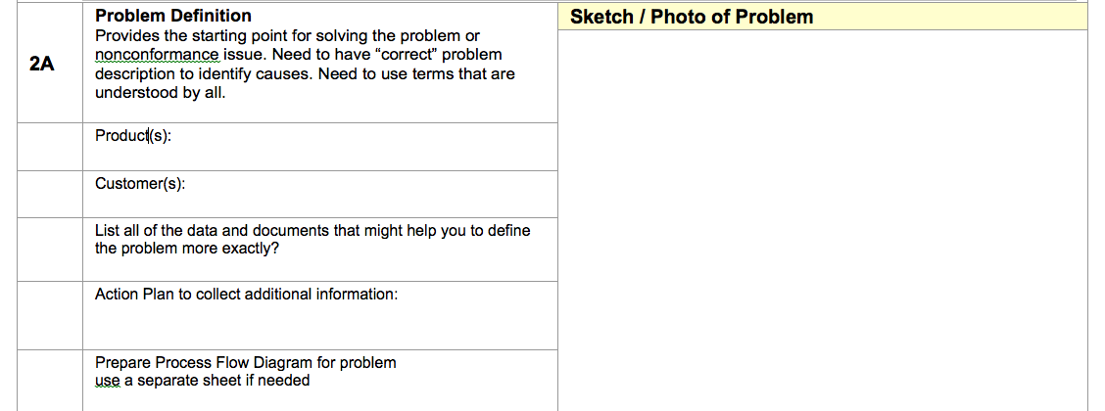
D2 Define the Problem
Use pictures when they are available

Slide 13
8D – Define Problem
Problem Definition is a positive statement
that describes the “pain”
Good Definition is critical to determining Root Cause
Answers 4W2H – Who, What, When, Where, How, How Many
“Why” is not part of Problem Definition (this is answered in Root Cause Analysis - RCA)
Good Definition does not place blame
Avoids suggesting solutions (“Problem happened due to…”, or “Lack of adhesive resulted in…”)
Define what is or what is not

Slide 14
8D – Problem Definition
Take the time to clearly define the problem, with facts.
Good Problem Definition is the springboard to asking the right questions on RCA (Why, Why, Why,…)
Poor Problem Definition leads to symptom resolution rather than Root Cause Solution
“Is/Is Not” is a good method for Clear and Concise Problem Definitions.
If “lack of”, “insufficient”, “due to”… are in your Problem Definition…your team is in trouble!

Slide 15
8D – Problem Definitions: Good or Bad?
“Lack of culinary efficiency caused a 10% miss in top box customer satisfaction in May.”
  Bad – Assumes cause of problem
“Food ticket times delays caused “server attentiveness” and “pace of meal” scores to be 5% below goal.”
  Bad – Places blame and assumes cause
“Service audits revealed significant gaps (3-10 minutes on average) in service delivery intervals increasing customer wait times and decreasing throughput by 20% on Friday, Saturday, and Sunday during times of peak demand”
Good – Answers 4W2H
Research it first, only record the facts!

Slide 16
D2 Checklist
D2: Describe the problem
  Checklist:
    What type of problem is it?
    Can we list any resources and documents which might better quantify this problem?
    Is there any evidence this problem has surfaced before?
    What is the extent of the problem
    Has the problem been increasing, decreasing or remaining constant?
    Do we have physical evidence of the problem in hand?
    Have failed execution been analyzed in detail?
    Is there an action plan to collect additional data if needed?
    Do we have the right team members to proceed to the next step?

Slide 17

Steps in an 8D
The steps in 8D:
  D#1 Establish the team
  D#2 Define the problem
  D#3 Take Short Term Action (Containment)
  D#4 Determine Root Cause
  D#5 Develop/Verify Corrective Action
  D#6 Implement/Validate Corrective Action
  D#7 Prevent Recurrence/Share the Solution
  D#8 Recognize the Team
Day 1
24 – 48hrs
2 weeks
30 days
Notes:
To insert a new slide with this template, go to the Home tab (up top), click New Slide and select the one that says Title and Content.
Tips:
Headlines should be set with an initial cap (sentence case) and the rest in lower case. Only product names or acronyms in the headline should begin with a capital letter.
Don’t load too much text onto slides. People are more interested in seeing visuals than reading what you are presenting on. We recommend that you keep your talking points in this notes section for all slides, or on a separate Word document that can be passed out after the presentation.

Slide 18

8D – Contain Problem (D#3)
Containing the problem and Protecting the Customer must occur immediately. 24hrs is the industry norm for containment actions to take place. Max of 48.
Determine the scope (time period, material lot numbers, products affected, etc.)
Production and/or Shipping Hold to be implemented
8D system is used to report/track Holds and Containments
“Iron Wall” is a form of Containment (Prevent problems from effecting to Customers)

Slide 19
Definition - Containment
Containment is the systematic search and quarantine of suspected nonconforming product throughout the supply/delivery chain. (Warehouse, in process shelves, supplier stock, …) Make sure you get it all.
In our Containment step we also include a process to determine if it’s necessary to notify customers in the form of a recall, advisory or other communication.
Did you get all of them?

Slide 20
D3 Checklist
Developing Interim Containment Actions (within 24 - 48 hours)
Temporary actions to contain the problem and “fix” until permanent correction is in place - document actions in Action Item Table
What containment actions have been identified? (Product in stock, Product in transit, Product at the supplier location, Product in process at the prep work station)
Have all quantities been accounted for and quarantined until disposition can be made? (BE CAREFUL that they do not end up back in stock)
Have we ensured that implementation of the containment action will not create other problems? i.e. product shortages.
Will interim actions last long enough until the Corrective Actions are in place?
Are responsibilities for containment actions clear?
When will the containment actions be complete?
Have the containment actions been documented?
Do we have the right team members to proceed to the next step?

Slide 21


Steps in an 8D
The steps in 8D:
  D#1 Establish the team
  D#2 Define the problem
  D#3 Take Short Term Action (Containment)
  D#4 Determine Root Cause
  D#5 Develop/Verify Corrective Action
  D#6 Implement/Validate Corrective Action
  D#7 Prevent Recurrence/Share the Solution
  D#8 Recognize the Team
Day 1
24 – 48hrs
2 weeks
30 days
Notes:
To insert a new slide with this template, go to the Home tab (up top), click New Slide and select the one that says Title and Content.
Tips:
Headlines should be set with an initial cap (sentence case) and the rest in lower case. Only product names or acronyms in the headline should begin with a capital letter.
Don’t load too much text onto slides. People are more interested in seeing visuals than reading what you are presenting on. We recommend that you keep your talking points in this notes section for all slides, or on a separate Word document that can be passed out after the presentation.

Slide 22

8D – Root Cause Analysis (D#4)
RCA is the Heart and Soul of the Corrective Action process
There may be multiple contributing causes but there is only one
True Root Cause
Actions should be taken to address the contributing causes if appropriate…
But; The Root Cause must be eliminated
or…
the problem will return!

Slide 23

Definition – Root Cause (RC)
The Root Cause is the most basic reason for a problem or defect. If this cause is eliminated, the problem would not occur.
If the cause of a problem is “operator error”, that’s not the real Root Cause. The Root Cause is more likely that the process is not “Error Proofed”.
Corrective Actions must address the Root Cause if the problem is to be eliminated.
You will know it is the Root Cause if you can turn the problem off and on

Slide 24

Root Cause
Immediate causes are NOT root causes. Typical immediate causes you may see on Corrective Action reports are:
  Operator Error
  Failure to Follow Procedures/work instructions
  Inspection not recorded by the operator
  Gage Not turned in for calibration
  Operator not trained
  Inadvertent omission
These are NOT root causes, they may be a contributing cause but not the true root cause!

Slide 25
Root Cause
Root causes are weaknesses (ineffective processes or controls) in the system that cause or allow (fail to prevent) errors and nonconformance's.
Effective corrective action will PREVENT recurrence or REDUCE THE FREQUENCY of occurrence.

Slide 26
5 Why’s
If you continue to ask Why? you will discover the systemic problem, rather than being satisfied with fixing a symptom. Symptoms that come from contributing causes

Slide 27



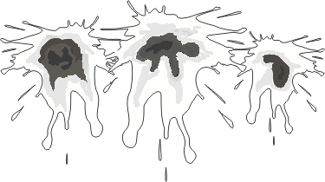
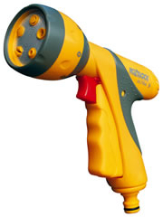
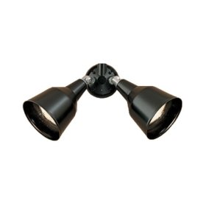
The 5 Whys
The stone on the Jefferson Memorial was crumbling
Why #1: Why was it crumbling?
Frequent washings were weakening the stone.
Why #2: Why was it washed so often?
To remove the bird droppings.
Why #3: Why are there so many bird droppings?
Birds were eating the abundant spiders there.
Why #4: Why were there so many spiders?
Spiders were attracted to all the midges.
Why #5: So why were there so many midges?
Every evening at dusk, midges emerge in a mating frenzy. At this same time, Park Services turns on its spotlights, which attracted all of the midges.
Solution: Delay turning on the spot lights until one hour after sunset, by which time midge population is down 90%. By doing this, the food chain is broken and less frequent washings are required.

Slide 28
5 Why Summary
What if the team does not identify the Root Cause?
  Possibly the problem was not defined well.
  Possibly working on symptoms instead of the real problem (problem definition!)
  Possibly some of the “facts” are not true – confirm with data.
  Possibly the team doesn’t include the right people to fully understand the problem.
  Possibly skipped a step or two, missing critical information – better to take “baby steps”.

Slide 29
How to get to the 5 Why if your not sure you have only one
Gather your team, identify the possible causes, select Top 3

Slide 30
How to get to the 5 Why if your not sure you have only one
Gather your team, identify the possible causes, select Top 3

Slide 31
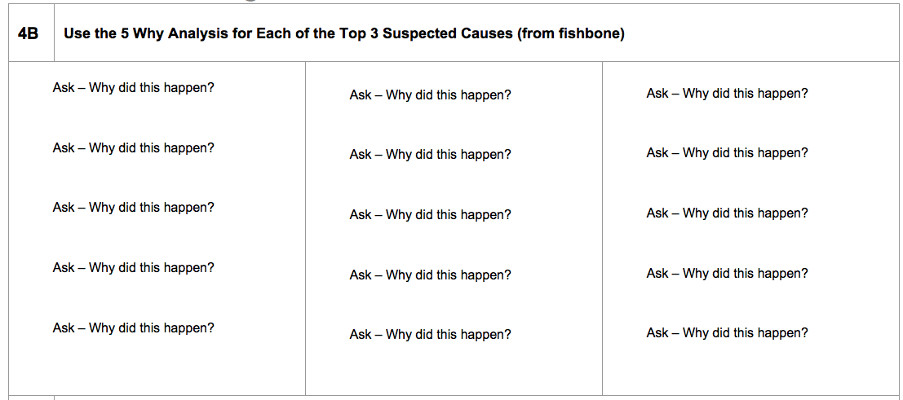
Now break out the 5 Why
Use one 5 Why worksheet for each of the top 3 suspect causes

Slide 32

5 Why Review(not necessary for group assignment)
Each response needs to be confirmed with data:
  Run experiments to confirm that the team’s response to each “why” is accurate.
  Don’t allow a dominant team member to state a “fact” without confirming it.
Read the “why responses” from the bottom to the top of the problem statement linking them with “therefore”.
  All responses should link logically backwards with the word “therefore”.

Slide 33
D4 Checklist
D4- Define/Verify Root Cause
  Checklist:
    What sources/methods have been used to determine root cause?
    Are all the potential caused listed in case at a future date you need to refer back to them.
    Can the root cause explain all we know about the problem description?
    Can the root cause be turned off and on?
    Do we have the right team members to proceed to the next step?

Slide 34
Steps in an 8D
The steps in 8D:
  D#1 Establish the team
  D#2 Define the problem
  D#3 Take Short Term Action (Containment)
  D#4 Determine Root Cause
  D#5 Develop/Verify Corrective Action
  D#6 Implement/Validate Corrective Action
  D#7 Prevent Recurrence/Share the Solution
  D#8 Recognize the Team
Day 1
24 – 48hrs
2 weeks
30 days
Notes:
To insert a new slide with this template, go to the Home tab (up top), click New Slide and select the one that says Title and Content.
Tips:
Headlines should be set with an initial cap (sentence case) and the rest in lower case. Only product names or acronyms in the headline should begin with a capital letter.
Don’t load too much text onto slides. People are more interested in seeing visuals than reading what you are presenting on. We recommend that you keep your talking points in this notes section for all slides, or on a separate Word document that can be passed out after the presentation.

Slide 35
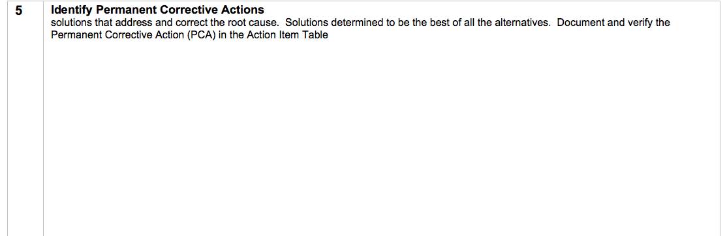


D5 Develop /Verify the Corrective Action
List specific action with specific owners and specific dates!

Slide 36


8D – Corrective Action (D#5)
Once the Root Cause is found it’s usually clear what the Corrective Action needs to be.
The Corrective Action must address the Root Cause!!!
There may be multiple Corrective Actions and some actions may address Contributing Causes – this will make your solution more robust in case other factors change in the future.
Corrective Action for the problem itself (Occurrence) plus the “Detection” issues need to be implemented to address the full dimension of the issue.
Closing contributing actions is a good thing!

Slide 37
Error Proofing
Error Proofing comes from a Japanese term “Poka Yoke”.
True Corrective Actions result in “Error Proofing ” in the Process or Design to prevent similar problems.
“Error Proofing” the process will accomplish both Corrective Action for the problem “Occurrence” and Corrective Action for “Detection”.

Slide 38
D5 Checklist
D5 Select and Verify the Corrective Action
  Checklist:
    Can the action be implemented?
    What risks are associated with this choice and how should they be managed?
    Will this create other problems?
    What methods will be used to verify the effectiveness in the short and long term?
    Have dates been set to verify the effectiveness?
    Has responsibility been assigned to verify the short and long term effectiveness?
    What do you plan to do if this action does not satisfactorily solve this problem?
    Do we have the right team members to proceed to the next step?

Slide 39
Steps in an 8D
The steps in 8D:
  D#1 Establish the team
  D#2 Define the problem
  D#3 Take Short Term Action (Containment)
  D#4 Determine Root Cause
  D#5 Develop/Verify Corrective Action
  D#6 Implement/Validate Corrective Action
  D#7 Prevent Recurrence/Share the Solution
  D#8 Recognize the Team
Day 1
24 – 48hrs
2 weeks
30 days
Notes:
To insert a new slide with this template, go to the Home tab (up top), click New Slide and select the one that says Title and Content.
Tips:
Headlines should be set with an initial cap (sentence case) and the rest in lower case. Only product names or acronyms in the headline should begin with a capital letter.
Don’t load too much text onto slides. People are more interested in seeing visuals than reading what you are presenting on. We recommend that you keep your talking points in this notes section for all slides, or on a separate Word document that can be passed out after the presentation.

Slide 40
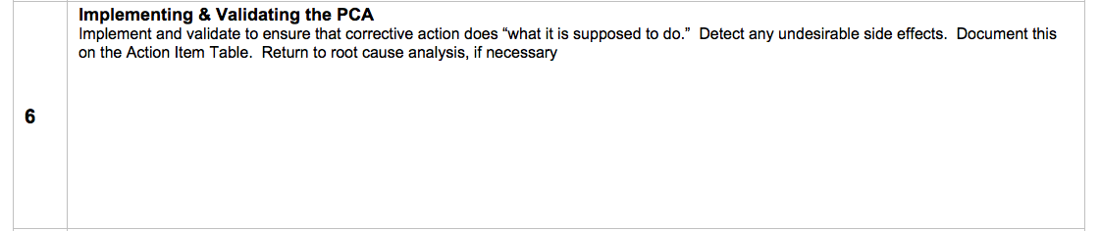
D6 Implement /Validate the Corrective Action

Slide 41

8D – Corrective Action Verification
It’s necessary that we “maintain the gain”
The Corrective Action has to address the Root Cause, so it’s important that a follow up audit verifies that the Root Cause was eliminated!
Someone with a vested interest who was not part of the Corrective Action team is chosen by the Quality Manager to follow up.
In some cases verification should be done soon after implementation and again after several weeks to verify that the change really is permanent.
Make sure it’s working long term, not just once!

Slide 42
D6 Checklist
D6 Implement/Validate the Corrective Action
  Checklist:
    Has an action plan been defined?
    Have responsibilities been assigned to implement the Corrective Action
    Has timing been established?
    Has required support been identified?
    What indicators will be used to verify the outcome?
    What controls are in place to assure the fix is as intended?
    Do we have the right team members to proceed to the next step?

Slide 43
Steps in an 8D
The steps in 8D:
  D#1 Establish the team
  D#2 Define the problem
  D#3 Take Short Term Action (Containment)
  D#4 Determine Root Cause
  D#5 Develop/Verify Corrective Action
  D#6 Implement/Validate Corrective Action
  D#7 Prevent Recurrence/Share the Solution
  D#8 Recognize the Team
Day 1
24 – 48hrs
2 weeks
30 days
Notes:
To insert a new slide with this template, go to the Home tab (up top), click New Slide and select the one that says Title and Content.
Tips:
Headlines should be set with an initial cap (sentence case) and the rest in lower case. Only product names or acronyms in the headline should begin with a capital letter.
Don’t load too much text onto slides. People are more interested in seeing visuals than reading what you are presenting on. We recommend that you keep your talking points in this notes section for all slides, or on a separate Word document that can be passed out after the presentation.

Slide 44
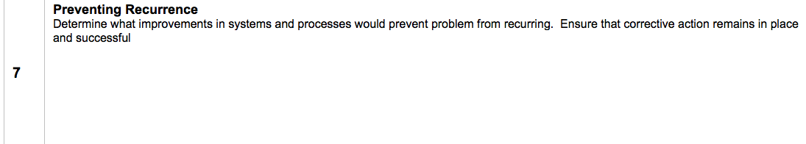
D7 Prevent recurrence/Share the Solution

Slide 45
8D – Prevent Recurrence & Share the Solution (D#7)
Addressing the Systemic issues is key to Preventing Recurrence (usually the 5th Why reveals the systemic problem) Follow up. i.e. did the implementation of the corrective action require any changes to other documents such as work instructions or control plans? Is the corrective action sustaining?
We need to share these best practice solutions, so others can learn from our work.
Our 8D includes a “systemic action” section as part of the CA close out process – this is a part of the “Solution Sharing” and “Prevention” process.
We need to continue developing means to share best practices
Others can learn from our work, share the information!

Slide 46
D7 Checklist
D7 Prevent reoccurrence/Share the solution
  Checklist:
    Has the practice been standardized?
    Have all appropriate personnel been notified of the changes?
    Have all changes been integrated to our existing system (work instructions, procedures, etc.)?
    How will the practices be shared?

Slide 47
Steps in an 8D
The steps in 8D:
  D#1 Establish the team
  D#2 Define the problem
  D#3 Take Short Term Action (Containment)
  D#4 Determine Root Cause
  D#5 Develop/Verify Corrective Action
  D#6 Implement/Validate Corrective Action
  D#7 Prevent Recurrence/Share the Solution
  D#8 Recognize the Team
Day 1
24 – 48hrs
2 weeks
30 days
Notes:
To insert a new slide with this template, go to the Home tab (up top), click New Slide and select the one that says Title and Content.
Tips:
Headlines should be set with an initial cap (sentence case) and the rest in lower case. Only product names or acronyms in the headline should begin with a capital letter.
Don’t load too much text onto slides. People are more interested in seeing visuals than reading what you are presenting on. We recommend that you keep your talking points in this notes section for all slides, or on a separate Word document that can be passed out after the presentation.

Slide 48

8D Recognize the Team
Remember to close out the paperwork!

Slide 49

8D – Recognize the Team (D#8)
Permanently eliminating problems is extremely satisfying in itself
CA Team members are providing a very important service to us all, so everyone should recognize the efforts of the people participating in Corrective Actions
The Person Responsible for Closure Approval thanks and congratulates the members of the Team
Your team has done a lot of hard work, recognize this! E-Star!

Slide 50

Summary of 8D
8D in the automotive industry has been very effective in driving improvements
Our 8D format can be utilized for Corrective Actions in the Hospitality Industry:
  Quick Containment – Within 48 hours!
  True Root Cause determination
    Use Effective Tools
    Utilized the 5 Why
    Address both Detection and Occurrence
  Implement Systemic Corrective Actions to drive improvements!

Slide 51
8D Checklist
D8 Recognize the Team
  Checklist:
    Have we recorded the teams work appropriately so that others facing similar problems in the future may refer to them?
    What unfinished Business remains?
    Have individual team members been informed that it is now complete?

Slide 52

Summary
We’ve covered:
  All steps of 8D
  Detailed discussion of RCA
  Training in 5 Why Analysis
The 8D Corrective Action process is necessary for continual improvement – immediate need is to drive reduction in Customer Complaints!
Everyone needs to use these tools – 8D needs to become part of our culture.
8D needs to become part of our culture, ingrained into our DNA!

Slide 53
Questions

