Slide 2
Learning Objectives
Explain how foreign currency futures are quoted, valued, and used for speculation purposes
Illustrate how foreign currency futures differ from forward contracts
Analyze how foreign currency options are quoted, valued, and used for speculation purposes
Explain how foreign currency options are valued
Define interest rate risk, and examine how can it be managed

Slide 3
Learning Objectives cont.
Explain interest rate swaps and how they can be used to manage interest rate risk
Analyze how interest rate swaps and cross currency swaps can be used to manage both foreign exchange risk and interest rate risk simultaneously

Slide 4
Foreign Currency Derivatives and Swaps
Financial management in the 21st century needs to consider the use of financial derivatives
These derivatives, so named because their values are derived from the underlying asset, are a powerful tool used for two distinct management objectives:
  Speculation
  Hedging

Slide 5
Foreign Currency Derivatives and Swaps
The financial manager must first understand the basics of the structure and pricing of these tools
A word of caution – financial derivatives are powerful tools in the hands of careful and competent financial managers. They can also be very destructive devices when used recklessly.

Slide 6
Foreign Currency Futures
A foreign currency futures contract is an alternative to a forward contract
  It calls for future delivery of a standard amount of currency at a fixed time and price
  These contracts are traded on exchanges with the largest being the International Monetary Market located in the Chicago Mercantile Exchange

Slide 7
Foreign Currency Futures
0
Contract specifications are established by the exchange on which futures are traded.
Major features that are standardized are:
  Contract size
  Method of stating exchange rates
  Maturity date
  Last trading day
  Collateral and maintenance margins
  Settlement
  Commissions
  Use of a clearinghouse as a counterparty

Slide 8
Foreign Currency Futures
Any investor wishing to speculate on the movement of a currency can pursue one of the following strategies
  Short position – selling a futures contract based on view that currency will fall in value
  Long position – purchase a futures contract based on view that currency will rise in value

Slide 9
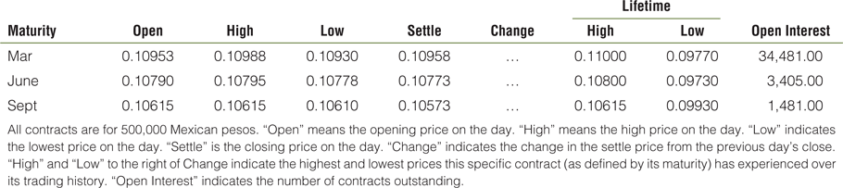
Exhibit 7.1 Mexican Peso (CME)--MXN 500,000; $ per 10MXN

Slide 10
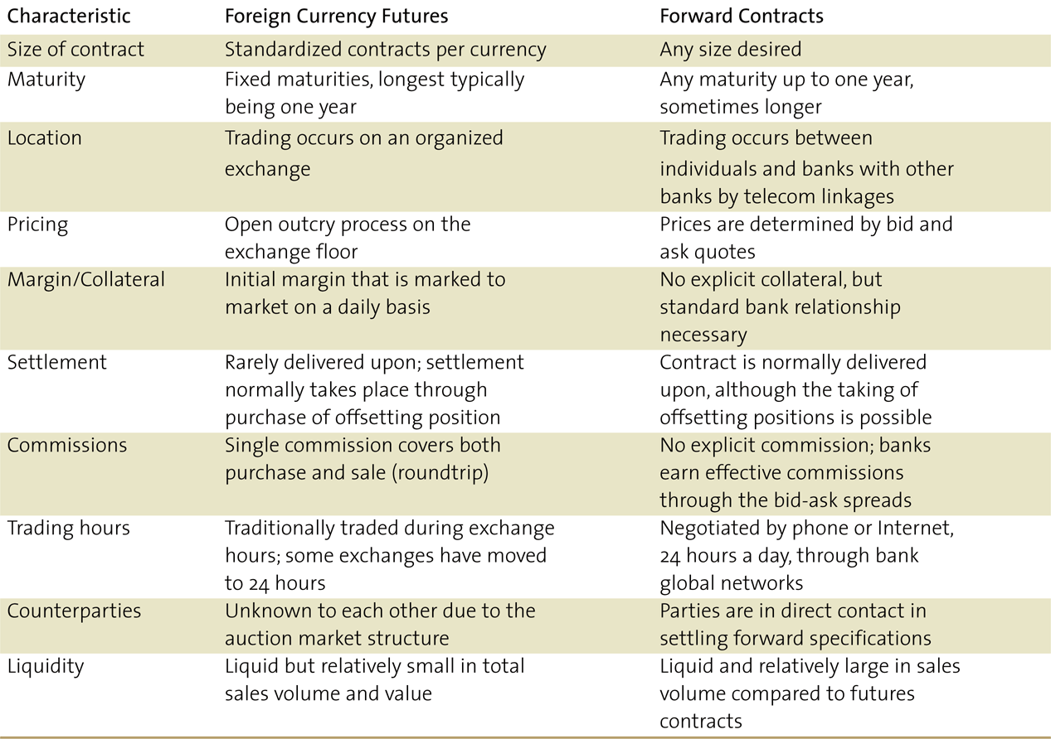
Foreign Currency Futures vs. Forwards Contracts

Slide 11
Currency Options
A foreign currency option is a contract giving the purchaser of the option the right to buy or sell a given amount of currency at a fixed price per unit for a specified time period
  Call – buyer has right to purchase currency
  Put – buyer has right to sell currency

Slide 12
Currency Options
0
The buyer is termed the holder, while the seller of the option is referred to as the writer or grantor.
Every option has three different price elements:
  The exercise or strike price
  The premium
  The underlying or actual spot exchange rate in the market

Slide 13
Currency Options
0
An American option gives the buyer the right to exercise the option at any time between the date of writing and the expiration or maturity date.
A European option can be exercised only on its expiration date, not before.

Slide 14
Currency Options
Options may also be classified as per their payouts
  At-the-money (ATM) options have an exercise price equal to the spot rate of the underlying currency
  In-the-money (ITM) options may be profitable, excluding premium costs , if exercised immediately
  Out-of-the-money (OTM) options would not be profitable, excluding the premium costs, if exercised

Slide 15
Foreign Currency Options Markets
0
The use of foreign currency options as a hedging tool and for speculative purposes has blossomed into a major foreign exchange activity
Options on the over-the-counter (OTC) market can be tailored to specific needs but have counterparty risk
Options on organized exchanges are standardized, but counterparty risk is substantially reduced

Slide 16
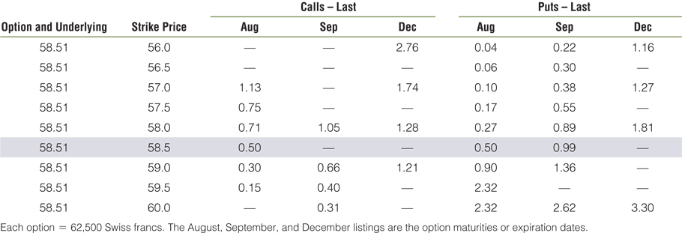
Exhibit 7.2 Swiss Franc Option Quotations (U.S. Cents/SF)

Slide 17
Buyer of a Call Option
Buyer of a call: (see Exhibit 7.3)
  Only exercises his/her right if the option is profitable
  As the spot price of the underlying currency moves up, the holder has the possibility of unlimited profit
  On the down side, the holder can abandon the option and walk away with a loss never greater than the premium paid

Slide 18
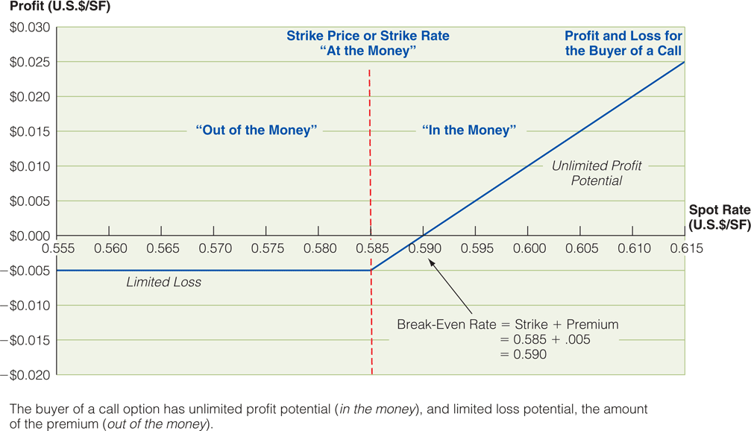
Exhibit 7.3 Profit and Loss for the Buyer of a Call Option

Slide 19
Writer of a Call
0
Writer of a call: (see Exhibit 7.4)
  Zero-sum game: what the holder loses, the writer gains
  The maximum profit is the premium
  Loss is unlimited and increases as the underlying currency rises if the writer does not own the currency (naked)
  Even owning the currency, the writer will experience an opportunity loss

Slide 20
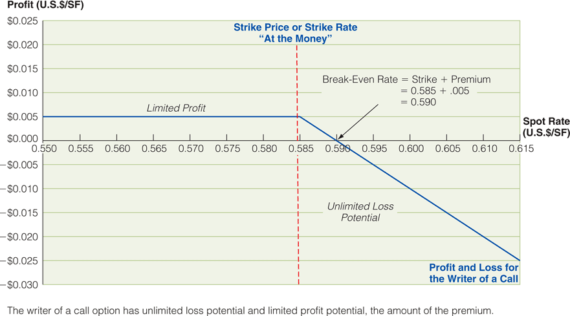
Exhibit 7.4 Profit and Loss for the Writer of a Call Option

Slide 21
Buyer of a Put
0
Buyer of a Put: (see Exhibit 7.5)
  Wants to be able to sell the underlying currency at the exercise price when the market price of that currency drops
  The buyer of a put (like the buyer of the call) can never lose more than the premium paid up front
  Limited maximum loss (premium) and profit (exercise price minus premium)

Slide 22
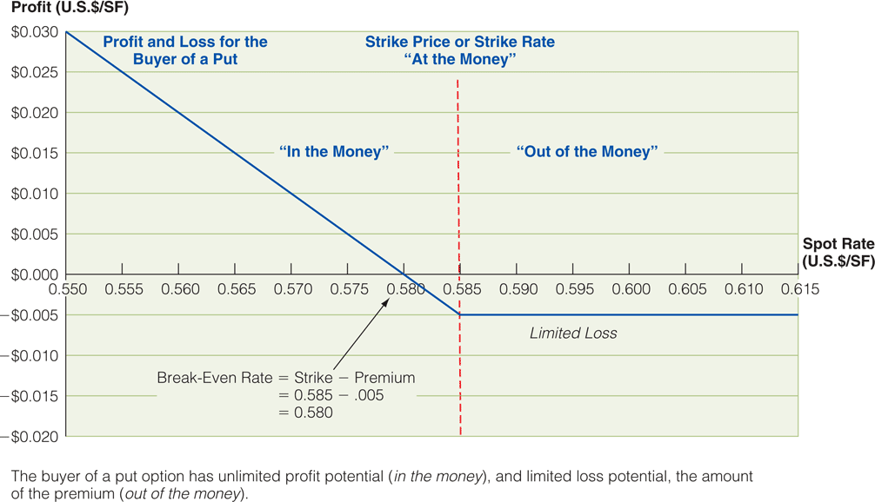
Exhibit 7.5 Profit and Loss for the Buyer of a Put Option

Slide 23
Writer of a Put
0
Seller (writer) of a put: (see Exhibit 7.6)
  The option will be exercised if the spot price of francs drops below $0.585/SF
  Below a price of $0.58/SF (break-even), the writer will lose more than the premium received from writing the option
  Above $0.585/SF, the option will not be exercised and the option writer will pocket the entire premium

Slide 24
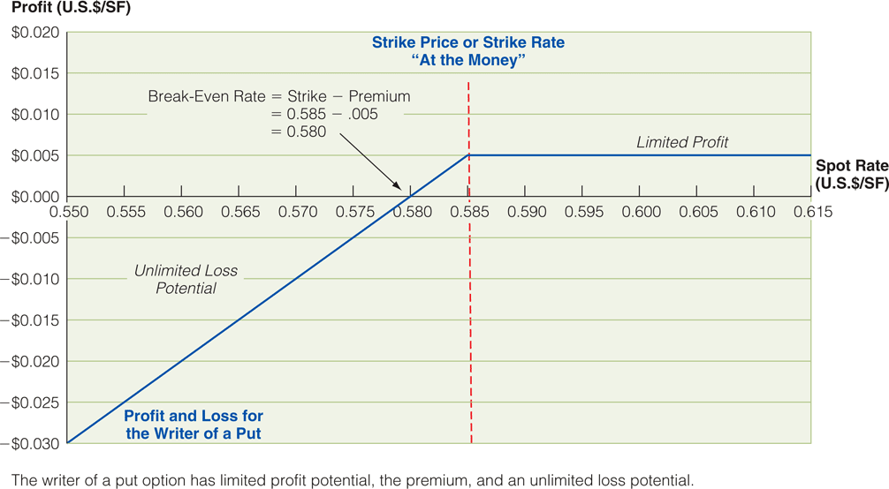
Exhibit 7.6 Profit and Loss for the Writer of a Put Option

Slide 25
Option Pricing and Valuation
0
The pricing of any currency option combines six elements:
  Present spot rate
  Time to maturity
  Forward rate for matching maturity
  U.S. dollar interest rate
  Foreign currency interest rate
  Volatility (standard deviation of daily spot price movements)

Slide 26
Option Pricing and Valuation
The total value (premium) of an option is equal to the intrinsic value plus time value.
The intrinsic value is the financial gain if the option is exercised immediately (at-the-money)
  This value will reach zero when the option is out-of-the-money
  At maturity date, the option will have a value equal to its intrinsic value

Slide 27
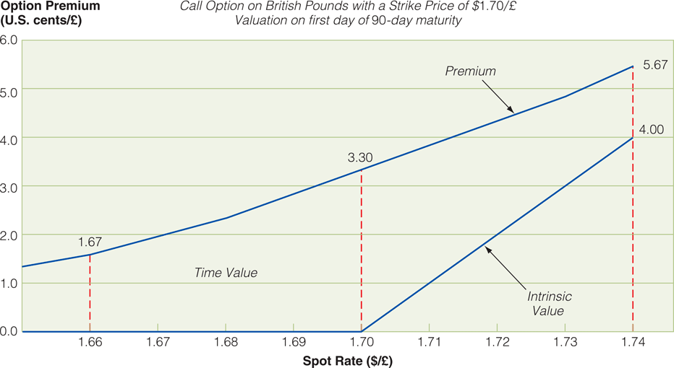
Exhibit 7.7 Option Intrinsic Value, Time Value & Total Value

Slide 28
Option Pricing and Valuation
The time value of the option exists because the price of the underlying currency can potentially move further into the money between today and maturity
  In the exhibit, time value is shown as the area between total value and intrinsic value

Slide 29
Option Pricing and Valuation
If currency options are to be used effectively, either for the purposes of speculation or risk management, the individual trader needs to know how option values – premiums – react to their various components.
Summarized in Exhibit 7.8.

Slide 30
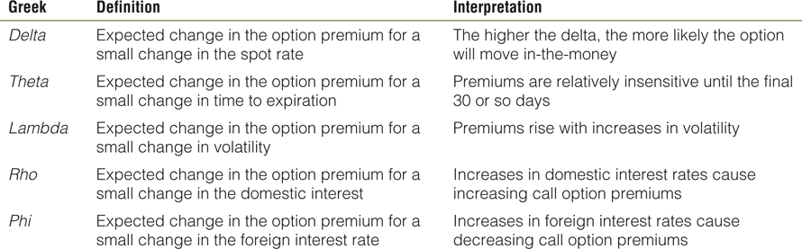
Exhibit 7.8 Summary of Option Premium Components

Slide 31
Interest Rate Risk
All firms are sensitive to interest rate movements in one way or another
Largest interest rate risk of the nonfinancial firm is debt service; the multicurrency dimension of interest rate risk for the MNE is of serious concern
The second most prevalent source of interest rate risk for the MNE lies in its holdings of interest-sensitive securities.

Slide 32
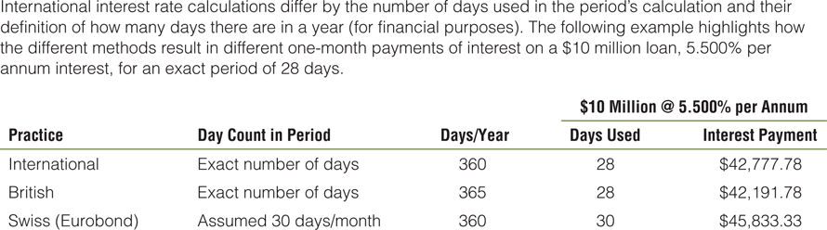
Exhibit 7.9 International Interest Rate Calculations

Slide 33
Credit Risk and Repricing Risk
Credit Risk or roll-over risk is the possibility that a borrower’s creditworthiness at the time of renewing a credit, is reclassified by the lender
Repricing risk is the risk of changes in interest rates charged (earned) at the time a financial contract’s rate is being reset

Slide 34
Interest Rate Futures
Widely used; popularity stems from highly liquid markets, simplicity in use, and the rather standardized interest rate exposures firms posses
Traded on exchanges ; the two most common are the CME and CBOT
The yield is calculated from the settlement price

Slide 35
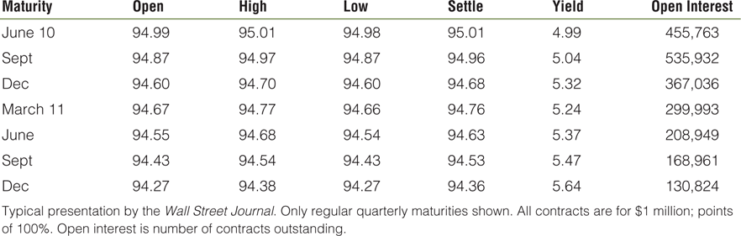
Exhibit 7.10 Eurodollar Futures Prices

Slide 36
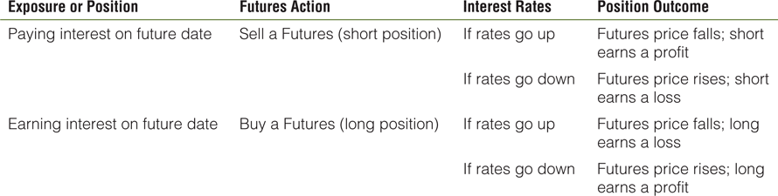
Exhibit 7.11 Interest Rate Futures Strategies for Common Exposures

Slide 37
Forward Rate Agreements
Interbank-traded contract to buy or sell interest rate payments on a notional principal.
Settled in cash.
The buyer has the right to lock in an interest rate for a desired term that begins at a future date.
Seller will pay the buyer the increased interest expense on a nominal sum if interest rates rise above the agreed rate, and vice versa

Slide 38
Interest Rate Swaps
Swaps are contractual agreements to exchange or swap a series of cash flows
Interest rate swap - swap a fixed interest payment for a floating rate payment
Currency swap - swap currencies of debt service
A single swap may combine elements of both interest rate and currency swap

Slide 39
Interest Rate Swaps
Swap agreement to pay fixed and receive floating to protect from rising debt-service payments
Swap agreement to pay floating and receive fixed to take advantage of lower debt-service payments
The cash flows of an interest rate swap are interest rates applied to a set amount of capital, no principal is swapped only the coupon payments

Slide 40
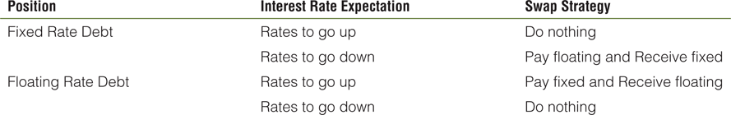
Exhibit 7.12 Interest Rate Swap Strategies

Slide 41
Currency Swaps
Swap rates are derived from the yield curve in each major currency
Used to replace cash flows scheduled in an undesired currency with flows in a desired currency
The desired currency is probably the currency in which the firm’s future operating revenues (inflows) will be generated
Firms often raise capital in currencies in which they do not possess significant revenues

Slide 42
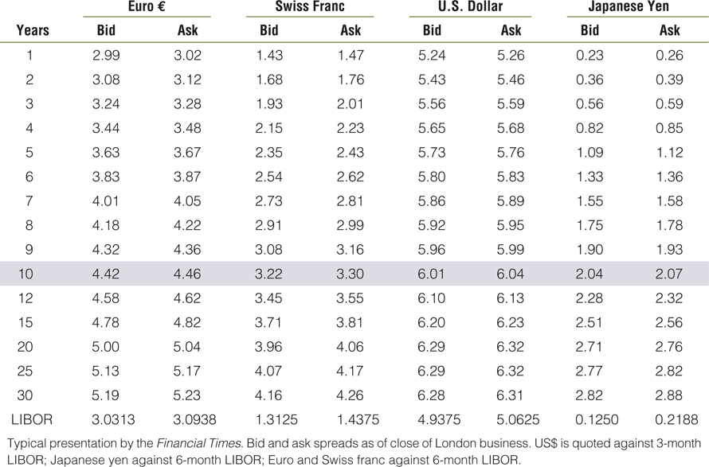
Exhibit 7.13 Interest Rate and Currency Swap Quotes

Slide 43
Summary of Learning Objectives
A foreign currency futures contract is an exchange-traded agreement calling for future delivery of a standard amount of foreign currency at a fixed time, place and price
Futures contracts are in reality standardized forward contracts
Trade occurs on the floor of an organized exchange. They require collateral and are normally settled through an offsetting position

Slide 44
Summary of Learning Objectives
Futures differ from forward contracts by size of contract, maturity, location of trading, pricing , collateral/margin requirements, method of settlement, commissions, trading hours, counterparties and liquidity
Financial managers prefer forwards over futures out of simplicity of use and position maintenance.
Financial speculators prefer futures over forwards because of the liquidity of the market

Slide 45
Summary of Learning Objectives
Options contracts give the holder the right, but not the obligation, to buy or sell a specified amount of currency at a predetermined price on or before a specified maturity date
The maximum loss for a buyer is limited to the premium of the option
The maximum profit for a writer is the premium.

Slide 46
Summary of Learning Objectives
Speculation is an attempt to profit by trading on expectations about prices in the future.
Currency option valuation is a complex combination of the current spot rate, the specific strike price, the forward rate, currency volatility and time to maturity
The total value of an option is the sum of its intrinsic and time value.

Slide 47
Summary of Learning Objectives
The largest interest rate risk of the nonfinancial firm is debt-service. The debt structure of the MNE will possess differing maturities of debt, different interest rate structures (such as fixed versus floating rate), and different currencies of denomination.

Slide 48
Summary of Learning Objectives
The primary sources of interest rate risk to a multinational nonfinancial firm are short-term borrowing and investing, as well as long-term sources of debt.
The primary instruments and techniques used for interest rate risk management include forward rate agreements (FRAs), forward swaps, interest rate futures, and interest rate swaps.

Slide 49
Summary of Learning Objectives
The interest rate and currency swap markets allow firms that have limited access to specific currencies and interest rate structures to gain access at relatively low costs.
A cross currency interest rate swap allows a firm to alter both the currency of denomination of cash flows in debt service, but also to alter the fixed-to-floating or floating-to-fixed interest rate structure.

