Slide 2
Learning Objectives
Examine how the supply and demand for any currency can be viewed as an asset choice issue within the portfolio of investors
Explore how the three major approaches to exchange rate determination – parity conditions, the balance of payments, and the asset approach – combine to explain in the numerous emerging market currency crises experienced in recent years
Observe how forecasters combine technical analysis with the three major theoretical approaches to forecasting exchange rates

Slide 3
Foreign Exchange Rate Determination
Three basic approaches
Parity conditions
Balance of Payments
Asset market
These are not competing theories but are in fact complimentary theories
Without the depth and breadth of the various approaches combined, our ability to capture the complexity of the global market for currencies is lost

Slide 4
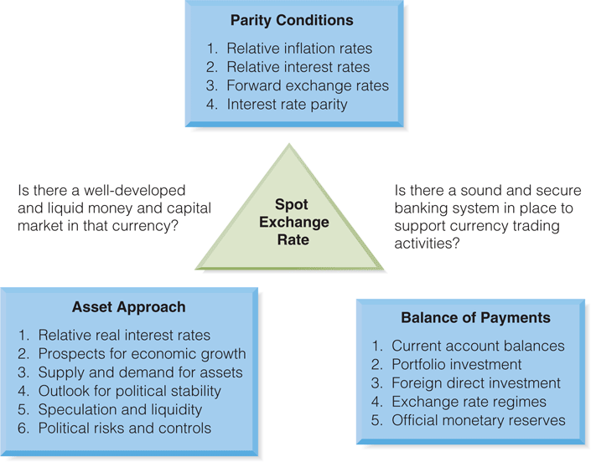
Exhibit 8.1 The Determinants of Foreign Exchange Rates

Slide 5
Purchasing Power Parity Approaches
Oldest and most widely followed theory
Embedded within most theories of exchange rate determination
Has significant data challenges in estimation
Versions: Law of One Price, Absolute and Relative PPP
Relative PPP - explains that changes in relative prices between countries drive the change in exchange rates over time

Slide 6
Balance of Payments (Flows) Approach
Equilibrium exchange rate is achieved when current account net inflows (outflow) match financial account outflows (inflow)
BOP transactions are widely captured and reported
Criticism for focusing on flows rather than stocks of money or financial assets
Dismissed by academic community but used by market participants

Slide 7
Monetary Approaches
The exchange rate is determined by
the supply and demand for national monetary stocks, as
expected future levels and rates of growth of monetary stocks.
Other financial assets, such as bonds are not considered relevant for exchange rate determination, as both domestic and foreign bonds are viewed as perfect substitutes.

Slide 8
Asset Market Approach (Relative Prices of Bonds)
AKA relative price of bonds or portfolio balance approach
argues that exchange rates are determined by supply and demand for a wide variety of assets
Shifts in supply and demand alter exchange rates
Changes in monetary and fiscal policy alter expectations and thus exchange rates
Theories of currency substitution follow the same basis premises of portfolio rebalance framework

Slide 9
Technical Analysis
The forecasting inadequacies of fundamental theories has led to the growth and popularity of technical analysis, the belief that the study of past price behavior provides insights into future price movements.
The primary assumption is that any market driven price (i.e. exchange rates) follows trends.

Slide 10
The Asset Market Approach to Forecasting
0
The asset market approach assumes that whether foreigners are willing to hold claims in monetary form depends on a set drivers (among others):
Relative real interest rates
Prospects for economic growth
Capital market liquidity
A country’s economic and social infrastructure
Political safety
Corporate governance practices
Contagion (spread of a crisis within a region)
Speculation

Slide 11
Currency Market Intervention
Foreign currency intervention is the active management, manipulation, or intervention in the market’s valuation of a country’s currency.
Why Intervene?
Fight inflation (strong currency)
Fight slow economic growth (weak currency)

Slide 12
Intervention Methods
Determined by
magnitude of a country’s economy,
magnitude of trading in it’s currency, and
the country’s financial market development
Types
Direct Intervention
Coordinated Intervention
Indirect Intervention

Slide 13
Currency Market Intervention
Capital Controls - This is the restriction of access to foreign currency by government. This involves limiting the ability to exchange domestic currency for foreign currency
The Chinese regulation of access and trading of the Chinese Yuan is a prime example over the use of capital controls over currency value.

Slide 14
Disequilibria: Exchange Rates in Emerging Markets
Although the three different schools of thought on exchange rate determination make understanding exchange rates appear to be straightforward, that is rarely the case
The problem lies not in the theories but in the relevance of the assumptions underlying each theory
Notes:
After several years of relative global economic tranquility, the second half of the 1990s was racked by a series of currency crises which shook all emerging markets: The Asian crisis of July 1997 and The Argentine crisis (1998 – 2002)

Slide 15
The Asian Crisis – July 1997
Roots
fundamental change in the economics of the region, the transition of nations from being net exporters to net importers
excess capital inflows into Thailand in 1996 and early 1997
As the investment “bubble” expanded, some questioned the ability of the economy to repay the rising amount of debt and the Thai baht came under attack.

Slide 16
The Asian Crisis – July 1997
The Thai government intervened directly (using reserves) and indirectly by raising interest rates in support of the currency
Soon thereafter, the markets ground to a halt and the Thai central bank allowed the bhat to float
The bhat fell dramatically and soon other Asian currencies (Philippine peso, Malaysian ringgit and the Indonesian rupiah) came under speculative attack

Slide 17
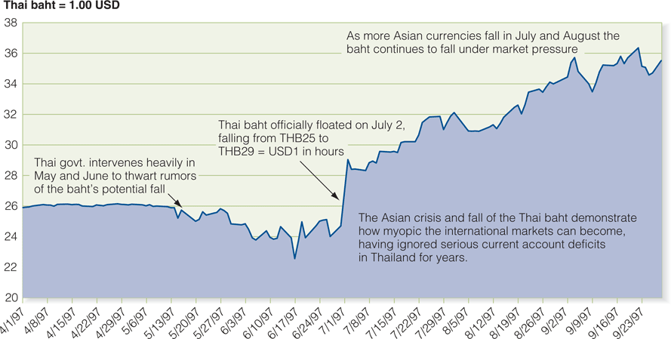
Exhibit 8.3 The Thai Baht and the Asian Crisis

Slide 18
The Asian Crisis – July 1997
The Asian economic crisis (which was much more than just a currency collapse) had many roots besides traditional balance of payments difficulties:
Corporate socialism
Corporate governance
Banking liquidity and management
What started as a currency crisis became a region-wide recession

Slide 19
The Russian Crisis of 1998
1995 – 1998 Russian govt and nongovt borrowing very high, servicing the debt becomes difficult
Russian exports (commodity-based) values decline after world commodity prices drop as a result of the Asian crisis of 1997
The Ruble was under a managed float (1.5% band) with daily interventions by the Russian Central Bank

Slide 20
The Russian Crisis of 1998
Capital flight was taking place
August 7 - Russia announces it will raise an extra $1 billion in foreign bonds
August 10 - Stocks drop by 5% on fears that China would cut its currency value (RUB6.3/USD)
August 17 - the Ruble is devalued by 34%
August 26 - the Ruble is down to RUB13/USD
Notes:
On August 7, 1998 began the “August Crash or Collapse” with the announcement that currency reserves had fallen $800M in the last week.

Slide 21
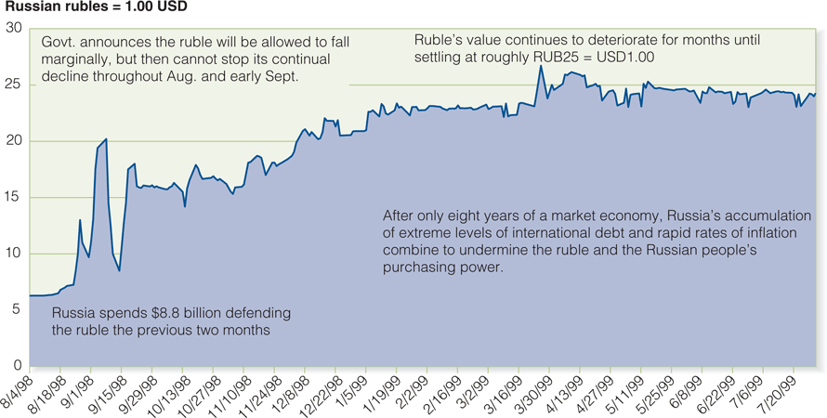
Exhibit 8.4 The Fall of the Russian Ruble

Slide 22
The Argentine Crisis - 2002
In 1991 the Argentine peso had been fixed to the U.S. dollar at a one-to-one rate of exchange.
A currency board structure was implemented in an effort to eliminate the source inflation that had devastated the nation’s standard of living in the past.

Slide 23
The Argentine Crisis - 2002
By 2001, after three years of recession, three important problems with the Argentine economy became apparent:
The Argentine peso was overvalued
The currency board regime had eliminated monetary policy alternatives for macroeconomic policy
The Argentine government budget deficit – and deficit spending – was out of control

Slide 24
The Argentine Crisis - 2002
In January 2002, the peso was devalued as a result of enormous social pressures resulting from deteriorating economic conditions and substantial runs on banks
In February 2002, the peso began a slow but gradual depreciation
However, the economic pain continued:
the banking system remained insolvent
social unrest continued
the economic and political systems collapsed
Notes:
Unfortunately, this was not the last currency crisis for Argentina. Argentina once again suffered capital flight and a rapid deterioration in the recognized value of its currency in 2013–2014. This crisis, highlighted by capital controls and black market (“blue market”) trading, was described in Chapter 2.

Slide 25
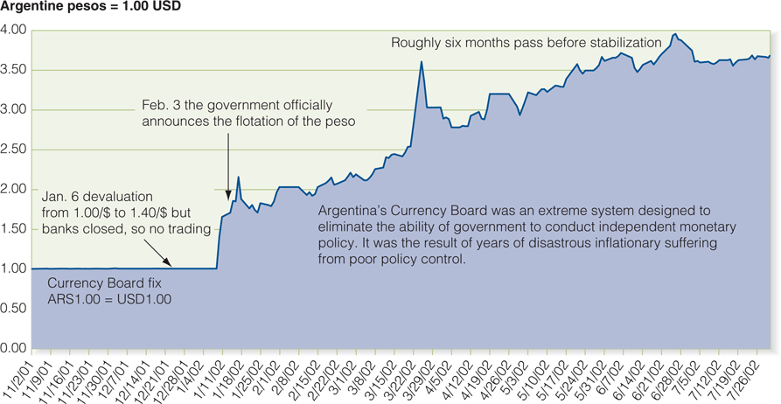
Exhibit 8.5 The Collapse of the Argentine peso

Slide 26
Forecasting in Practice
In addition to the three approaches to forecasting discussed earlier (Parity Conditions, Balance of Payments, Asset Approach) forecasting practitioners also utilize technical analysis
Focused on price and volume data to determine past trends that are expected to continue into the future
The longer time horizon of the forecast, the more inaccurate the forecast is likely to be

Slide 27
Forecasting in Practice
Whereas forecasting for the long run must depend on the economic fundamentals of exchange rate determination, many of the forecast needs of the firm are short to medium term in their time horizon and can be addressed with less theoretical approaches.

Slide 28
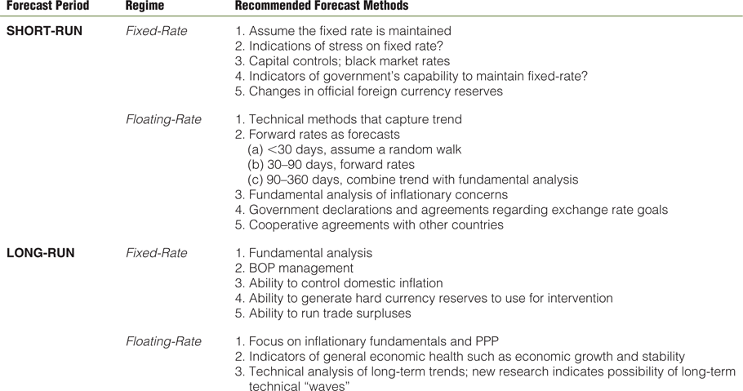
Exhibit 8.6 Exchange Rate Forecasting in Practice

Slide 29
Forecasting in Practice
Decades of theoretical and empirical studies show that exchange rates do adhere to the fundamental principles and theories in the long term
In the short term, a variety of random events, institutional frictions, and technical factors may cause currency values to deviate significantly from their long term fundamental path

Slide 30
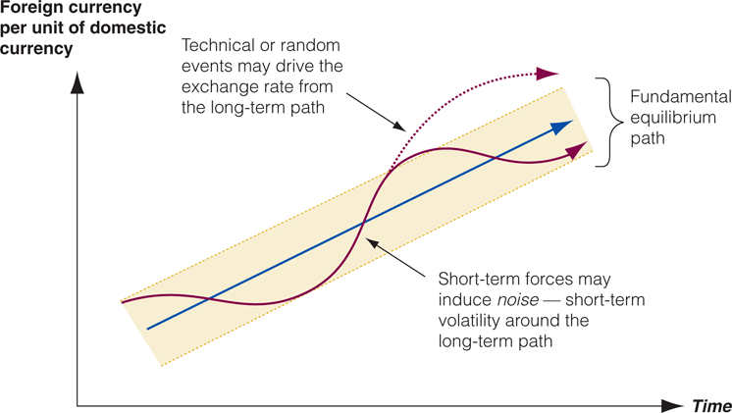
Exhibit 8.7 Short-Term Noise Versus Long-Term Trends

Slide 31
Forecasting in Practice
Although theories are clear and sound, it may appear on a day-to-day basis that the currency markets do not pay much attention to the theories
The difficulty is understanding which fundamentals are driving markets at which points in time
One example of this relative confusion over exchange rate dynamics is the phenomenon known as overshooting

Slide 32
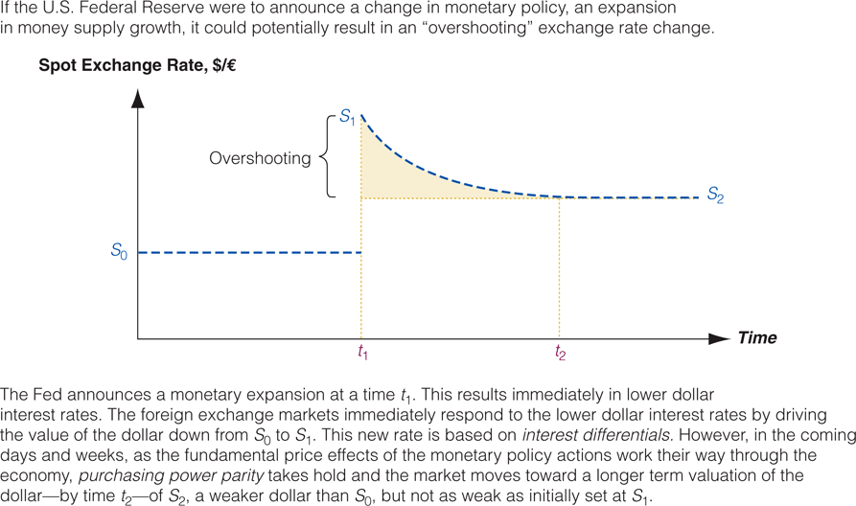
Exhibit 8.8 Exchange Rate Dynamics: Overshooting

Slide 33
Summary of Learning Objectives
The asset approach suggests that demand for monetary claims depends partly on relative real interest rates and a country’s outlook for economic growth and profitability
Longer-term forecasting requires analysis of fundamentals: BOP, relative inflation, interest rates and long-run properties of PPP

Slide 34
Summary of Learning Objectives
Technical analysis focus on price and volume data to determine past trends that are expected to continue in the future
Forecasting in practice is a mix of both fundamental and technical analysis
The Asian crisis was primarily a BOP and currency crisis in its origins. A weak economic and financial infrastructure, corporate governance problems and speculation also contributed

Slide 35
Summary of Learning Objectives
The Russian ruble crisis of 1998 was a complex combination of speculative pressures best explained by the asset approach
The Argentine crisis of 2002 was probably a combination of a disequilibrium in international parity conditions (differential rates of inflation) and balance of payments disequilibrium (current account deficits combined with financial account outflows)

