Slide 1
League expansion
Bryce Fisher

Slide 2
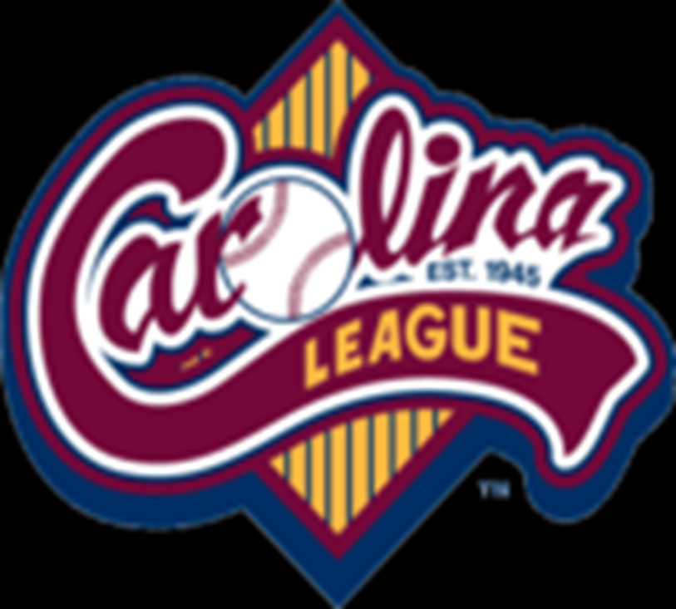
History of the Carolina League
Officially announced on October 29, 1944
Organizational Meeting at Durham, North Carolina
Successor to the Bi-State League
Began Play in 1945 With Eight Teams
Notes:
The league was officially announced on October 29, 1944 after an organizational meeting at Durham, North Carolina. The league was a successor to the Bi-State League that existed before World War II. The league began play in 1945 with eight teams based in Burlington, Durham, Greensboro, Leaksville, Raleigh, Winston-Salem (all from North Carolina), along with Danville and Martinsville from Virginia.

Slide 3
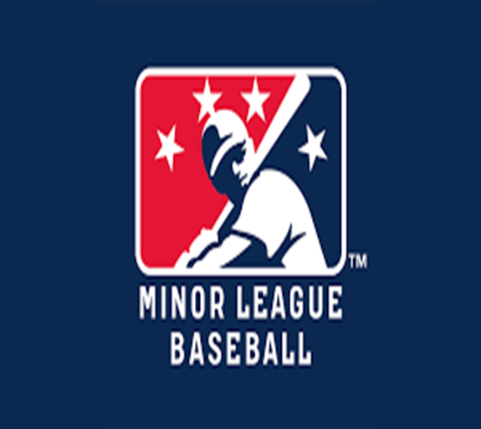
Current league
Minor League Baseball league
8 Teams
Atlantic Coast
Class A-Advanced league
Notes:
The Carolina League is a Minor League Baseball league which operates along the Atlantic Coast of the United States. The league has 8 teams which are in a Class A-Advanced league

Slide 4
Teams northern Division
Frederick Keys Frederick, Maryland
Lynchburg Hillcats Lynchburg, Virginia
Potomac Nationals Woodbridge, Virginia
Wilmington Blue Rocks Wilmington, Delaware
Notes:
The League is split into two divisions. The Northern Division has four teams. The Frederick Keys are located in Frederick, Maryland and affricated with the Baltimore Orioles. The Lynchburg Hillcats are located in Lynchburg, Virginia and affricated with the Cleveland Indians. Potomac Nationals home is Woodbridge, Virginia and the affricated with the Washington Nations. Wilimington Blue Rocks home is Wilmington, Delaware and affricated with the Kansas City Royals.

Slide 5
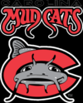
Teams Southern Division
Carolina Mudcats Zebulon, NC
Myrtle Beach Pelicans Myrtle Beach, SC
Winston-Salem Dash Winston-Salem, NC
Salem Red Sox Salem, Virginia
Notes:
The Southern Division also has four teams. The Carolina Mudcats home is Zebulon, NC and the minor league team of the Milwaukee Brewers. The Myrtle Beach Pelicans is located in Myrtle Beach, SC and has Chicago Cubs affiliation. The Winston-Salem Dash is located in Winston-Salem, NC and has Chicago White Sox affiliation. Salem Red Sox is in Salem, Virginia and has Boston Red Sox affiliation.

Slide 6
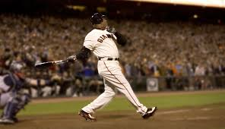
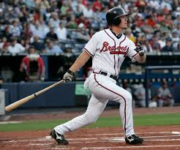
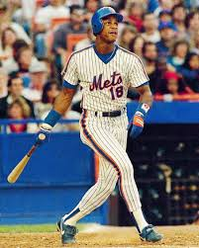
Former notable players
Barry Bonds (Prince William, 1985)*
Dwight Gooden (Lynchburg, 1983)
Andruw Jones (Durham, 1996)
Chipper Jones (Durham, 1992)*
Andy Pettitte (Prince William, 1993)
Jorge Posada (Prince William, 1993)
Darryl Strawberry (Lynchburg, 1981)*
Notes:
Some notable former players of the league are Barry Bonds which is the All-Time homerun leader. Chipper Jones which will be a first ballot hall of famer this year. Darryl Strawberry also was apart of the league, who was a four time World Series Champion.

Slide 7
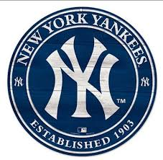
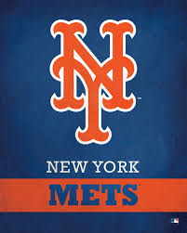
League Expansion
Will expand from 8 teams to 10 teams
Notes:
. The league has recently announced it will expand from 8 teams to 10 teams within the next three years. The two new expansion Carolina League teams will represent
either the New York Mets or the New York Yankees. Currently, the Carolina League has sent a call for proposals to various cities throughout North Carolina, South Carolina, Virginia, Maryland, and West Virginia to represent the Carolina League expansion teams.

Slide 8
Charles town Miners
Notes:
Charles Town, West Virginia would make an excellent host for this team.

Slide 9
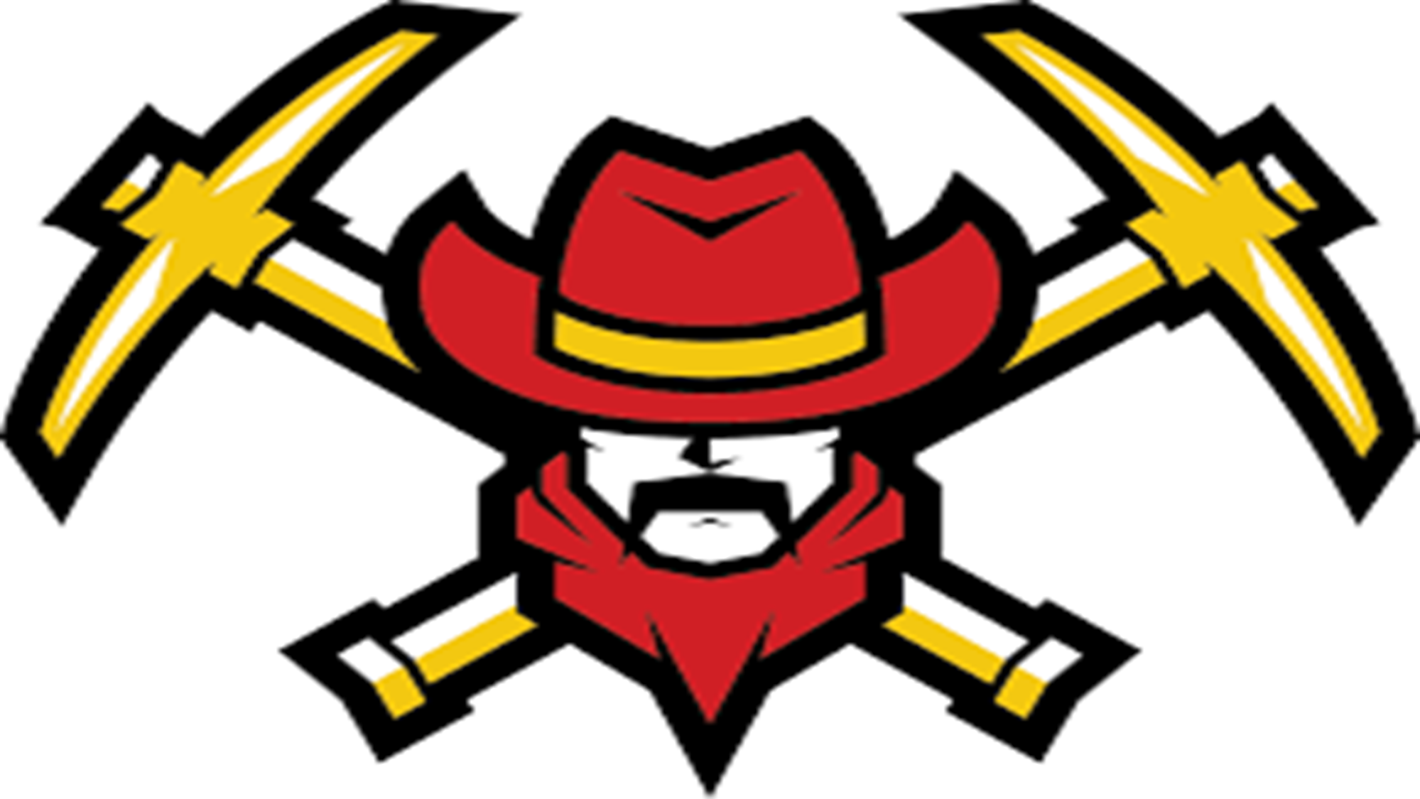
values
The Charles Town Miners will aspire to be an outstanding athletic organization that provides a high-quality experience to every coach and player. A high-quality experience is one in which everyone while the developing skills and decision-making as players, coaches, and men.

Slide 10
Administration Staff needed
Owner
General Manager
Human Resource Manager
Marketing Director
Business Operator
Director of Special Events
Travel Manager

Slide 11
Baseball Staff Needed
Club Manger
Batting Coach
Pitching Coach
Player Development Coach
Strength & Conditioning Coach
Notes:
Coaches are responsible for managing and monitoring play time and ensuring that each player gets exposure to the game throughout the season. Their purpose is the development each and every person to the best of their ability.

Slide 12
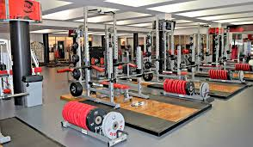
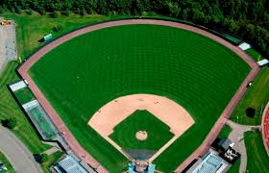
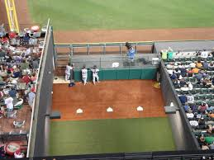
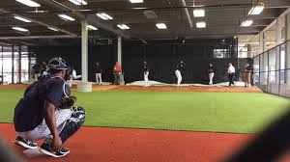
BASEBALL FACITIES
BASEBALL FIELD
BATTING CAGES
BULLPEN LANES
PLAYER LOUNGE
WEIGHT ROOM

Slide 13
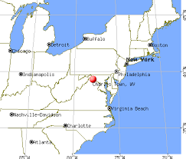
Charles Town, WV
Humid Subtropical
73 miles northwest of Washington, D.C.
75 miles west of Baltimore
Notes:
Due to its low elevation for West Virginia, Charles Town is on the northern extent of the Humid Subtropical climate zone, having cool to mildly cold winters and hot and humid summers. Precipitation is evenly distributed throughout the year, providing lush, abundant plant growth. Charles Town is located 73 miles northwest of Washington, D.C. and 75 miles west of Baltimore.

Slide 14
Charles Town, WV
Population of 5,259
1,289 families
2,011 households
-37.2% had children under the age of 18 living with them
-47.3% were married couples living together
VERY FAMILY ORIENTED CITY
Notes:
As of the census of 2010, there were 5,259 people, 2,011 households, and 1,289 families residing in the city. There were 2,011 households of which 37.2% had children under the age of 18 living with them, 47.3% were married couples living together,

Slide 15
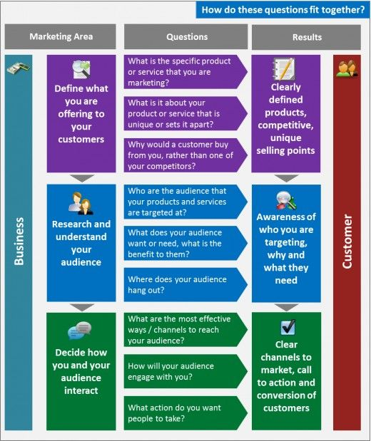
Benefit for the league
Open Market
Notes:
Charles Town, WV is an open sports market. The only other pro sports team in the city is the West Virginia Badgers, which is a indoor football team. The pro baseball market is wide open in a family driven city with almost 40% of the families having young kids.

Slide 16
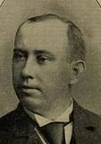
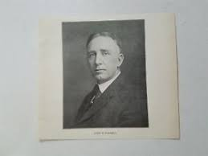
Governance history
Patrick T. Powers (First President)
John H. Farrell (Secretary-Treasurer)
14 Leauges/96 Clubs
Notes:
-Patrick T. Powers, was elected as the first President of the NAPBL. The first NA office was established in Auburn, N.Y., under President Powers and the Secretary-Treasurer was John H. Farrell
-Fourteen leagues and 96 clubs were members during the first season in 1902
-Powers left office in 1909, there were 35 leagues and 246 clubs.

Slide 17
Michael Sexton
President (1910-1932)
Sexton led a fight at the 1914
Restored peace
The Minor Leagues began to flourish.
Notes:
In 1910, Michael Sexton became President. In his first few years, wars between the Major Leagues and the outlaw Federal League hurt the Minors. The Federal League raided top Minor League teams, as well as National and American League teams, for players and territory. Sexton led a fight at the 1914 Winter Meetings to ward off a bid from radicals for the Minor Leagues to desert the Major Leagues and back the Federal League. For 22 years, Sexton presided over the Minor Leagues, leaving at the height of the Depression in 1932. But during his time, peace was restored and the Minor Leagues began to flourish.

Slide 18
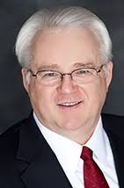
Current Governance
Pat O'Conner
11th President in January 2008
Chief Operating Officer
Professional Baseball Agreement with Major League Baseball through the 2020 season;
Notes:
Pat O'Conner took over as Minor League Baseball's 11th President in January 2008. He was elected to a four-year term, after serving as Chief Operating Officer, Moore's top aide, for 15 years. O'Conner was re-elected to a second term in December 2011. Highlights of O'Conner's first term in office include the extension of the Professional Baseball Agreement with Major League Baseball through the 2020 season

Slide 19
Governance Current organization
Pat O'Conner President & Chief Executive Officer
Stan Brand Vice President
Brian Earle Chief Operating Officer
Dan O'Brien Jr. Senior Executive Advisor to the President
Bill Smith Assistant to the President
Vincent Pierson Manager, Diversity & Inclusion
Tara Thornton Manager, Human Resources
Belicia Montgomery Analytics Specialist
Kim Bradbury Receptionist
***Board of Trustees***

Slide 20
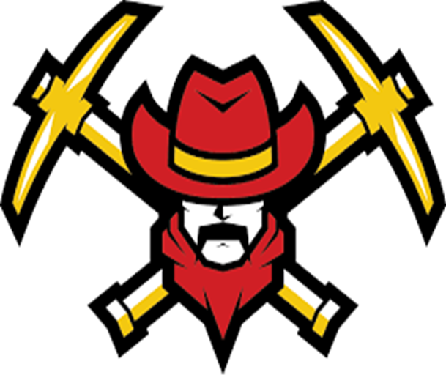
Issues facing governing bodies Ethical
More Minority-Hiring
Poorly Run Franchises
Chewing Tobacco
Deepening Bonds With The Fans
Notes:
-The MLB and MILB needs to look into hiring more minorities in management positions.
-A lot of Minor League teams are sending owners into debt and being purchased just to free the owner of a liability investment. This is because some franchises are ran poorly.
-The leagues need to look at banning the use of tobacco in all baseball stadiums. There are some young fans that we have to set good role examples for. Tobacco can be very harmful.
-The league and team has to do a better job with building relationships with fans.

Slide 21
Issues facing governing bodies Legal
Salaries Below Minimum Wage
Many former Minor League players have file a class action lawsuit seeking better wages. Their complaint is that major leagues salaries have increased over the past years, but minor league salaries have grown only a fraction.

Slide 22
Charles Town benefits
Tourist Attraction
Property Value Could Soar
Lead To the City Being A Location Target
Affordable Entertainment
A Venue for events
Notes:
-A new minor league team would attract tourist.
-The property value around a new stadium would go up tremendously.
-Charles Town could also be a target location for companies that want to relocate of expand.
-The team would give the community the option to have some affordable entertainment with tickets being less than $10.
-The stadium could be a venue for other events like concerts, charity events, and other entertainment for the city.

Slide 23
Organizational Management Leadership Structure
Owner
General Manager
Human Resource Manager
Marketing Director
Business Operator
Director of Special Events
Travel Manager
Notes:
Owner- Have Capital to endure some losses
General Manager- should try to do what best for the team operations
Human Resource Manager- make sure the organization member is working in a healthy enivornment
Marketing Director- make sure the team, games, and other events are market to the right groups and audience
Business Operator- make sure that the team or stadium is operating the right way from a business standpoint
Director of Special Events- plan and make sure community and charity events are operated as planed
Travel Manager- makes sure that the team and members of the organization are great when traveling.

Slide 24
Organizational Management Goals
Community Events
Charity Events
Fan Appreciation
Strong Bonds With Fans
Notes:
-The organization should do its best to make sure that the community and fans know that they are important. I think hosting community, charity events, and fan appreciation day will build strong bonds with the community and fans. Keep the community and tax payers happy should be the main goal of management.

Slide 25
Ethical Practices Code of Ethics
Always do what’s right and not what is best for the team or organization
Create a great and safe work environment for everyone.
Players First Organization
Community that welcome us should always be concerned in our decisions as an organization.
We should show and help players and staff be healthy productive citizens.
Keep a great public image and relation with the fans. Be role models to the young fans of the game.

Slide 26
Risk analysis owning a team in Charles Town
Team Being Ran Poorly
Tax Money Spent Doesn’t return to the Community
Honeymoon Effect
Notes:
-As stated earlier in this presentation, a poorly ran franchise could cause the owner to lose money and go into overwhelming debt.
-The community and tax-payers might get upset if the money they put up for a modern doesn’t return to the community. The pros of a new stadium like job creation, sport excitement, and entertainment might become seasonal leaving the community with questions.
-When most minor league teams start, it does well for the first 5-10 years. After the honeymoon phase is where the trouble begin. Keeping the team and stadium relevant is a huge task.

Slide 27
Summary & conclusion
I recommend that the owner of this organization and team be a real people person and have a serious love for baseball.
I also recommend that the organization put the players and community first.
Also keeping the stadium book as possible will be a great way to create jobs, make the community happy, and keep the stadium relevant.
The organization has to do its best to keep a great public relation reputation because a minor league team has very small room for error.

