Slide 1
Essaying A final project to synthesize your thinking and offer personal insights on a topic of your choice
YOU WILL NEED: ☑ a copy of the Essaying prompt
☑ a blank page to brainstorm and journal

Slide 2
“undertaking a study, the subject of which is man.”
Upon retirement in 1571, Michel de Montaigne spent his time in the French countryside reading and writing, where he claimed to be merely “essaying” – which in French means trying – a kind of exploratory, unresolved thinking on the page.
Essays traffic in ideas, asking questions, and explaining thinking in order to help the reader become equally enthralled.
Explore larger meaning of issues, deeper connections, reveal insight and implications

Slide 3
Essaying in the 21st century
Christ in the Garden of Endless Breadsticks

Slide 4
writer should discover, articulate and express personal insights as they intersect with and circle around a specific topic
Writing consultant Katherine Bomer in her book “The Journey is Everything”
“The kind of writing I am arguing for in this book: prose pieces that are personal, lyrical, literary, descriptive, reflective, narrative, expository, philosophical, political, spiritual…all of the above.”
Memoir+argument+reflection
Genre blending
Cultivate voice
First person “I”
Show your personality, thinking

Slide 5
Decide on your Audience
Who is your reader? Who cares about this topic?
(peers in your field, RWS students, readers of a specific demographic or area of interest, the larger university community, policy makers)
Make writing choices that guide this reader.

Slide 6
How do I craft an essay that can “linger, arouse, question, travel, contradict, reveal and expose the mind?”
Use corresponding devices to these goals:
show multiple perspectives
guide, pause, interrogate
include unexpected elements like poetry or lyrics, pop culture or philosophical truths

Slide 7
Essaying Requirements
Narration: use vivid, descriptive language and details to make one or moments come alive for the reader; develop so the reader can “see” the experience. Use “first person “I.”
Significance: stories can’t be without real meaning, they must act as support and evidence or commentary for the topic exploration. Make sure the stories actually support a claim, an understanding or a key idea explicitly named in the essay – you’ll want to guide readers through your thinking.
Organization: controlling idea vs. thesis – every paragraph should have a focus. Think of this essay in manageable “chunks” – narration, supporting evidence/voices, transitions and connections. By the end of the essay, has the writer offered insight and/or larger meaning of their topic and their thinking?
Creativity: Is there a hook/dramatic device in the intro, an interesting conclusion, is the voice of the writer present throughout the essay? The tone should be intentional, and the writing should not be flat, boring or solely academic.

Slide 8
Support
Use relevant and varied, credible and balanced quotes to set tone
Scholarly articles to Tweets
Internet sources to peer voices
Philosophers and artists
Situate your findings, topic in the larger cultural moment
Make connections
Think BIG – history, society, policy
*Need a minimum of three outside sources and MLA works cited page
Your goal of addressing CONTEXT is linked to your selection of support, voices and research that reveals your perspective and leads readers to insight and meaning,

Slide 9
Epigraph ˈepəˌɡraf/ *noun a short quotation or saying at the beginning of a book or chapter, intended to suggest its theme
☑ WRITERLY CREATIVITY

Slide 10
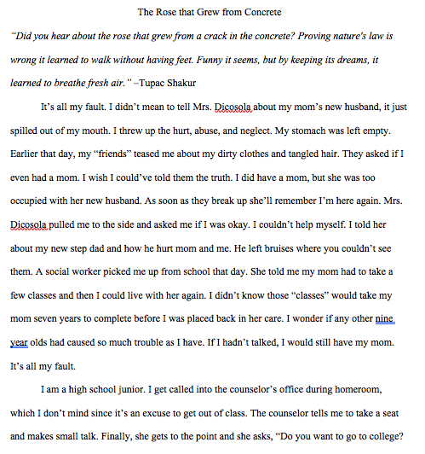
A Dramatic Introduction
No Formulaic Thesis
Essaying writers takes risks – a creative title, a personal connection to the topic, an epigraph that makes sense by the end of the essay.

Slide 11
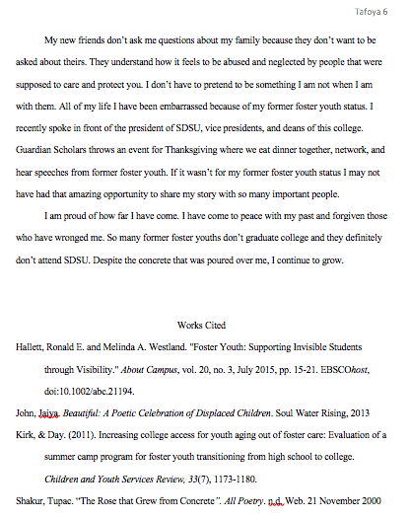
MLA format, 5-6 pages long, 12 point font
Thoughtful conclusion, creatively unifies topic
Works Cited page with 3+ Credible entries

Slide 12
Ideas for Writing
Consider an essential question that drives your inquiry
“In The Picture of Dorian Gray, the preface has a line that struck me, "The only excuse for making a useless thing is that one admires it intensely" (Wilde 3). This made me analyze myself deeply. I questioned my perspective of life, my priorities, and the way I perceive beauty. I asked myself, ‘Do I intensely admire anything? Have I ever?’”

Slide 13
How Do I Begin? Brainstorm…
The key to essaying is exploring a topic in which you are truly interested.
Favorite journal entry/topic
Insights into life as writer, student
Issue in your field or environment
Following your curiosity
Exploring new idea or experience
Rethinking an assumption or data
Making larger meaning of object or overlooked concept
“I am so clever that sometimes I don't understand a single word of what I am saying.”
― Oscar Wilde

