Slide 1
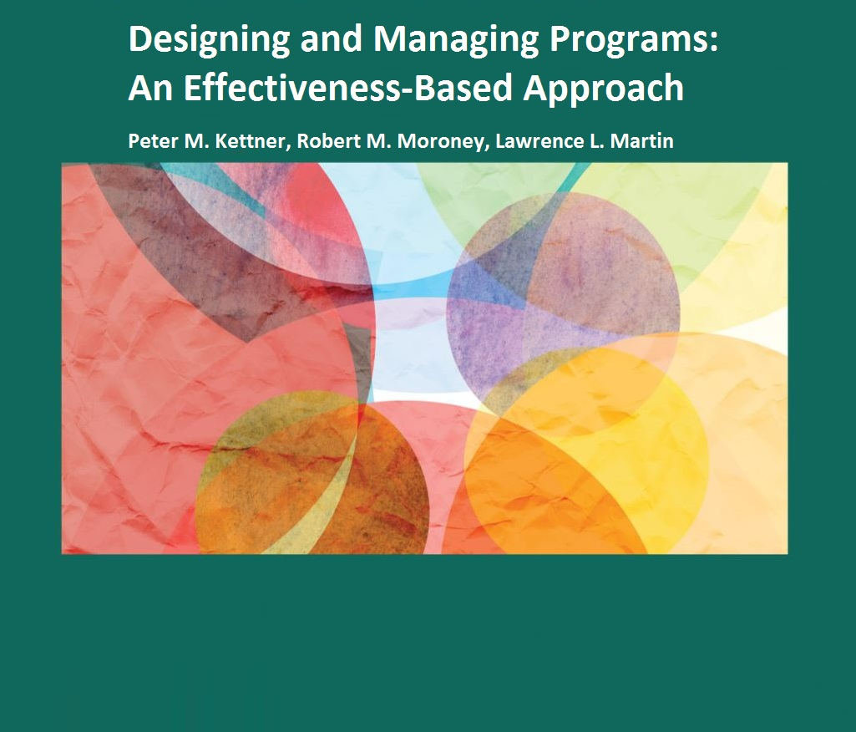
Chapter 12: Budgeting for Financial
Control, Management, and Planning

Slide 2
The Differences Between Budgeting and Accounting
Accounting is a financial activity
Accounting and accounting systems are concerned with the past and current condition of a human service agency and its programs
Budgeting is a programmatic and a financial activity
Budgeting and budgeting systems are concerned with the present and future condition of a human service agency and its programs

Slide 3
The Principal Purposes of Budgeting
Principal purposes of budgeting:
financial control
management
planning
Financial control purposes tend to overshadow the management and planning purposes
To derive maximum benefits from budgeting equal importance should be given to financial control, management and planning

Slide 4
The Principal Purposes of Budgeting The Financial Control Purposes
Ensures that agency and program expenses do not exceed agency and program revenues
Revenues are committed when they conform to the approved budget and when proposed expenses work toward the accomplishment of agency or program plans, goals and objectives
Fiduciary responsibilities are discharged through formal adoption of budgets by governing boards in nonprofit organizations and by appropriate legal authority for governmental organizations

Slide 5
The Principal Purposes of Budgeting The Management Purposes
Policies, procedures and processes used to ensure that agency and program resources are expended efficiently to provide the most service or product (outputs) as possible
Management purposes include:
Ensuring that budgets are implemented as adopted
Ensuring that budget revisions are formally approved before significant changes are implemented

Slide 6
The Principal Purposes of Budgeting The Planning Purposes
Determines what revenues will be used to achieve what agency or program results, accomplishments or impacts (outcomes)
Budget is an integral component of a human service agency’s planning system
Direction or redirection of revenues should be determined in accordance with agency and program planning priorities
Planning function allows assurances to be given to funding sources that specified target populations will have resources allocated to addressing their needs

Slide 7
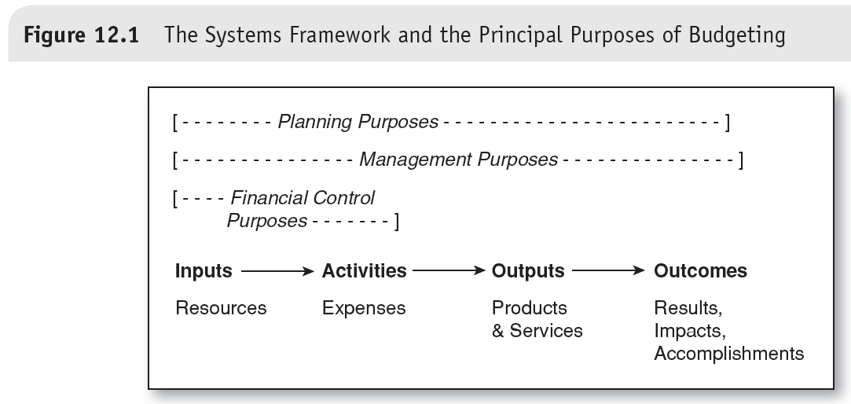

Slide 8
Budgeting and the Systems Framework
Systems framework identifies:
Financial control purposes of budgeting deal with relationship between revenues (inputs) and expenses (activities)
Management purposes of budgeting deal with relationship between revenues (inputs) and outputs (intermediate outputs, quality outputs and service completions).
Planning purposes of budgeting deal with relationship between revenues (inputs) and agency and program results, accomplishment or impacts (outcomes)

Slide 9
Major Models of the Budgetary Process
Incremental model
Political model
Rational planning model

Slide 10
Major Models of the Budgetary Process
Incremental Model:
Views budgetary process and budget decisions as extensions of past budgetary processes and decisions
Agencies and programs are allocated a share of resources based primarily on what they received in previous years, often with a marginal (or incremental) increase or decrease

Slide 11
Major Models of the Budgetary Process
Political Model:
Views budgetary process as a negotiation
Budgeting decisions are end products of conflict and compromise between competing stakeholders
Stakeholders attempt to mobilize political and community support for preferred agencies and to ensure that they receive an equitable allocation of community and agency resources

Slide 12
Major Models of the Budgetary Process
Rational Planning Model:
Views budgetary process as a set of logical steps tied to community, agency or program planning that results in budgeting decisions based on needs, priorities, plans, goals and objectives
Uses data and information as the basis for decision making
Involves a planning process that includes:
Needs assessment
Establishment of community, agency or program goals and objectives
Linking resources to goals and objectives

Slide 13
Major Budgeting Systems
Line-item
Functional
Program

Slide 14
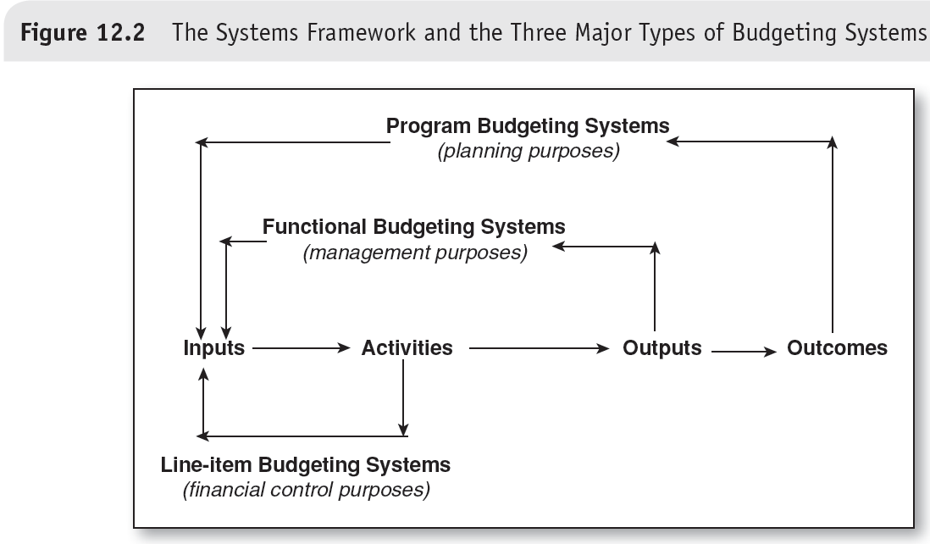

Slide 15
Major Budgeting Systems Line-Item Budgeting Systems
Deal with inputs (revenues) and activities (expenses)
Financial control is principal purpose
Represent a plan for where agency or program funds will be secured and how funds will be spent
Deal strictly with monetary issues
Not concerned with issues such as:
Amount of service or product to be produced (outputs)
Accomplishment of agency
Program goals and objectives (outcomes)

Slide 16
Major Budgeting Systems Functional Budgeting Systems
Deal with inputs (revenues) and outputs (intermediate outputs, quality outputs and service completions)
Management is principal purpose
Concerned with the efficiency and productivity of an agency or program (ratio of outputs to imputs)
Also identified as “output budgeting,” “efficiency budgeting,” or “productivity budgeting”
Represent a plan that includes:
How much funding will be devoted to individual programs
Amount of service or product program is expected to produce
Estimated unit cost (cost per output)

Slide 17
Major Budgeting Systems Program Budgeting Systems
Deal with inputs (revenues) and the accomplishment of goals and objectives (outcomes)
Planning is principal purpose
Also identified as “outcome budgeting” or “effectiveness budgeting”
Similar to functional budgeting systems but focus changes from outputs to outcomes
Program budgeting system identifies:
Total program costs
Number of outcomes (intermediate and final) to be achieved
unit cost or cost per outcome

Slide 18
Dealing With Revenue Increases and Decreases
Line-item, functional and program budgeting systems provide different perspectives on revenue increases or shortfalls
Effectiveness-based planning requires information provided by functional and program budgeting systems to assess:
Impact of revenue increases and decreases on the amount of service or product that can be provided
Number of client outcomes that can be achieved

Slide 19
Budgeting in Human Service Agencies and Programs Today
Most agencies and programs still rely primarily on line-item budgeting systems(!)
Line-item, functional and program budgeting systems can be seen as components of one comprehensive budgeting system
Functional and program budgeting systems build on line-item budgeting
Extending a line-item budgeting system to incorporate the concepts needed for functional and program budgeting supports an effectiveness-based approach to human services programs

