Slide 1
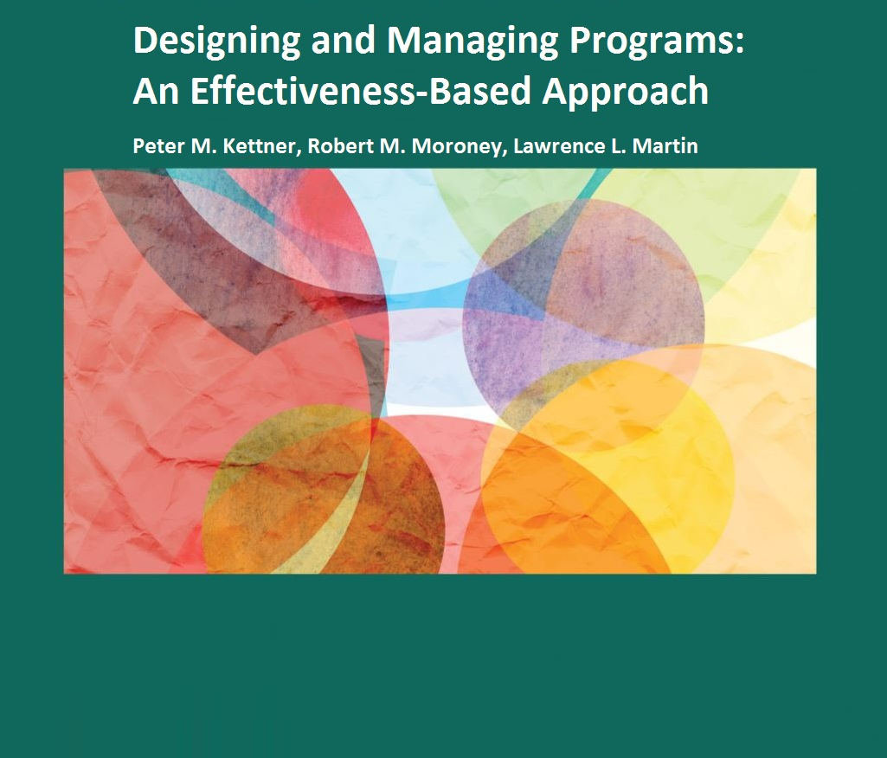
Chapter 13: Developing Line-Item, Functional, and Program Budgeting Systems

Slide 2
Developing Line-Item Budgeting Systems
Line-item budgeting systems are characterized by:
Standardized budget formats
Common budget definitions
Structured budgetary process
The time period (fiscal year) covered by line-item budgeting systems is usually 12 months
Fiscal year tends to follow one of three time frames:
January 1 to December 31 (used by many nonprofit human service agencies and programs)
July 1 to June 30 (used by many state and local government human service agencies and programs)
October 1 to September 30 (used by federal agencies and programs)

Slide 3
Developing Line-Item Budgeting Systems
Developing a line-item budgeting system involves the following steps:
Designing a standardized line-item budget format
Developing common budget definitions and terms
Identifying all revenues and expenses
Balancing the budget

Slide 4
Developing Line-Item Budgeting Systems
1. Designing the Line-Item Budget Format
All revenue and expense items are mutually exclusive and exhaustive
2. Developing Common Budget Definitions and Terms
Each category of revenue and expense is operationally defined to provide guidance and ensure uniformity in the treatment of budget items
3. Identifying all Revenues and Expenses
Format should include a complete presentation of all anticipated revenues and all proposed expenses

Slide 5
Developing Line-Item Budgeting Systems
4. Balancing the Budget
Line-item budgeting system clearly indicates if budget is balanced or unbalanced
Format facilitates identification of where proposed expenses might be reduced or where additional revenues might be sought to bring finalized budget into balance
A forced balanced budget is created when management consciously overstates revenues or understates expenses

Slide 6
The Link Between Line-Item, Functional and Program Budgeting Systems
Functional and program budgeting systems are generally developed at the program level
Creation of functional budgeting systems and program budgeting systems begins with the line-item budget
Functional budgeting systems are concerned with the outputs, efficiency and productivity of programs
Program budgeting systems are concerned with the outcomes or effectiveness of programs

Slide 7
The Link Between Line-Item, Functional and Program Budgeting Systems
Functional and program budgeting systems have common implementation steps:
1. Developing the line-item budget
2. Determining the agency’s program structure
3. Creating the cost allocation plan format
4. Identifying direct and indirect costs
5. Assigning direct costs to programs and indirect costs to the indirect cost pool
6. Allocating indirect costs and determining the total cost of programs

Slide 8
The Link Between Line-Item, Functional and Program Budgeting Systems
1. Developing the Line-Item Budget
Create a line-item budget that identifies all anticipated revenues and proposed expenses
2. Determining the Agency’s Program Structure
Identify the number of distinct programs operated by the agency
Creating the Cost Allocation Plan Format
Primary document used to derive functional or program budget from line-item budget

Slide 9
The Link Between Line-Item, Functional and Program Budgeting Systems
4. Identifying Direct and Indirect Costs
Every item of proposed expense can be classified as either a direct cost or an indirect cost
Direct costs are those items of proposed expense that benefit only one program
Indirect costs:
Those items of expense proposed to be incurred for two or more programs (“overhead costs” or “organizational and maintenance (OM) costs”)
All operating expenses that benefit two or more agency programs

Slide 10
The Link Between Line-Item, Functional and Program Budgeting Systems
5. Assigning Direct Costs to Programs and Indirect Costs to the Indirect Cost Pool
The total cost of a program is the sum of its direct and indirect costs
6. Allocating Indirect Costs to Programs and Determining Total Program Costs
Use cost allocation process--methodologies or bases most frequently used are:
Total direct costs
Direct labor costs
Direct labor hours
Direct costing

Slide 11
The Link Between Line-Item, Functional and Program Budgeting Systems
Allocating Indirect Costs to Programs and Determining Total Program Costs
1. Total Direct Cost Methodology
1. Determining each program’s share of direct costs
2. Totaling all direct costs
Determining the indirect cost rate
Allocating the indirect cost pool to each program, using derived indirect cost rate

Slide 12
The Link Between Line-Item, Functional and Program Budgeting Systems
Allocating Indirect Costs to Programs and Determining Total Program Costs
2. Direct Labor Costs Methodology
Similar to the total direct costs methodology, except instead of finding each program’s relative percentage share of total direct costs, each program’s relative percentage share of direct labor costs is computed and used as the base
Direct labor costs are staffing costs, including ERE, that are considered direct costs

Slide 13
The Link Between Line-Item, Functional and Program Budgeting Systems
Allocating Indirect Costs to Programs and Determining Total Program Costs
3. Direct Labor Hours Methodology
Similar to the total direct costs and the total direct labor costs methodologies, except that each program’s relative percentage share of total direct labor hours is determined and used as the base
Direct labor hours are the total annual hours worked by all agency staff that are considered direct costs
Average work year is generally computed at 2,080 hours

Slide 14
The Link Between Line-Item, Functional and Program Budgeting Systems
Allocating Indirect Costs to Programs and Determining Total Program Costs
4. Direct Costing Methodology
Involves converting indirect costs to direct costs
Requires that a unique measure or base be found and used to allocate each item of indirect cost
Any item of indirect cost can be converted into a direct cost by finding a measure to serve as the allocation base

Slide 15
The Link Between Line-Item, Functional and Program Budgeting Systems
Allocating Indirect Costs to Programs and Determining Total Program Costs
Which Cost Allocation Methodology Is Best?
No one best cost allocation methodology for indirect costs
Different methodologies may result in only marginal if any changes in allocation of indirect costs
Total direct costs methodology is simplest approach to implement (assumes strong relationship between total direct costs and indirect costs associated with the program)
Direct labor costs methodology is considered better when the majority of an agency’s programs are labor intensive (70% or more of total budget)

Slide 16
The Link Between Line-Item, Functional and Program Budgeting Systems
Allocating Indirect Costs to Programs and Determining Total Program Costs
Which Cost Allocation Methodology Is Best?
Direct labor hours methodology also appropriate for labor intensive agencies, particularly when staff are paid at differing rates
Direct costing methodology is considered the most accurate because a relevant bases is used for each item of indirect cost
Some programs use a combination of methods--direct costing for salaries, wages and ERE, combined with another methodology for the remaining costs

Slide 17
The Link Between Line-Item, Functional and Program Budgeting Systems
Allocating Indirect Costs to Programs and Determining Total Program Costs
Is Cost Allocation Worth the Effort?
Without cost allocation, an agency does not know the full costs of providing its various programs
Without cost allocation, an agency cannot develop accurate costs per unit of service (intermediate output), service completion (final output) or outcome
If an agency does not include indirect costs in the computation of its unit costs, it will underprice services

Slide 18
Functional Budgeting Systems
Determining program total costs is required to move from a line-item budgeting system to a functional or program budgeting system
Six additional steps are required to create a functional budgeting system:
Selecting the program’s intermediate output (unit of service) measure
Determining the program’s intermediate output objective
Computing the program’s cost per intermediate output
Selecting the program’s final output (service completion) measure
Determining the program’s final output (service completion) objective
Computing the program’s cost per final output (service completion)

Slide 19
Program Budgeting Systems
Creation of a program budget involves essentially the same steps as the creation of a functional budgeting system
Difference is that functional budget systems steps focus on outputs while program budgeting systems focus on outcomes
Selecting the program’s intermediate outcome measure
Selecting the program’s intermediate outcome objective
Computing the program’s cost per intermediate outcome
Selecting the program’s final outcome measure
Determining the program’s final outcome objective
Computing the program’s cost per final outcome

Slide 20
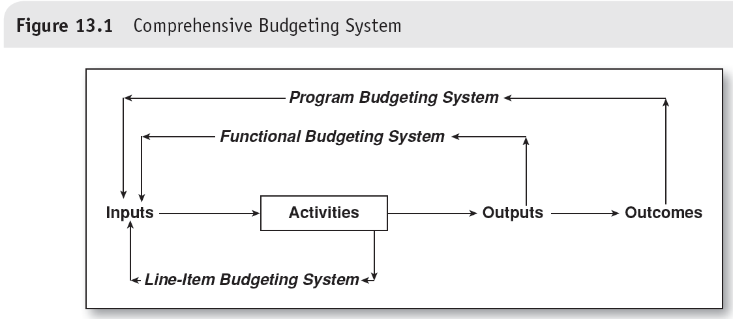
A Comprehensive Budgeting System
The combination of line-item, functional and program budgeting systems provides a comprehensive view of the operation of a human services agency and its programs that no one system can provide

