Slide 1
The Shirt

Slide 2
Introduction
Film is a representative of society
Gender and gender roles are central to film
The Shirt portrays women as strong and protectors
Fits in the category of The Female of the Species

Slide 3
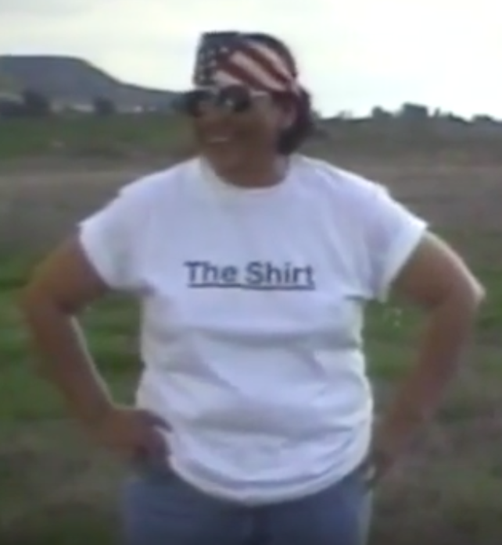
The Shirt: About the film
Produced by Shelley Niro
Released in 2003
Silent Film
The Shirt gives Native people a voice

Slide 4
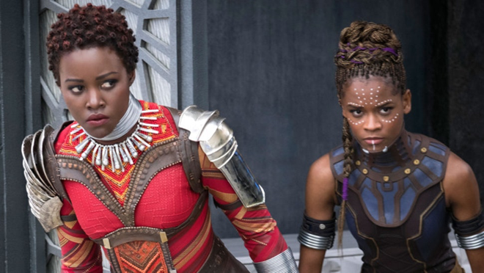
Film Perspective
Women as protectors of society
T-shirt displays various messages
Women are vocal in decrying abuses
Europeans as ruthless killers of
Native Americans

Slide 5
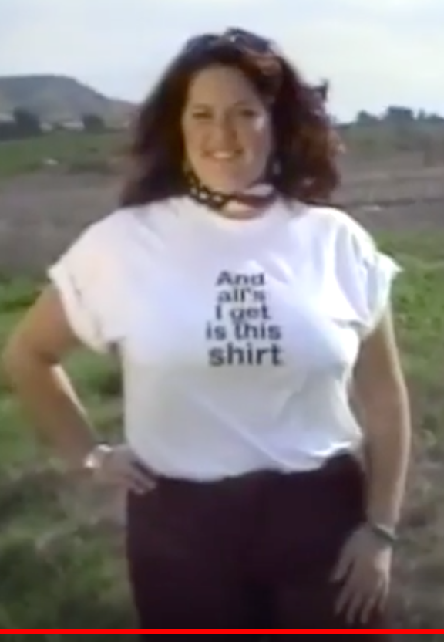
Acting Style
The acting is very strong despite being passive and it’s stoic and it speaks to us not just through the act itself but also the nature in the background speaks to the audience, this land used to belong to them and now it’s not.
The acting shows the audience how native people were literally “stripped” from everything they used to own, the text on the solemn facial expression sets the space for us to think about what these people went through
The final shot shows that even her clothes are taken away by the white people

Slide 6
Cinematography
Sequel of shots
Alternating between message and landscape
Emphasize the value of the people’s heritage
Present time for audience to identify with message

Slide 7
Site design
Indigenous lands, First Nations reserves.
River pan fades revealing electric power transmission towers.
The water represents the transpiring events.

Slide 8
Lighting Design
Continuous lighting
Only day
Juxtaposition of nature and infrastructure

Slide 9
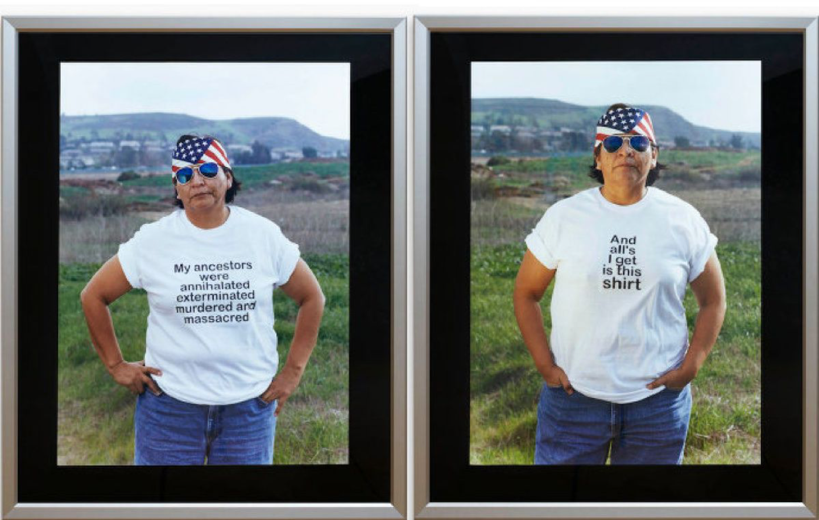
Costume Analysis
In The Shirt, the actress is wearing a single white t-shirt that has a message written on it and a pair of jeans. By the end, the shirt was “taken” away from her by the Anglo-saxon people and she was left with just her jeans.
The message shows what happened to her ancestors during the process of colonization.

Slide 10
Conclusion
Strong statement made by a Native American woman
Position of women as protectors
Confirms the female of the species is deadlier
The shirt speaks out

