Slide 1
Inventory Systems
Brittany Crowe
Colorado Technical University
Inventory & Supply Chain Management
Phase 1 Individual Project

Slide 2
Introduction
In the current world, a company cannot afford to loose any money in their operations (Means, 2017).
Inventory control is necessary for a business to run smoothly.
Notes:
Inventory systems provide an organization with the ability to track the raw materials and supplies required to manufacture a product to meet customer requirements. With the competition from businesses in the current world, organization do everything to make sure they do not loose any money during their daily operations.

Slide 3
Concerns
The main inventory concerns include dead inventory, low product turnover, failure to track product and excess inventory.
These problems are the reason the company has been loosing money.
Notes:
When there is a miscommunication in company departments, there will be something that is not working properly. in this case, the company has been loosing money, and the president does not know the reasons. I accessed the inventory department and discovered some issues that have been draining the company money and leading to loses. They include dead inventory, low product turnover, failure to track products and excess inventory.

Slide 4
Dead Inventory
These are goods that cannot be sold
Some reasons include, out of season, out of style or irrelevant.
A product is termed as ‘dead’ if on the shelf for 12 months.
Notes:
Dead inventory does not refer to products that have expired. This are products that have not been sold for long periods of time because they are out of fashion, out of stock or no longer relevant to the customers. Carrying out a frequent sales report is the best way to identify dead inventory. This way the company can find a way to dispose of the products before they lead to huge losses.

Slide 5
Low Product Turnover
Low product turnover results from low demand
Leads to excessive inventory that wastes space and costs the business
Notes:
The inventory needs to be run properly to benefit the company. low turnover is as a result of poor demand tracking. This way, there is miscommunication about the number of customers that need products. this affects the company through having excessive products in the warehouse. Excessive products will use up space and cost the company losses when liquidating them.

Slide 6
Failure to Track Products
Failure to keep track causes accounting errors
The in charge parties rely on manual processes to keep track.
Accounting errors end up affecting company expenditure.
Notes:
It is not enough to manually track inventory, as there may be unexpected changes. Frequently tracking inventory ensures the company is a ware of any changes such as customer demand, and they adjust accordingly. Failure of properly tracking inventory results to accounting errors that will affect the expenditure as well as profits of the company.

Slide 7
Excess Inventory
This happens when the company orders the incorrect number of products.
It results to storage issues and affects company capability to deliver quality products.
Notes:
When there is a problem with excessive inventory, it takes up the space for new products. this hinders the company from receiving new inventory, hence they cannot meet the needs of customers. Excessive inventory affects profitability of the company as also wastes warehouse space. The company should make sure they have the right orders so that they can clear the inventory and create space for new products.

Slide 8
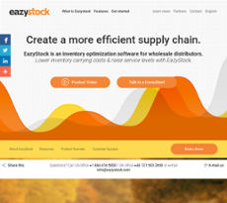
Recommendations
The use of software solutions such as Eazystock (Mourtzis, Doukas & Vandera, 2017).
This would help save time as well as money.
Notes:
Eazystock will help the company stay ahead of all the problems is currently experience. It will be able to see the decrease in stock, frequently track inventory and spot the dead inventory. This would be beneficial for the company as they would free up space in the warehouse and sell all products before they cost the company. Eazystock is up to date with the current business market, therefore would allow the company to stay competitive.

Slide 9
Recommendations (cont.)
Sales is a good way to get rid of excess and dead inventory (Wild, 2017).
It also helps attract new customers
Notes:
Sales is the easiest way to clear out the warehouse and get ready to receive new inventory. The great thing about sales is that they wil help genrate money to the company. The company may not reach their targeted numbers but at least they are not throwing away products to create required space. Sales is also a good way to inform new clients about the company.

Slide 10
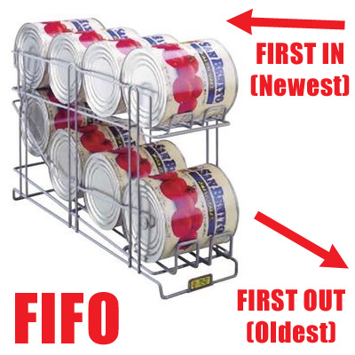
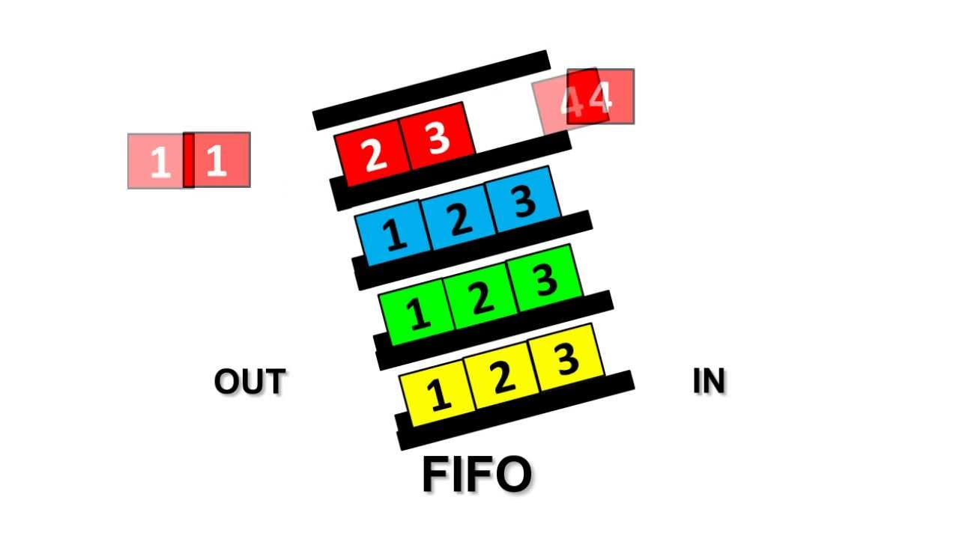
Recommendations (cont.)
Apply the Fist-in-First-out rule on inventory (Chen, Pang & Pan, 2014).
This takes care of excessive, dead and spoilage of inventory.
Notes:
The First-in-First-out rules makes sure that inventory does not pile up in the warehouse. It also helps get rid of products on time and at a fast rate in order to create space. This rule is also a great way to increase on company profits and create room to always meet the needs of customers.

Slide 11
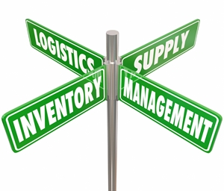
Conclusion
It is normal for business to experience challenges in inventory systems.
Staying focused and coming up with solutions is the best way to survive in the business world.
Notes:
The inventory problems experienced in the company are frequent in all business. A business has to go through challenges at some point. The best way to deal with these issues is acknowledging them and coming up with possible and reliable solutions.

Slide 12
References
Chen, X., Pang, Z., & Pan, L. (2014). Coordinating inventory control and pricing strategies for perishable products. Operations Research, 62(2), 284-300.
Means, G. (2017). The modern corporation and private property. Routledge.
Mourtzis, D., Doukas, M., & Vandera, C. (2017). Smart mobile apps for supporting product design and decision-making in the era of mass customisation. International Journal of Computer Integrated Manufacturing, 30(7), 690-707.

Slide 13
References (cont.)
Wild, T. (2017). Best practice in inventory management. Routledge.

