Slide 1
Chapter 16
Child and Adolescent Health

Slide 2
The Health of a Child Has
Long-Term Implications
Health habits adopted by children and youth profoundly influence their potential to lead healthy, productive lives.
The physical and emotional health of a child plays a pivotal role in the overall development and well-being of the entire family.
Children who are healthy, well-nourished, well cared for at home, and safe and secure in their world achieve a higher potential.

Slide 3
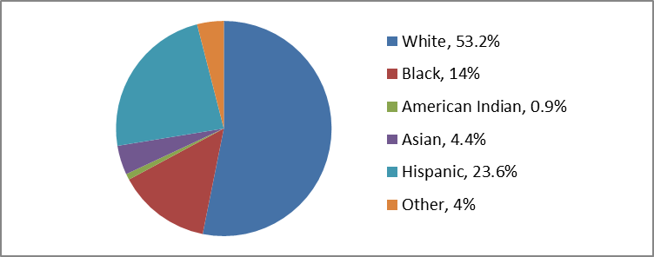
U.S. Children by Race/Ethnicity
Figure 16-1 From Federal Interagency Forum on Child and Family Statistics: America's children in brief: key national indicators of well-being, 2012. www.childstats.gov/americaschildren/demo.asp. Accessed March 8, 2013.

Slide 4
Impact of Pregnancy on a Child’s Health
The health of the mother before, during, and after pregnancy has a direct impact on the health and well-being of her children.
A comprehensive approach is needed to…
  Identify and treat potential risks
  Overcome barriers to good health before, between, and beyond pregnancy
  Protect and promote the health of women and children
  Ensure the health of future generations

Slide 5
Risk Factors
Risks to mother → Risks to baby
Not in optimal health → Poor pregnancy outcome
Uncontrolled medical conditions → Low birth weight with serious medical conditions
Exposure to drug, alcohol, tobacco, poor nutrition → Chronic conditions that affect health and well-being
Unsafe environment (secondhand smoke, lead-based paint) → Chronic conditions throughout childhood and maybe adolescence/adulthood
Risks to Children
No preventive health care and immunizations → preventable diseases or chronic conditions in life

Slide 6
Infant Mortality
Infant mortality reflects the health and welfare of an entire community and is used as a broad indicator of health care and health status.
Infant mortality is related to several factors:
  Maternal health
  Medical care quality and access
  Socioeconomic conditions
  Public health practices

Slide 7
Infant Mortality (Cont.)
Leading causes of infant death in the United States (almost 60% of all infant deaths)
  Congenital defects
  Disorders relating to short gestation and low birth weight
  Sudden infant death syndrome (SIDS)
  Maternal complications of pregnancy
  Accidents such as suffocation
United States ranks 27th in infant mortality among industrialized nations

Slide 8
U.S. Infant Mortality
Has dropped every year since 1940 (not 2002)
Attributable to public health measures and improved standard of living
  Improved sanitation
  Clean milk supply
  Immunizations
  Nutritious food
  Enhances access to maternal health care
Technological advances also contributed
  e.g., synthetic lung surfactant

Slide 9
International Comparisons of
Infant Mortality Rates* (2011)
World Rank | Country | 1960 | 2011
1 | Iceland | 13.0 | 0.9
2 | Sweden | 16.6 | 2.1
3 | Japan | 30.7 | 2.3
4 | Finland | 21.0 | 2.4
4 | Norway | 16.0 | 2.4
6 | Czech Republic | 20.0 | 2.7
7 | Republic of Korea | -- | 3.0
8 | Portugal | 77.5 | 3.1
9 | Spain | 43.7 | 3.2
10 | Belgium | 31.4 | 3.3
*Infant mortality rate represents infant deaths per 1000 live births.

Slide 10
International Comparisons of Infant Mortality Rates* (2011) (Cont.)
World Rank | Country | 1960 | 2011
11 | Italy | 43.9 | 3.4
11 | Greece | 40.1 | 3.4
13 | France | 27.7 | 3.5
13 | Israel | -- | 3.5
13 | Ireland | 29.3 | 3.5
16 | Germany | 35.0 | 3.6
16 | Austria | 37.5 | 3.6
16 | Denmark | 21.5 | 3.6
16 | Netherlands | 16.5 | 3.6
20 | Switzerland | 21.1 | 3.8
*Infant mortality rate represents infant deaths per 1000 live births.

Slide 11
International Comparisons of Infant Mortality Rates* (2011) (Cont.)
World Rank | Country | 1960 | 2011
20 | Australia | 20.2 | 3.8
22 | United Kingdom | 22.5 | 4.3
23 | Poland | 54.8 | 4.7
24 | Slovakia | 28.6 | 4.9
24 | Hungary | 47.6 | 4.9
26 | New Zealand | 22.6 | 5.5
27 | United States | 26.0 | 6.1
28 | Chile | 120.3 | 7.4
29 | Turkey | 189.5 | 7.7
30 | Mexico | 92.3 | 13.6
*Infant mortality rate represents infant deaths per 1000 live births.

Slide 12
Infant Mortality Rates
Figure 16-2 From Murphy SL, Xu J, Kochanek KD: Deaths: Final Data for 2010, National Vital Statistics Report, Vol 61, No.4, May 8, 2013. http://www.cdc.gov/nchs/data/nvsr/nvsr61/nvsr61_04.pdf. Accessed September 3, 2013.

Slide 13
Preterm Birth and Low Birth Weight
Preterm: Birth before 37 weeks of gestation
LBW: Infant born less than 5.5 pounds
Important predictors of infant health
Greater risk of death than full term
Greater risk of mental and physical disabilities
  Cerebral palsy
  Visual problems (e.g., retinopathy of prematurity)
  Feeding problems
  Hearing loss
  Developmental delays

Slide 14
Preterm Birth and Low Birth Weight (Cont.)
Factors associated with preterm and LBW
  Minority status
  Chronic stress
  Maternal age of <17 years and >35 years
  Chronic health problems of mother
  Lack of prenatal care
  Multiple births
  Certain problems with the uterus or cervix
  Low socioeconomic status
  Unhealthy maternal habits
  Induced labor and elective C-section births

Slide 15
Preconception Health
Half of all pregnancies are unintended.
Impact on developing fetal organ systems by:
  Healthy maternal weight and good nutrition
  Tending to chronic maternal diseases
  Being up-to-date on vaccinations
  Avoiding environmental toxins
  Decreasing stress and eliminating abusive relationships
  Avoiding illicit drugs, tobacco, and alcohol

Slide 16
Preconception Health (Cont.)
Preconception counseling as a prevention strategy:
  Effective contraception to avoid unintended pregnancies and pregnancy spacing
  Recommend intake of folic acid daily
  Encourage healthy lifestyle modifications
Prenatal care
Prenatal substance use

Slide 17
Prenatal Care
Early and regular prenatal care enhances chance of a healthy, full-term baby.
  Health education and counseling
  Risk identification
  Monitoring and treatment of symptoms
  Referral to health, nutrition, social services
    Medicaid, WIC, food stamps, smoking cessation services, housing, child care, job training, substance abuse treatment, domestic violence screening and counseling

Slide 18
Prenatal Substance Use
The use of tobacco, alcohol, or illicit drugs in any combination is dangerous to a woman’s health and worsens infant health and development outcomes.
  Smoking is one of the most preventable causes of infant morbidity and mortality
  Alcohol can lead to FAS
  Drugs can cause permanent harm to an unborn baby

Slide 19
Breastfeeding
“Breastfeeding is a natural and beneficial source of nutrition and provides the healthiest start for an infant. In addition to the nutritional benefits, breastfeeding promotes a unique and emotional connection between mother and baby.”
– American Academy of Pediatrics, 2012

Slide 20
Breastfeeding (Cont.)
AAP recommends
  Exclusive breastfeeding for first 6 months
  Breastfeeding in combination with introduction of complementary foods until at least 12 months
  Continuation of breastfeeding for as long as mutually desired by mother and baby
2011Surgeon General’s Call to Action to Support Breastfeeding
  Actions aimed at increasing society support
  Nurses, other professionals, and support groups

Slide 21
Breastfeeding Advantages
Mother
Baby
Lower risk of breast and ovarian cancer
Lower risk of postpartum depression
Lower risk of type 2 diabetes
Saves money on formula
Cells, hormones, and antibodies in breast milk
Lower risk of asthma
Lower risk of obesity
Lower risk of diabetes
Lower risk of SIDS
Fewer illnesses

Slide 22
Sudden Unexplained Infant Death
Definition of SUID
  Less than 1 year of age
  Occurs suddenly and unexpectedly
  Cause of death not immediately obvious before investigation
  Half of SUID are SIDS
Definition of SIDS
  Death cannot be explained after a thorough investigation, including autopsy, examining death scene, and review of clinical history

Slide 23

Sudden Unexplained Infant Death (Cont.)
Back to Sleep campaign (1994)
  Heighten awareness of the safety of positioning infants on their backs for sleep
  SIDS death declined by >50%
Safe to Sleep campaign (2010)
  Included other actions to reduce risks of other sleep-related causes of death (e.g., suffocation)
http://www.nichd.nih.gov/sts

Slide 24
Safe to Sleep Campaign Recommendations
Always place baby on back to sleep for naps and night
Place baby on firm surface with fitted sheet
Not in adult bed, couch, or chair alone or with adults
Keep soft objects, toys, and loose bedding out of sleep area
Do not smoke during pregnancy
Do not allow smoking around baby
Do not let baby get too hot during sleep
Follow vaccine and health check-up recommendations
Avoid advertised SIDS products
Get regular health care during pregnancy
– National Institute of Child Health & Human Development: Safe sleep for your Baby, 2013

Slide 25
Childhood Health Issues
Accidental injury is the leading cause of death in children ages 1 to 14.
Childhood obesity is a health crisis; it can lead to numerous health problems.
Childhood immunization is a benchmark of child health.
Environmental concerns can be found in air, water, and from toxic exposure to chemicals.
Child maltreatment is an indicator of children’s physical and emotional health status.
Children with special health care needs frequently need multiple health care services.

Slide 26

Adolescent Health Issues
Adolescent sexual activity is often unprotected and can result in pregnancy and STIs.
Teen childbearing and parenting often have long-term negative consequences for both child and mother.
Violence among youth is a multifaceted problem.
The use of tobacco, alcohol, and drugs has serious and long-lasting consequences for adolescents and society.

Slide 27

Factors Affecting Child and Adolescent Health
Significant factors in overall well-being:
  Parents’ or caregivers’ income, education, and stability
  Security and safety of the home
  Nutritional and environmental issues
  Health care access and use
Specific issues:
  Poverty
  Racial and ethnic disparities
  Health care use

Slide 28
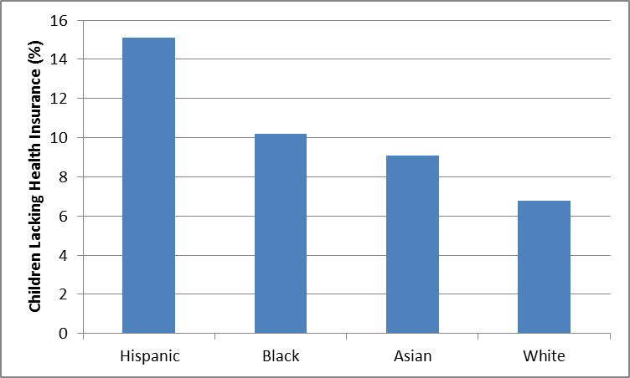
Children Lacking Health Insurance
Figure 16-5 Data from DeNavas-Walt C, Proctor D, and Smith J: Income, poverty, and health insurance coverage in the United States: 2011. U.S. Census Bureau Current Population Reports, September 2012. http://www.census.gov/prod/2012pubs/p60-243.pdf. Accessed March 8, 2013.

Slide 29
Strategies to Improve Child and Adolescent Health
Collect/analyze data tracking well-being of children and adolescents.
Establish goals and set measurable objectives using Healthy People 2020.
Implement health promotion and disease prevention strategies.
  More significant and cost-effective for children than other age groups.
Utilize public health programs targeted to children and adolescents.

Slide 30
Public Health Programs Targeted to Children and Adolescents
Health Care Coverage Programs
  Affordable Care Act
  Medicaid and CHIP
  EPSDT (Early and Periodic Screening, Diagnosis, and Treatment)
Direct Health Care delivery programs
  Maternal and Child Health Block Grant (Title V)
  Community & Migrant Health Centers program
  School-Based Health Centers
  WIC

Slide 31

Sharing Responsibility for Improving Child and Adolescent Health
Parents’ role
Community’s role
Employer’s role
Government’s role
Community health nurse’s role

Slide 32
Community Health Nurse’s Role
An advocate for improved individual and community responses to children’s needs.
A researcher for effective strategies to serve women and children.
A participant in publicly funded programs.
A promoter of social interventions that enhance the living situations of high-risk families.
A partner with other professionals to improve service collaboration and coordination.
Understand the legal and ethical implications of decision making.

Slide 33
Monitoring the Health and Well-Being of Children
Resource | Website address
Centers for Disease Control and Prevention (CDC) | http://www.cdc.gov
Federal Interagency Forum on Child and Family Statistics | http://www.childstats.gov
National Center for Education Statistics (NCES) | http://nces.ed.gov
National Center for Health Statistics (NCHS) | http://www.cdc.gov/nchs
US Bureau of Justice | http://www.ojp.usdoj.gov/bjs
US Bureau of Labor Statistics | http://www.bls.gov
US Census Bureau | http://www.census.gov
USDHHS Healthy People 2020 | http://www.healthypeople.gov

