Slide 1
Patents / Intellectual Property
Anthony Miele

Slide 2
About Me

Slide 3
From Western Massachusetts, attended WNEU for EE

Slide 4
1986 Fall On Campus Interviews
National Security Agency
U.S. Airforce
U.S. Patent and Trademark Office

Slide 5
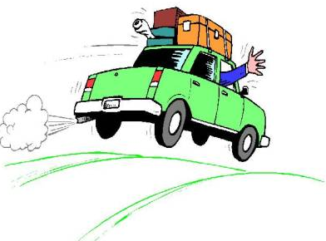
Job Offers May/June 1987
…
…
U.S. Patent and Trademark Office

Slide 6
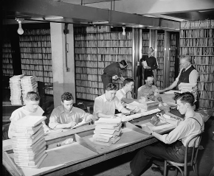
At the US Patent and Trademark Office

Slide 7
System With Sensors and AI to Prevent Collisions
Start business?
Partners, cofounders
Who owns what we create?
How do we protect it?
What about deals?
Exit strategy?

Slide 8
WHAT IS Intellectual Property?

Slide 9
What are the Types of IP?

Slide 10
How are those types of IP created?
Patents
Trademarks
Trade Secrets
Copyrights

Slide 11
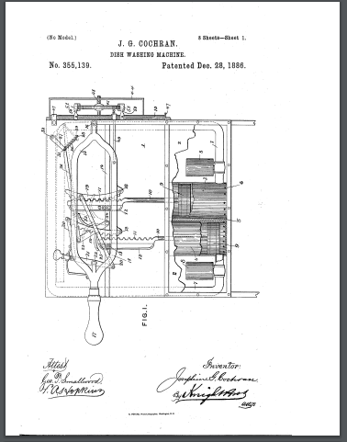
Example old patent to Dishwasher

Slide 12
Example patent claim
1. A dishwasher for treating dishes according to an automatic cycle of operation, the dishwasher comprising: a chassis defining an interior; a tub …
Its a type of definition that acts like a “fence” around the protected invention.

Slide 13
What Rights Do We Have - Can we use our stuff?

Slide 14
Do We Own Our Stuff?
Importance of Agreements and Assignments

Slide 15
We Own It - so now can we use it?

Slide 16
We Own It - So can we stop others from doing same stuff?
Hint: Cross License

Slide 17
Misleading Narratives
The troll narrative

Slide 18
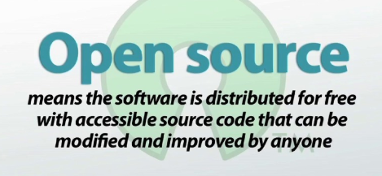
Misleading Narratives
The Open Source Narrative

Slide 19
Advice Summary
“Lock your front door” (Protect your innovations)
Make sure you own what your company’s employees create
Avoid Liability - don’t copy; avoid using patented technology; get own patents
Use Trademarks, Trade Secrets, Patents, Copyrights
May need a License if Want right to use
Right to exclude is a respectable right -- remember - need investors; third party dealings; exit strategies too!!

