Slide 1
International Trade and Imaginary Things
Stephen A. LeMay
University of West Florida

Slide 2
Imaginary Things
This list of items may not seem imaginary, but they are social constructs and dependent entirely on broad belief in their existence and value. In this presentation, we will discuss each idea, its nature, and its relationship to the others.
Nations
Borders
Governments
Money

Slide 3
Nations
Countries like the United States or the Russian Federation exist because they are recognized by their own people and people in other countries. This recognition means that these same people also recognize other imaginary things like borders, governments, and money.
The concept of nation is obviously essential to international business. With no nations, there is no such thing as international business.

Slide 4
Borders
Think about what happens when groups of people disagree about the borders. The Russian Federation took the Crimea from the Ukraine. Russia, as the more powerful country, imposed its will on the Ukraine. The situation was complicated, perhaps, but power governed. People who were Ukrainian and subject to Ukrainian law are now Russian and subject to Russian Federation law. Wars are fought over these imaginary lines.
Borders are not actual lines drawn on the ground. They are legal constructs recognized by one country and its neighbors. They are defined in treaties and by common agreement. They are crucial because they determine which government’s laws apply on a specific plot of land.

Slide 5
Governments
Consider China and Taiwan. China objects to any recognition of Taiwan as a country that is distinct from China, although many people in Taiwan see themselves as Taiwanese, not Chinese. Those countries that challenge China on this point are often subject to economic and political sanctions. This means that Taiwan has trouble creating its own trade agreements because potential trading partners have no desire to offend the much larger, more powerful China.
Governments also exist by agreement. They may be dictatorships imposed by a minority or democracies supported by the population within the country’s borders, but official recognition matters. The recognized government, for example, can designate a person to sign trade agreements. Without official recognition, the signature is meaningless.

Slide 6
Money
Money is also issued by governments. Stable currencies are issued by stable governments. Often, when people lose faith in a government, they also lose faith in the currency it issues. If you look at reserve currencies like the US dollar, the Euro, the Japanese yen, the Swiss franc, and so on, you are also looking at stable governments. These governmental entities rarely change administrations through revolutions. Rather, they change the people in the government by way of legal means, usually those defined in their own constitutions.
Money is fundamentally a tautology, A=A. It is valuable because we value it. It is a giant social agreement. This is true whether you agree that paper is money or that rare metals or rocks are money. What matters is whether people will exchange goods and services for it, not what it is. Money is kept valuable by faith, sort of like clapping to keep Tinkerbell alive in the story of Peter Pan.

Slide 7
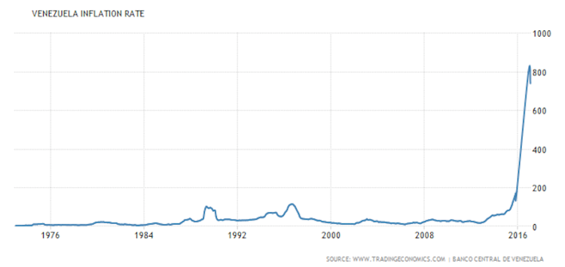
Summary and Examples
Venezuela.
The human imagination is astonishing and our ability to collectively act on imaginary things is even more so. Economies and trade depend entirely on these imaginary things at this point in history.
This image shows the Venezuelan inflation rate. You will find that the inflation rate rises as the stability and effectiveness of the government falls. The government is now in chaos, so the currency is nearly worthless. Consumers must race to the grocery store—if they can find one that’s open—to buy goods before the currency loses more value. Airlines will not let you buy a ticket with Venezuelan currency. It loses value too quickly.

