Slide 1
Frauds, Myths, and Mysteries in Archaeology
What Is Archaeology:
Introduction
Instructors: Dr. Ann M. Raab
&
Dr. Cynthia Jones

Slide 2
What We Will Be Covering:
What is Archaeology?
Big Questions for Archaeology
The Four Fields of Anthropology
What Archaeology Isn’t
A Brief History of Archaeology

Slide 3
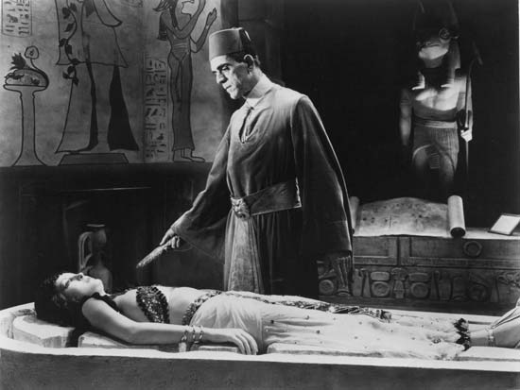
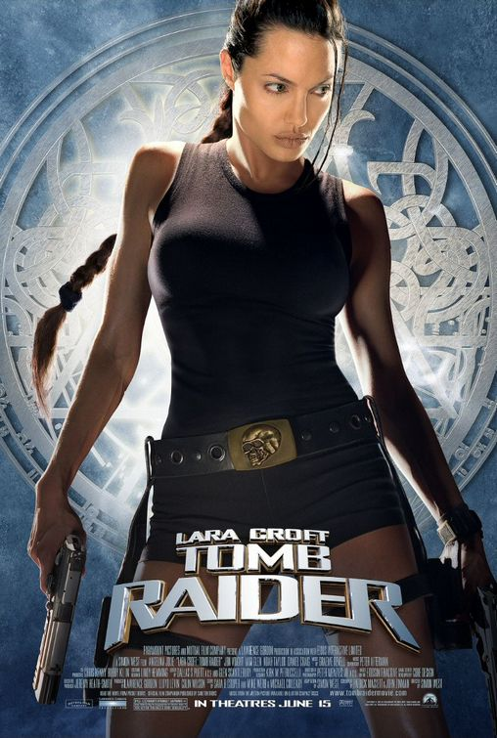
Real archaeology is just Like
this, right?

Slide 4
What Is Archaeology?
“Archaeology is the search for FACTS, not truth. If it’s truth you’re looking for, Prof. Tyree’s Philosophy course is right down the hall…Forget any ideas about lost cities, exotic travel and digging up the world…we do not follow maps to buried treasure and “X” never marks the spot…Seventy percent of all archaeology is done in the library.”
~ Indiana Jones (fictional archaeologist)

Slide 5
What Is Archaeology?
The study of our human past
Combines themes of time and change
Uses material remains that have survived
Focuses on past human behavior and change in society over time

Slide 6
Big Questions for Archaeology
The origin of “humanness” and cultural behavior
Controlled use of fire
Development of hunting
Variation among hunter-gatherer groups
Origins of agriculture and domestication
Rise of complexity and civilizations

Slide 7
How Does Archaeology Answer Those Questions?
Archaeology is the study of material remains from past events. Study of these remains provides a powerful avenue for studying the past
To know our place and to have confidence about where we are going are essential ingredients for the success of our species
However, we cannot study the past directly – we must use the materials which remain with us today
Linking these material remains with past behaviors is the central methodological and procedural concern for archaeology

Slide 8
Anthropology’s Four Fields
In the U.S., archaeology is typically found within a department of anthropology
There are usually four main sub-fields of anthropology:
Cultural (social) anthropology
Biological (physical) anthropology
Linguistic anthropology
Archaeology

Slide 9
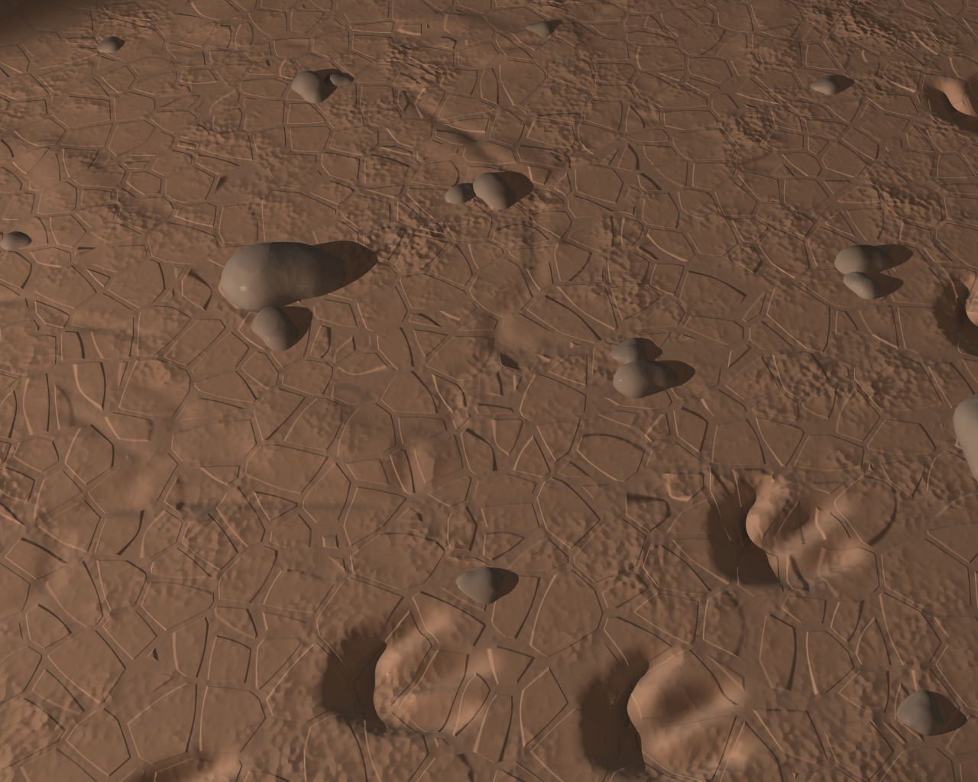
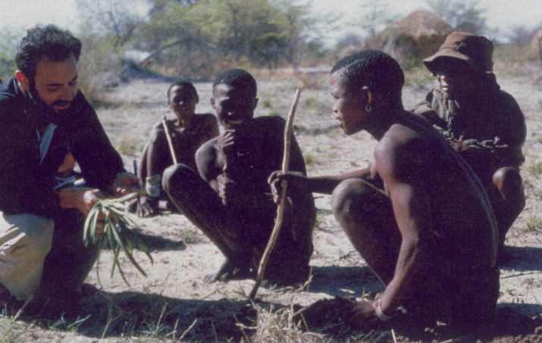
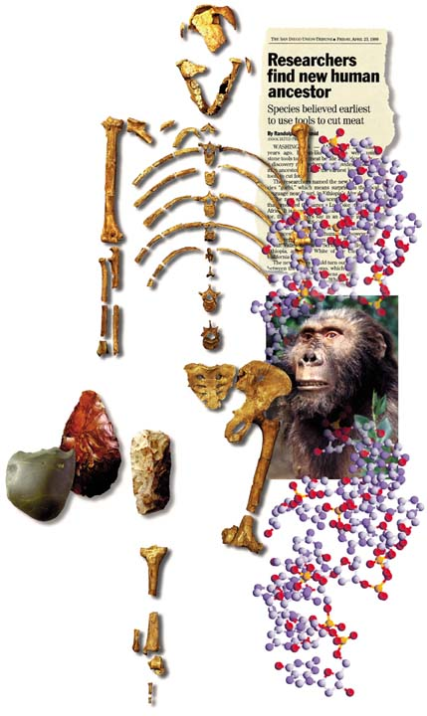
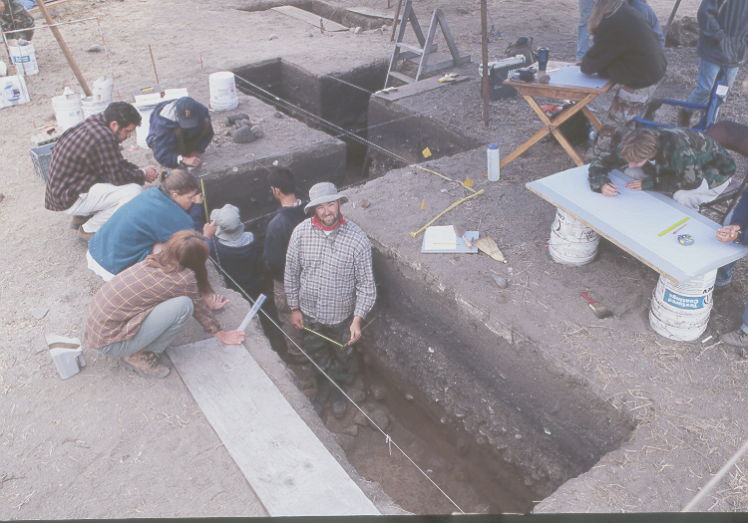
The Four Fields of Anthropology
Cultural Anthropology-
Study of the origins & variability
of cultural beliefs & practices of
living societies, including our own.
Anthropological Linguistics-
Study of the origins & cultural roles of language.
Physical Anthropology-
Biological Anthropology, including
human origins & evolution.
Archaeology-
Study of the cultural origins
& variation based on material
evidence.

Slide 10
What Is Archaeology?
Within the field of archaeology, there are further divisions:
Prehistoric: Study of material remains from people/cultures in existence before written history
Classical: Mostly concerned with the literate Mediterranean civilizations of Greece and Rome
Historical: In the United States, refers primarily to the archaeology of the civilizations of the recent industrial era, since about 1700 or so
Regardless of the subject matter, the goals, tools and approaches of archaeology are the same.

Slide 11
What Archaeology Isn’t
Following scientific objectives, archaeologists have rejected mystical, self-serving and pseudo-scientific theories, including the occult, romantic primitivism, other-worldly contacts and pseudo-historical events.

Slide 12
Mysticism and the Occult
Pseudo-history and the supernatural
Archaeology does NOT study:
Lost continents and peoples
Space aliens and ancient civilizations
Ancient knowledge, power and healing
Communicating with the dead

Slide 13
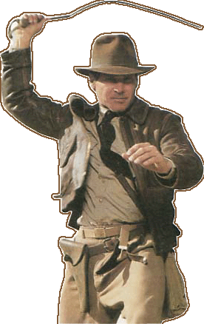
Archaeological Adventurism
Fun but false stereotypes
The “Lone Wolf” archaeologist
Tomb raiders
- Artifact collectors
Most modern archaeologists
work with teams of researchers.
Many work in corporate settings.
Most countries today require permits
and research designs to look for or
excavate archaeological sites.
Most professional archaeologists do not have
personal collections of artifacts. Private
collecting is one of the greatest threats to
archaeology in the modern world.
Archaeologists condemn “pot hunting”
(looting archaeological sites).

Slide 14
A Brief History of Archaeology
Archaeology vs. Antiquarianism
While the fundamental goal of archaeology today is information, not objects, early archaeologists could more accurately be defined as “Antiquarians”
Antiquarian: Originally, someone who studied antiquities (that is, ancient objects) largely for the sake of the objects themselves – not to understand the people or culture that produced them
The Renaissance stimulated interest in ancient Mediterranean art and culture, including Greece, Rome and Egypt, and some excavation was done, but not much
European museum building drove the quest for collecting antiquities

Slide 15
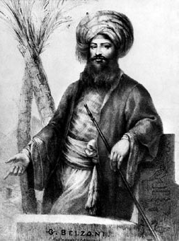
Giovanni Battista Belzoni: Genteel Antiquarian
One of the earliest antiquarians
Circus strongman with knowledge of hydraulics, stuck in Egypt to become pillager
Used destructive methods, but took notes, made illustrations and observations
Interest in what ancient “things” had to tell is the beginning of the science of archaeology

Slide 16
Jens Jacob Asmussen Worsaae: Professional
Native of Denmark (1821-1885), fascinated by artifacts
Received informal training from Christian Thomsen (1788-1865) who devised the typological scheme of Stone Age, Bronze Age, and Iron Age
Introduced inquiry into archaeology: excavating to answer questions
Demonstrated existence of middens, or trash heaps
Documented potsherds, or fragments of pottery, along with charcoal, bones, and stone implements

Slide 17
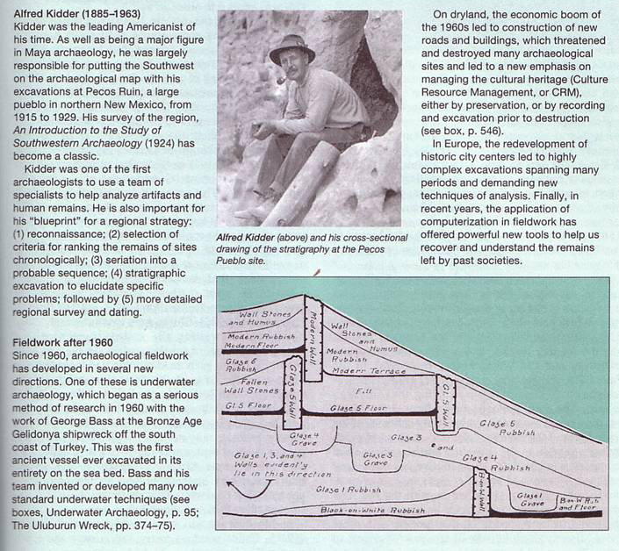
Alfred Vincent Kidder (1885-1963)
Founder of Anthropological Archaeology
Using potsherds, explained how ceramic decoration could help determine cultural relationships among various prehistoric groups
Established archaeology as “the branch of anthropology which deals with prehistoric peoples”: from things to people
American Southwest Pecos Pueblo, New Mexico
Maya ruins of Central America

Slide 18
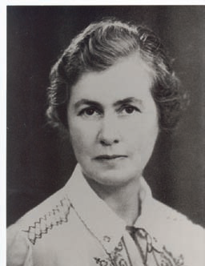
Gertrude Caton-Thompson (1888-1985)
Advanced archaeology, intellectually
Studied settlement patterns: excavated a village site in Egypt
Conducted interdisciplinary work: surveyed the northern Fayum Desert in Egypt, working with a geologist
Reconstructed the sequence of settlements
Established their relationship to ancient lake levels
Established the importance of site stratigraphy, a site’s physical structure produced by the deposition of geological and/or cultural sediments into layers, or strata, to reveal age and original inhabitants

Slide 19
Archaeology at Mid-20th Century
Transcending mere cultural chronologies by classifying artifacts and sorting out patterns in space and time
Culture history, or documenting how material culture changed over time and space, to produce in depth reconstructions of prehistory

Slide 20
Culture History
The kind of archaeology practiced in the early to mid-twentieth century.
It “explains” differences or changes over time in artifact frequencies by positing the diffusion of ideas between neighboring cultures or the migration of a people who had different mental templates for artifact styles.

Slide 21
V. Gordon Childe (1892-1957)
Wrote “The Dawn of European Civilization” and “The Neolithic Revolution”
His work was firmly rooted in culture-history
Artifacts may define a culture, but they don’t describe it
Saw two revolutions:
Neolithic (agricultural) revolution
Urban revolution
The great changes in the archaeological record are evidence of changes in society

Slide 22
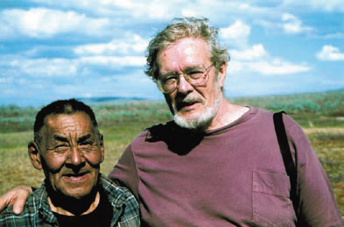
Lewis R. Binford
Recognized need to:
address cultural evolution, ecology, and social organization
make use of scientific methods and quantitative techniques
scrutinize firsthand the operation of disappearing cultural adaptations
“New Archaeology,” or emphasis on the understanding underlying cultural processes and the use of the scientific method; sometimes called processual archaeology

Slide 23
Archaeology in the 21st Century
A very multi-disciplinary endeavor
Competing theoretical paradigms, but overall a scientifically-based discipline
The technology of archaeology is improving significantly
Excavation
Non-invasive survey
Dating methods

