Slide 1
HR Management Text
Chapter 3:
Providing Equal Opportunity &
A Safe Workplace
Updated Legal & Case Notes

Slide 2
Introduction
In the United States, the federal government has set some limits on how an organization can practice human resource management.
Among these limits are requirements intended to:
  Prevent discrimination in hiring and employment practices
  Protect the safety and health of workers while they are on the job
Companies that skillfully navigate the maze of regulations can gain an advantage over competitors.
The next slides cover current legislative initiatives.

Slide 3
The Regulation of HR Management
All three branches of the government play an important role in creating a legal environment for human resource management.
  Legislative
    Two houses of Congress
    Enacted laws governing HR activities
  Executive
    Includes many regulatory agencies & Executive Orders
    Enforces laws passed by Congress
  Judicial
    Federal court system
    Interprets law
    Holds trials
Learn the basic details of the law from chart: Noe text pg 59.

Slide 4
Employee Rights & Relations
Negligent Hiring
  Employers responsible for thorough background check
Immigration Reform & Control Act (1986)
  Assure that applicants are legally qualified to work in US (I-9 forms)
Employment-at-will: Unless specified in a contract, employer may end employment relationship at any time w/o cause.
  Exceptions: contract (explicit or implied), public policy violation (ask to perjure), breach of good faith (avoid paying bonus)
Also - Drug Testing , Polygraphs, Closures

Slide 5
Employment Law Update
Association of Corporate Counsel
Recurring Themes
  Co-employment / Joint Employer Liability
  Impact of Recent NLRB Decisions
  Proliferation of State Laws
  Increased Agency Enforcement & Systemic Initiatives
What does this all mean and what should we be doing?

Slide 6
Wage and Hour Legal Trends Update
Wage & Hour Issues
  Wage & Hour claims represent over 90% of the employment class actions filed every year
  Federal wage & hour lawsuits filed nationally have increased more than 400% since 2000, with a record high in 2015 of 8,781
Employee Misclassification
  Exempt v. Non-Exempt Status
      New White Collar Exemption Regulation
  Resulting in the failure to pay overtime wages, failure to provide meal and rest breaks, and to account for off-the-clock work
Expansion of joint employer liability
Pay Practices Issues Continue to Evolve at the State & Local Level
Arbitration with Class Action Waiver to the Rescue?

Slide 7

White Collar Exemptions
Salary basis test:
  Employee must be paid a predetermined and fixed salary that is not subject to reduction because of variations in the quality or quantity of work performed.
Salary level test:
  The amount of salary paid must meet a minimum specified in the regulations.
Duties test:
  Primary duties must involve executive, administrative, or professional duties, as defined in regulations.
Rationale for white collar exemptions:
Typically earn salaries well above the minimum wage and enjoy other privileges that compensate them for longer work hours—fringe benefits, job security, advancement.
Work cannot be dispersed easily to other workers.
Notes:
Currently $455 per week ($23,660 per year)
NY--$675 per week ($35,100)
Highly Compensated Employees--$100,000
Does not apply to lawyers, doctors, teachers, or outside sales

Slide 8
Changes: Salary Level Will Increase
New salary level for White Collar Exemptions: equal to the 40th percentile of weekly earnings for full-time salaried workers based on BLS data:
  $913 per week or $47,476 a year.
  BLS began tabulating data in 2015 at the request of the DOL.
New salary level for Highly Compensated Exemption: equal to the 90th percentile of earnings for full-time salaried workers based on BLS data:
  Final Rule is $134,004 per year--$2,577 per week.
  HCE only requires employee to have one exempt duty, effectively amounting to anyone making more than $134,004 is exempt.

Slide 9
Who are Contingent Workers?
Anyone your organization engages to perform work but who is not your organization’s employee.
Includes
Independent Contractors
  Consultants; Technical experts
  You pay them directly, frequently by 1099
Other Employer’s Employees
  Staff augmentation; Outsourced labor
  You pay a third-party supplier

Slide 10
What Should Companies Do Now?
Assess your outsource staffing arrangements
Do you have control? Right to control?
Are there indicia of common law employment?
Assess your risks
Is there a bargaining unit risk?
Is there an ACA employer mandate risk?
Is there a risk of liability for employment practices?
Take responsive actions
Can you achieve similar results without control (or right of control)?
Can you negotiate indemnifications with your labor suppliers?

Slide 11
What’s New: NLRB Year in Review
ELECTIONS
  Authorization Cards. Actual signatures no longer needed to support petitions for election.
Bargaining Units – Joint Employer Units. Employees of staffing companies and their customers may be joined together in a single bargaining unit (Miller & Anderson, 364 NLRB No. 39 (2016)).
Continued Application of NLRB’s “Quickie Election Rule”
  NLRB’s revised election procedures decreasing the amount of time between petition to election have been in effect for nearly 18 months
  In the first year, average time from petition to election was decreased from 38 days to 24 days. Union win rates in initial certification elections have not increased, however, and continue to hover around 70%.

Slide 12
DOL’s 2016 FMLA Employer’s Highlights
https://www.dol.gov/whd/fmla/employerguide.pdf
Very user-friendly comprehensive discussion of employer obligations.
Generally nothing “new” but good resource.
DOL emphasizes that managers and HR must be able to recognize FMLA-qualifying reasons for leave and properly initiate required notifications and eligibility check – employee need not make formal FMLA leave request to trigger employer obligations.
A number of cautions to employers about actions that can constitute unlawful interference, such as:
  Requiring excessive proof of family relationship or in loco parentis status
  If a medical certification is complete, employer may not ask for more medical information or require a doctor’s note for each absence

Slide 13
Highlights from FMLA Pro-Employer Opinions
Issues regarding “interference” with FMLA rights
Employer’s intent is immaterial to an FMLA interference claim and Employer can interfere by discouraging an employee from taking an FMLA leave.
An employee’s voluntary and uncoerced acceptance of a light duty assignment while recovering from a serious health condition does not constitute interference.
Nondisruptive “de minimis” communications such as short phone calls requesting the employee to pass on institutional knowledge are not interference but requiring the employee to complete work-related tasks or produce work product may be interference.
Failure to comply with call-in procedures. Termination for “excessive absences” is not FMLA interference even though absences may have qualified for FMLA protection but employee did not follow call-in procedures and there were no “unusual circumstances” excusing her.

Slide 14
EEOC 2016 Employer’s Guide: Leaves Highlights
  https://www.eeoc.gov/eeoc/publications/ada-leave.cfm
  Employers must consider unpaid leave as a reasonable accommodation so long as it does not create undue hardship – even if employee is not eligible for leave under the FMLA or other law or policy or has exhausted FMLA or other leave.
  “Maximum leave policies” may be permissible but employers must grant exceptions when necessary as an accommodation. (EEOC v. Lowe’s $8.5 million settlement for inflexible leave policy 05/2016)
  “100% healed policies” not allowed. Employer must engage in individualized analysis to determine whether or not employee can return to work with a reasonable accommodation without causing an undue hardship or resulting in a direct threat to the safety of the employee or others.
  Reassignment is a potential accommodation. Employer must place a disabled employee in a vacant position for which he or she disqualified and cannot require the employee to compete with other applicants for the open position. This rule does not apply to promotions or negate uniform seniority systems.
  Factors that may be considered in evaluating undue hardship include: (1) frequency of leave; (2) flexibility on when leave may be taken; (3) Whether intermittent leave is predictable or unpredictable; (4) impact on a company’s operations.
  Indefinite leave is not a reasonable accommodation.

Slide 15
Pregnancy Accommodations
Pregnancy itself is not a disability – however, complications caused by pregnancy can be.
Pregnancy Discrimination Act: prohibits discrimination but fall short of requiring accommodation in all cases.
Young v. UPS: Complicated ruling. Employer not absolutely required to offer same accommodation to pregnant employees that it offers to non-pregnant employees -- but must have a good reason for not doing so.
State laws: Many states have – or are adopting – laws requiring pregnancy accommodations:
  Most recent: Colorado; Ohio (bill pending).
  Also: RI; Illinois; DE; NY; Alaska (public sector only), CT; LA; TX (public sector only); MD; NJ; Dist. Col.; Minn.; WV; Nebraska; ND; Hawaii; Utah; Philadelphia.
EEOC v. Motel 6 (8/31/16) The EEOC filed suit after Motel 6 place pregnant employee with high risk pregnancy on forced leave of absence. (https://www1.eeoc.gov//eeoc/newsroom/release/8-31-16.cfm?renderforprint=1) .

Slide 16
Jurisdictions That Have Paid Sick Leave Laws
States | Cities | Counties/Districts/Territories
California Connecticut Illinois (effective 1/1/17) Massachusetts Oregon Vermont (effective 1/1/17) | California: Emeryville, Los Angeles, Oakland, San Diego, San Francisco, Santa Monica Illinois: Chicago Minnesota: Minneapolis New Jersey: Bloomfield, East Orange, Elizabeth, Irvington, Jersey City, Montclair, Newark, New Brunswick, Passaic, Paterson, Plainfield, Trenton New York: New York City Pennsylvania: Philadelphia Washington: Seattle, Spokane, Tacoma | District of Columbia Puerto Rico Montgomery County (MD)
Paid sick leave laws are also being considered in Alaska, Arizona, Chicago, Florida, Hawaii, Louisiana, Maryland, Michigan, St. Paul (Minnesota), Nebraska, Nevada, New Hampshire, New Jersey, New York, North Carolina, Pennsylvania, South Carolina, South Dakota, Virginia, Washington, and West Virginia. In addition, the U.S. Department of Labor has issued a proposal that requires federal contractors and subcontractors to provide workers with seven days of paid sick leave on an annual basis for contracts starting on 1/1/17.

Slide 17
Jurisdictions That Have Paid Family Leave Laws
States | Cities | Pending legislation
California New Jersey New York Rhode Island Washington (unfunded) | San Francisco | Massachusetts Connecticut District of Columbia
The latest trend: Employers offering their own paid Family Leave Programs if when not legally required. Examples: Facebook; Netflix; Hilton; Patagonia; Etsy; Bank of America; Johnson & Johnson Paid Family Leave was the topic of several speeches at the 2016 DNC.

Slide 18
The EEOC
Continues The Hunt for Systemic Discrimination
Targeting widespread patterns or practices of discrimination
Started in 2005 with its Systemic Discrimination Task Force
One Charge can Launch into a Class Action
Respond to every charge knowing that the EEOC is looking for more
EEOC requests are getting broader and more onerous
Issues New Standards For Investigations
Submissions to be made via Internet Portal (this has unexpected but significant effects);
EEOC will share your position statement with Charging Party (don’t expect the same in return);
Specific requirements for submitting confidential information;
Extensions of time to respond more limited, closely scrutinized;
Stricter scrutiny of position statements that are generalized or fail to provide supporting documents; EEOC specifies certain information expected -- but beware of systemic initiative!
Proposal to Collect Pay Data
Adds “W-2 earnings” and work hours for all employees to EEO-1 reports in 2017
    Reported by race and gender in 12 pay bands in 10 EEO-1 categories
    Reporting burden will increase by 1,933%
EEOC and OFCCP will use pay data for targeted systemic pay investigations
EEOC will publish pay data by industry and geography for employers to “benchmark” against
    Who else can use the pay data? Unions, plaintiffs’ counsel, competitors, the press . . .

Slide 19
Areas of Particular Enforcement:
Transgender Claims
Key Concepts
SEX
SEXUAL ORIENTATION
GENDER IDENTITY
GENDER EXPRESSION

Slide 20
New OSHA Developments
Reporting of workplace accidents
Electronic record-keeping
New Anti-Retaliation Provisions
Post-accident Drug & Alcohol testing
Safety Incentive Programs
New whistleblower investigations manual
Increases in penalties

Slide 21
 | Federal Equal Pay Laws vs. State Laws: Key Differences
 | California Fair Pay Act | New York Fair Pay Act | Massachusetts Pay Equity | Federal Equal Pay Act | Title VII
Comparator | “Substantially similar work” | “Equal work” | “Comparable character” or “comparable operations” | Equal work | No requirement of substantially equal work; not limited to gender; covers all protected classes
Same Establishment Defense | No | Same geographic region, no larger than a county | No | Yes | No
Wage Difference to Be Explained | “Entire” wage difference | No express “entire” difference requirement | No express “entire” difference requirement | No express “entire” difference requirement | No “entire” difference requirement
Affirmative Defenses | Narrows definition of “bona fide factor other than sex” -must be “job-related” and “consistent with business necessity” | Narrows definition of “bona fide factor other than sex” -must be “job-related” and “consistent with business necessity” | Seniority | Seniority, merit, quantity or quality of production, or a factor other than sex | Legitimate, non-discriminatory basis for pay differential
Damages | Wage differential, including interest thereon, equal amount of liquidated damages, attorney’s fees and costs | Wage differential, liquidated damages up to 300%, attorneys’ fees and costs | Wage differential, equal amount of liquidated damages, attorneys’ fees and costs | Wage differential, liquidated damages, attorneys’ fees and costs | In addition to other relief provided under Title VII, back pay for up to two years prior to the Charge.
Statute of Limitations | Three years | Six Years | One year | Three Years | 360/180 days for Charge **but Ledbetter Fair Pay Act applies

Slide 22
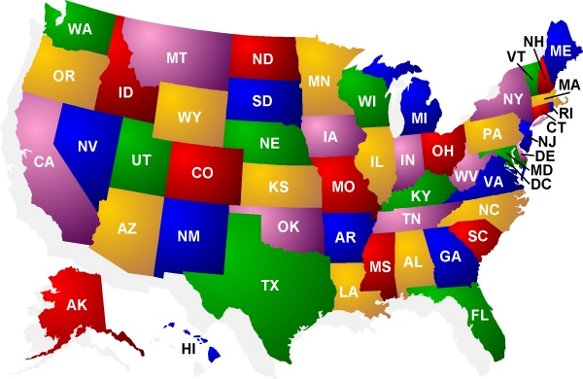
What to Look for in 2017
In general, states—and localities—have been legislating where the federal government has not, including with respect to
Paid Sick Leave
Fair Pay
Criminal Background Checks
Parental/Family Leave
Generally, seeing an expansion of employee rights.

Slide 23
EEO
Equal Employment Opportunity: The condition in which all individuals have an equal chance for employment regardless of their race, color, religion, sex, disability, or national origin.
This EEO “condition” is created through:
  Constitutional amendments
  Legislation
  Executive orders
  Court decisions
Notes:
Equal employment opportunity is the condition in which all individuals have an equal chance for employment regardless of their race, color, religion, sex, disability, or national origin.
The federal government’s efforts to create equal employment opportunity include:
Constitutional amendments
Legislation
Executive orders

Slide 24
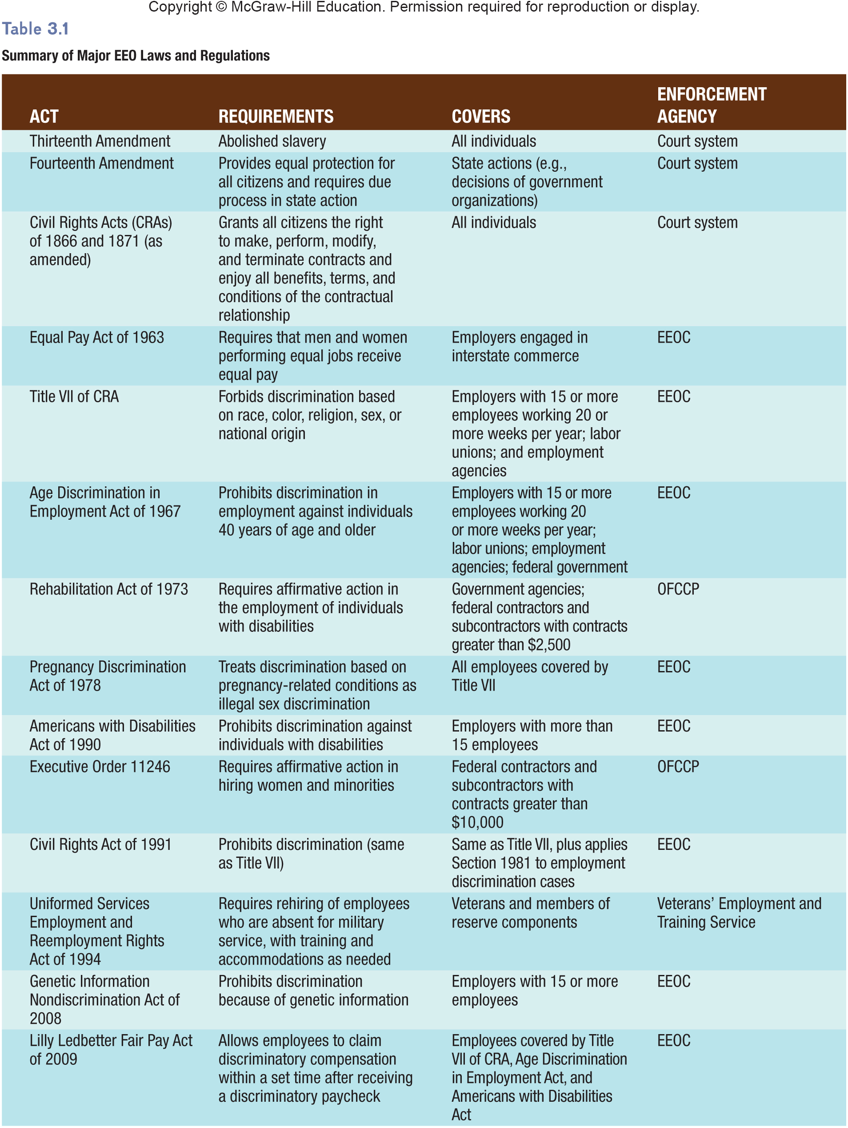
Table 3.1
Summary of Major EEO Laws and Regulations
Notes:
Table 3.1 summarizes major EEO laws discussed in Chapter 3 and in this presentation. These are U.S. laws. Equal employment laws in other countries may differ.

Slide 25
Major National Employment Legislation
Congress has passed laws designed to provide equal opportunity and in later years has passed additional laws that have extended EEO protection more broadly.
  Title VII of the Civil Rights Act of 1964
  Equal Employment Opportunity Commission (EEOC -1972)
  Age Discrimination in Employment Act (ADEA)
  Vocational Rehabilitation Act of 1973
  Pregnancy Discrimination Act of 1978
  Americans with Disabilities Act of 1990
  Civil Rights Act of 1991
  Fair Labor Standards Act 1938
  Equal Pay Act of 1963
  Uniformed Services Employment and Reemployment Rights Act of 1994
  Occupational Safety & Health Act (OSH Act)

Slide 26
EEO: Constitutional Amendments
Thirteenth
Amendment
Fourteenth
Amendment
Abolished slavery in United States.
Has been applied in cases where discrimination involved symbols and incidents of slavery.
Forbids states from taking life, liberty, or property without due process of law.
Prevents states from denying equal protection of discrimination.
Applies to decisions or actions of government or private groups.
Notes:
For example, a person could file a claim under the Fourteenth Amendment if he or she had been fired from a state university (a government organization) but not if the person had been fired by a private employe.r

Slide 27
EEO: Legislation
Civil Rights Acts
(1866 & 1871)
Equal Pay Act (1963)
Civil Rights Act of 1866 granted all persons same property rights as white citizens.
Civil Rights Act of 1871 granted all citizens right to sue in federal court if they feel they have been deprived of some civil right.
Men and women in an organization doing the same work must be paid equally.
Equal is defined in terms of skill, effort, responsibility, and working conditions.
Notes:
Under the Equal Pay Act of 1963, pay differences are allowed if they result from differences in seniority, merit, quality or quantity of production, or any factor other than gender (such as work shift differentials). However, the act allows for reasons why men and women performing the same job might be paid differently. If the pay differences result from differences in seniority, merit, quantity or quality of pro- duction, or any factor other than sex (such as participating in a training program or working the night shift), then the differences are legal.

Slide 28
EEO: Legislation
Title VII Civil Rights Act (1964)
Age Discrimination in Employment Act (ADEA)
Prohibits employers from discriminating based on:
        Race
        Color
        Religion
        Sex
        National origin
Applies to organizations that employ 15 or more.
Prohibits discrimination against workers who are over the age of 40.
Age discrimination complaints make up a large percentage of complaints filed with EEOC.
Notes:
Title VII is the major law regulating EEO in the United States. The law is enforced by the Equal Employment Opportunity Commission (EEOC), an agency of the Department of Justice. ADEA was originally enacted in 1967 and has been subsequently amended. Similar to Title VII, the ADEA outlaws hiring, firing, setting compensation rates, or other employment decisions based on a person’s age being over 40. To defend against claims of discrimination, one practical way is to establish performance-related criteria for layoffs, rather than age- or salary-related criteria

Slide 29
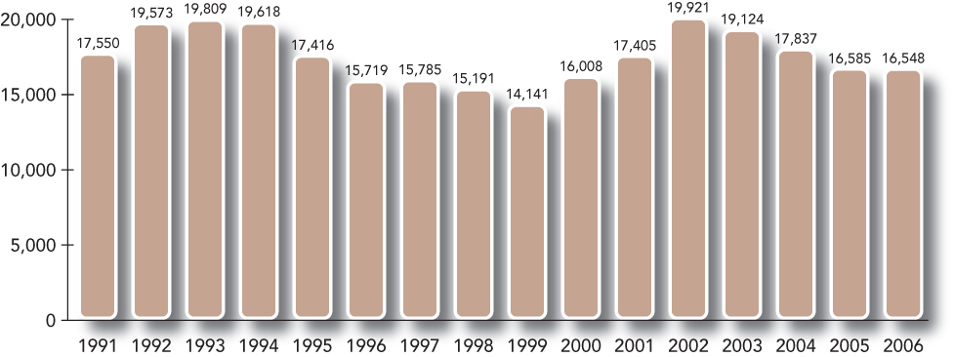
Age Discrimination in Employment Act (ADEA)
  Outlaws discrimination in employment decisions based on a person’s age (over 40).
  ….whether it’s intentional or not.
  Age Discrimination Complaints 1991-2006
McGraw-Hill/Irwin
Notes:
In a recent Supreme Court case (2005), the court ruled that workers who are 40 and older may sue employers for employment decisions that affect them differently than younger workers, whether or not the employers intended any harm. Therefore, the number of ADEA cases may increase in the next several years. Here are the numbers from 1991 to 2004….. Go to next slide

Slide 30
ADEA in U.S. SUPREME COURT
Meacham v. Knolls Atomic Power Laboratory (June 19, 2008)
Under ADEA employer bears burden of persuasion on “reasonable factors other than age” (RFOA) defense
Plaintiff still retains burden to isolate and identify specific employment practices responsible for alleged disparities
Documentation to establish RFOA is essential

Slide 31
EEO Legislation
Vocational Rehabilitation Act (1973)
Vietnam Era Veteran’s Readjustment Act (1974)
Covered organizations must engage in affirmative action for individuals with disabilities.
Employers are encouraged to recruit qualified individuals with disabilities and make reasonable accommodations to them.
Requires federal contractors and subcontractors to take affirmative action toward employing veterans Vietnam War veterans.
Covers veterans who served between August 5, 1964 and May 7, 1975.
Notes:
Vocational Rehabilitation Act of 1973 was intended to enhance employment opportunities for individuals with disabilities. The act covers executive agencies, contractors, and subcontractors that receive more than $2,500 annually from the federal government. Vietnam Era Veteran’s Readjustment Act of 1974 requires federal contractors and subcontractors to take affirmative action toward employing veterans of the Vietnam War (those serving between August 5, 1964, and May 7, 1975). Congress intended this act to encourage employers to recruit qualified individuals with disabilities and to make reasonable accommodations to all those people to become active members of the labor market. Department of Labor’s Employment Standards Administration enforces this act

Slide 32
Affirmative Action
An organization’s active effort to find opportunities to hire or promote people in a particular group. Affirmative action may correct past discrimination, but quota-based activities can result in charges of reverse discrimination.

Slide 33
EEO Legislation
Pregnancy Discrimination Act (1978)
Americans with Disabilities Act (ADA) of 1990
Defines discrimination on the basis of pregnancy, childbirth, or related form of medical condition to be a form of illegal sex discrimination.
Benefits, including health insurance, should cover pregnancy and related medical conditions in the same way as other medical conditions.
Protects individuals with disabilities from being discriminated against in the workplace.
Prohibits discrimination based on disability in all employment practices.
Employers must take steps to accommodate individuals covered by the act.
Notes:
Pregnancy Discrimination Act of 1978 is an amendment to Title VII of the Civil Rights Act of 1964. ADA prohibits discrimination based on disability in all employment practices. The ADA defines disability as a physical or mental impairment that substantially limits one or more major life activities, a record of having such an impairment, or being regarded as having such an impairment. For example, an employer may not refuse to hire a woman because she is pregnant. Decisions about work absences or accommodations must be based on the same policies as the organization uses for other disabilities. Benefits, including health insurance, should cover pregnancy and related medical conditions in the same way that it covers other medical conditions

Slide 34
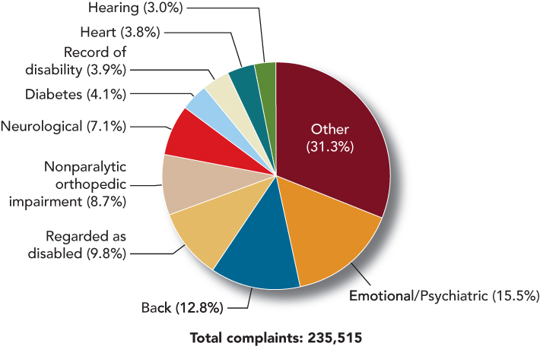
Disabilities Associated with Complaints
Filed under ADA
McGraw-Hill/Irwin

Slide 35
EEO Legislation
Civil Rights Act (1991)
Uniformed Services Rights Act
Adds compensatory and punitive damages in cases of discrimination under Title VII and ADA.
Amount of punitive damages is limited by the act and depends on size of the organization charged with discrimination.
Employers must reemploy workers who left jobs to fulfill military duties for up to five years.
Should be in the job they would have held if they had not left to serve in the military.
Notes:
The Civil Rights Act of 1991 broadened the relief available to victims of discrimination. One major change in EEO law under CRA 1991 has been the addition of compensatory and punitive damages in cases of discrimination under Title VII and the ADA. Punitive damages are a punishment. Compensatory damages include such things as future monetary loss, emotional pain, suffering, and loss of enjoyment of life.
Uniformed Services Employment & Reemployment Rights Act (USERRA) of 1994 Under this law, employers must reemploy workers who left jobs to fulfill military duties for up to five years. When service members return from active duty, the employer must reemploy them in the job they would have held if they had not left to serve in the military, providing them with the same seniority, status, and pay rate they would have earned if their employment had not been interrupted. Disabled veterans also have up to two years to recover from injuries received during their service or training, and employers must make reasonable accommodations for a remaining disability.
The act requires employers to reemploy service members in the job they would have held if they had not left to serve in the military.
Why is this act important?

Slide 36
Genetic Information
Nondiscrimination Act of 2008 (GINA)
Employers may not use genetic information in making decision related to terms, conditions, or privileges of employment
Includes a person’s genetic tests, genetic test of the person’s family members, and family medial histories
Forbids unintentional collection of this data
Forbids harassment of employee because of genetic information
Notes:
Because the developments in the fields of genetics and medicine, more is known about genes associated with risks for developing particular diseases. This is helpful for individuals who can begin to take precautions but raises concerns that employers could use this information when making employment-related decisions. The Genetic Information Nondiscrimination Act of 2008 prohibits these actions by employers. Specifically,
Employers may not use genetic information in making decision related to the terms, conditions, or privileges of employment
Includes a person’s genetic tests, genetic test of the person’s family members, and family medial histories
Forbids unintentional collection of this data
Forbids harassment of employee because of genetic information

Slide 37
Executive Orders
Executive order 11246
Prohibits federal contractors from discriminating based on race, color, religion, sex, or national origin
Required Affirmative Action: Active effort to find opportunities to hire or promote people in a particular group
Executive order 11478
Fed. govt cannot discriminate based on race, color, religion, sex, or national origin
Notes:
Executive order 11246 – Lyndon Johnson
Prohibits federal contractors from discriminating based on race, color, religion, sex, or national origin
Required Affirmative Action: Active effort to find opportunities to hire or promote people in a particular group
Affirmative action applies to federal contractors who receive more than 10,000 and over $50,000 they must have a written AA plan.
Executive order 11478 – Richard Nixon
Federal government cannot discriminate based on race, color, religion, sex, or national origin

Slide 38
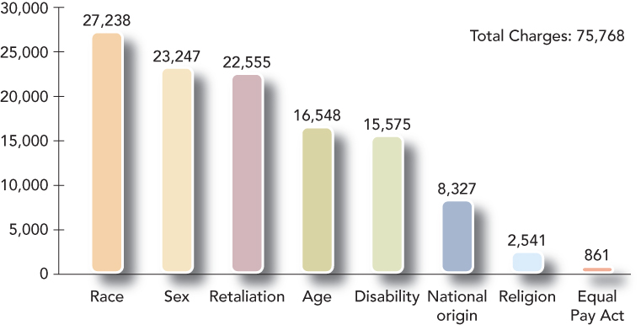
Government’s Role in EEO
Equal Employment Opportunity Commission
  Created by CRA 1964
  Enforces most EEO laws
  Receives and investigates complaints
  Issues guidelines
Office of Federal
Contract Compliance
  Enforces
  Executive Orders
  Charges filed
  with EEOC
Complaints must be filed within 180 days of incident.
EEOC has 60 days to investigate complaint.
McGraw-Hill/Irwin
Notes:
Equal Employment Opportunity requires that employers comply with EEO laws.
The executive branch of the federal government uses the Equal Employment Commission and the Office of Federal Contract Compliance Procedures to enforce these laws.
The Equal Employment Opportunity Commission is responsible for enforcing most of the EEO laws including:
Title VII
The Equal Pay Act
Americans with Disabilities Act
The EEO investigates and resolves complaints about discrimination, gathers information, and issues guidelines.
The EEOC monitors organization’s hiring practices.
EEO-1Report
The EEOC issues guidelines designed to help employers determine when their decisions violate the laws enforced by the EEOC.
Uniform Guidelines on Employee Selection Procedures
Steps that can take place whenever individuals believe they have been discriminated against include:
File a complaint
60 days to investigate
Right to sue
Consent decree
Two options
Office of Federal Contract Compliance
Enforces Executive Orders (AA plans and compliance)
Contractors who have more than $50,000 must have a written AA plan on file that has a
Utilization analysis
Goals and timetables for percentages of women and minorities – not quotas, just goals
Action steps – plan for meeting its’ goals
Aside from women and minorities, Vietnam veterans and individuals with disabilities should also have affirmative action taken to employ them.

Slide 39
Avoiding Discrimination
Key terms to be aware of:
  Disparate Treatment – differing treatment of individuals
  Disparate Impact – disproportionately exclude a protected group (Title VII). A common test of this is the 4/5 rule.
  Bona Fide Occupational Qualification (BFOQ)
Notes:
Disparate treatment – Differing treatment of individuals, where the differences are based on the individuals’ race, color, religion, sex, national origin, age, or disability status
Disparate impact - a condition in which employment practices are seemingly neutral yet disproportionately exclude a protected group from employment opportunities.
BFOQ – A necessary (not merely preferred) qualification for performing a job.

Slide 40
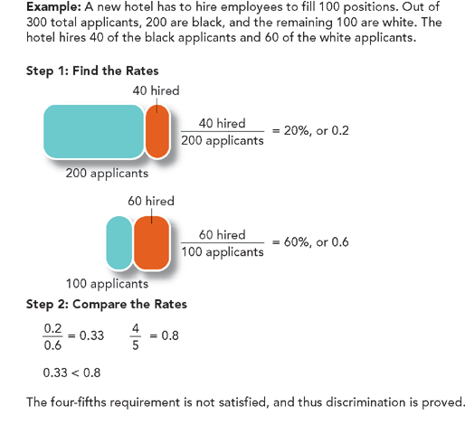
Calculating Disparate Impact
Notes:
The rule of thumb for determining adverse or disparate impact is that the rate of hiring of the minority group is less than 4/5ths the hiring rate for the majority group. Therefore, the rate doesn’t have to be the same, only 80% of that for the majority group.
Let’s walk through an example…. Go from slide

Slide 41

Businesses’ Role in Providing for EEO:
Avoiding Discrimination
Reasonable Accommodation: An employer’s obligation to do something to enable an otherwise qualified person to perform a job.
      Companies should recognize needs based on individuals’ religion or disabilities.
      Employers may need to make such accommodations as adjusting work schedules or dress codes, making the workplace more accessible, or restructuring jobs.
Notes:
For example, accommodations for an employee’s religion often involve decisions about what kinds of clothing to permit or require. LO5 Define sexual harassment, and tell how employers can eliminate or minimize it.
Sexual Harassment - Unwelcome sexual advances as defined by the EEOC. religious belief requiring accommodation, the employee should demonstrate this need to the employer. Assuming that it would not present an undue hardship, employers are required to accommodate such religious practices. They may have to adjust schedules so that employees do not have to work on days when their religion forbids it, or they may have to alter dress or grooming requirements. For employees with disabilities, reasonable accommodations also vary according to the individuals’ needs.

Slide 42
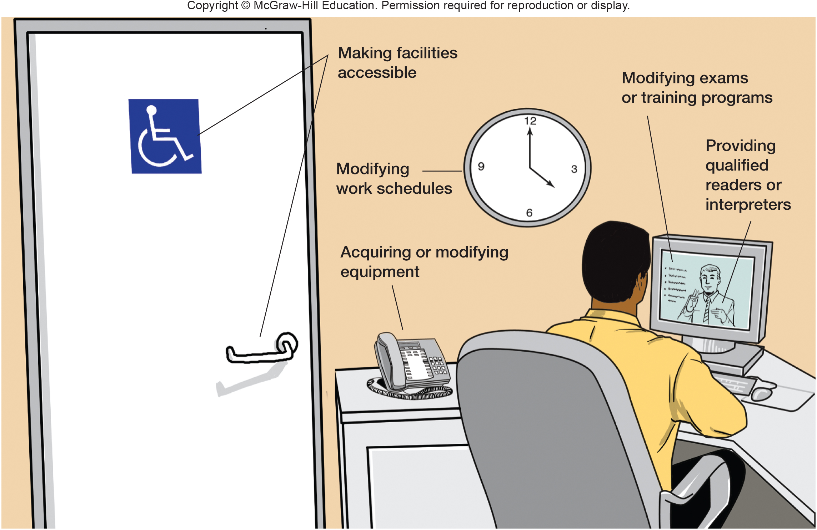
Figure 3.5
Reasonable Accommodation under the ADA
Notes:
For employees with disabilities, reasonable accommodations vary according to the individuals’ needs. Figure 3.5, employers may restructure jobs, make facilities in the workplace more accessible, modify equipment, or reassign an employee to a job that the person can perform. In some situations, a disabled individual may provide his or her own accommodation, which the employer allows, as in the case of a blind worker who brings a guide dog to work. f accommodating a disability would require significant expense or difficulty, how-ever, the employer may be exempt from the reasonable accommodation requirement (although the employer may have to defend this position in court). An accommodation is considered “reasonable” if it does not impose an undue hardship on the employer, such as an expense that is large in relation to a company’s resources.
Sexual Harassment
Unwelcome sexual advances as defined by the EEOC.
religious belief requiring accommodation, the employee should demonstrate this need to the employer. Assuming that it would not present an undue hardship, employers are required to accommodate such religious practices. They may have to adjust schedules so that employees do not have to work on days when their religion forbids it, or they may have to alter dress or grooming requirements.
For employees with disabilities, reasonable accommodations also vary according to the individuals’ needs.

Slide 43
Sexual Harassment
Quid Pro Quo Harassment
  Occurs when “submission to or rejection of sexual conduct is used as a basis for employment decisions.”
  Involves a tangible or economic consequence,
  such as a demotion or loss of pay.

Slide 44
Sexual Harassment (cont.)
Hostile Environment
  Occurs when unwelcome sexual conduct “has the purpose or effect of unreasonably interfering with job performance or creating an intimidating, hostile, or offensive working environment.”
  Dirty jokes, vulgar slang, nude pictures, swearing, and personal ridicule and insult constitute sexual harassment when an employee finds them offensive.
  Courts use a “reasonable person” test for hostile environment.

Slide 45
Preventing Sexual Harassment
Sexual Harassment refers to unwelcome sexual advances
  Quid pro quo – this for that
  Hostile work environment
Applies to same-sex harassment, male to female, and female to male.
Avoid sexual harassment claims
  Develop a policy statement
  Train employees
  Develop a reporting mechanism
  Act promptly with discipline and protection
Notes:
Sexual Harassment refers to unwelcome sexual advances
Quid pro quo
Hostile environment
Applies to same-sex harassment, male to female, and female to male.
How could companies avoid sexual harassment claims?
To ensure a workplace free from sexual harassment, organizations can follow some important steps:
Develop a policy statement
Train employees
Develop a reporting mechanism
Act promptly with discipline and protection

Slide 46
Supreme Court Further Expands Retaliation
Protected activity (the basis of a retaliation claim) covers more than just the filing of formal charges and lawsuits:
  Crawford v. Metro Gov’t of Nashville, 129 S. Ct. 846 (2009).
    sexual harassment investigation of supervisor
    Plaintiff stated in response to questioning that she had been harassed
    after investigation, supervisor was not disciplined, & 3 employees who had stated they had been harassed were terminated
    Plaintiff filed lawsuit alleging retaliation for opposing unlawful conduct
    Sixth Circuit held that, as Plaintiff never “instigated or initiated” any complaint of harassment, she had not sufficiently “opposed” unlawful conduct
    Supreme Court reversed, holding that employee’s communication to her employer of a belief that discrimination has occurred constitutes opposition under Title VII
    it is not necessary that the individual initiate a formal complaint, charge, or investigation

Slide 47
Sexual Orientation
Title VII of the Civil Rights Act of 1964 lists
“sex” (gender) as a protected class.
  Sexual orientation is not a valid defense against discrimination—gender applies to one’s sex at the time of birth and not to one’s sexual orientation.
  No federal law bars discrimination based on
  sexual orientation, or transgender and
  transsexual individuals.
  Companies in support of their diversity initiatives are fostering “gay-friendly” work places.
  Most companies in the Fortune 500 now offer health benefits to same-sex couples

Slide 48
Occupational Safety and Health
Occupational Safety and Health Act (OSH Act)
  All places of employment engaging in Interstate Commerce
  Authorized establishment and enforcement of occupational safety and health standards
  Divided enforcement between DOL & DOH
Occupational Safety and Health Administration (OSHA) – Under DOL
  Agency responsible for inspecting employers, applying safety and health standards, and levying fines for violation
National Institute for Occupational Safety and Health (NIOSH) – Under DOH (Research)
Notes:
Occupational Safety and Health Act (OSH Act)
U.S. law authorizing the federal government to establish and enforce occupational safety and health standards for all places of employment engaging in interstate commerce
Occupational Safety and Health Administration (OSHA)
Labor Dept. agency responsible for inspecting employers, applying safety and health standards, and levying fines for violation
The Occupational Safety and Health Act (OSH Act) enacted by Congress in 1970, is the most comprehensive U.S. law regarding worker safety.
Enforcement responsibilities divided between:
Department of Labor
Department of Health
Occupational Safety and Health Administration (OSHA) is responsible for:
Inspecting employers
Applying safety and health standards
Levying fines for violations
Conducting research (NIOSH)

Slide 49
Occupational Safety and Health
General Duty Clause – employer must provide an employee with a safe place of employment
Employees’ Rights:
  Request an inspection
  Have a representative present an inspection
  Have dangerous substances removed
  Be promptly informed
  Have violations posted
“Right to Know” Laws – health risks with exposure to certain substances
HAZCOM – Hazardous Communications
Notes:
General duty clause - employer must provide an employee with a safe place of employment
Employer’s must complete forms documenting work-related injuries and illnesses - OSHA’s Form 300 A
What rights do employees have?
Request an inspection
Have a representative present an inspection
Have dangerous substances removed
Be promptly informed
Have violations posted

Slide 50
Employee Rights Under OSH Act
Employees have the right to:
Request an inspection.
Have a representative present at an inspection.
Have dangerous substances identified.
Be promptly informed about exposure to hazards and be given access to accurate records regarding exposure.
Have employer violations posted at work site.
Notes:
OSH Act also grants specific rights to employees. Besides complying with OSHA regulations, employers often establish safety awareness programs designed to instill an emphasis on safety. They may identify and communicate hazards through the job hazard analysis technique or the technic of operations review. They may adapt communications and training to the needs of different employees, such as differences in experience levels or cultural differences from one country to another. Employers may also establish incentive programs to reward safe behavior.

Slide 51
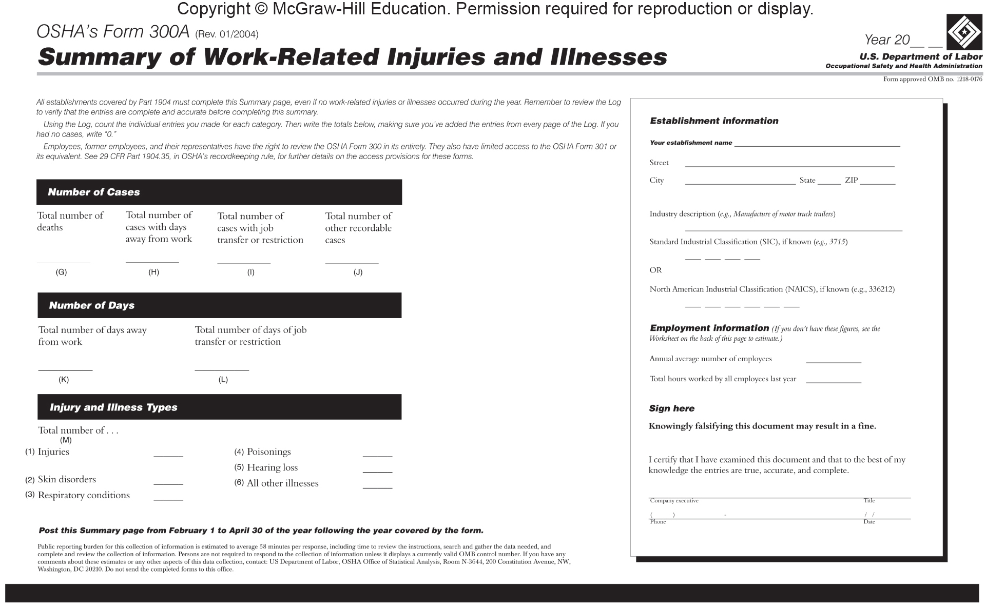
Figure 3.6
OSHA Form
Notes:
Figure 3.6 shows a sample of OSHA’s Form 300A, the annual summary that must be posted, even if no injuries or illnesses occurred.

Slide 52
Employer Sponsored Safety & Health Programs
Under the Occupational Safety and Health Act, employers have a general duty to provide employees a place of employment free from recognized safety and health hazards.
The Occupational Safety and Health Administration publishes regulations and conducts inspections.
Besides complying with OSHA regulations, employers often establish safety awareness programs designed to instill an emphasis on safety.
Notes:
Identifying and communicating hazards
Job hazard analysis technique is a safety promotion technique that involves breaking down a job into basic elements, then rating each element for its potential for harm or injury.
Technic of operations review (TOR) is an analysis method for determining which specific element of a job led to a past accident.
Managers should talk directly to employees about safety.
Managers should recognize that different groups of individuals may constitute different audiences.
National Safety Council research indicates:
40% of accidents happen to individuals in the 20-to-29 age group
48% of accidents happen to workers during the 1st year on the job
Reinforcing safe practices – not only identifying and training employees on safe practices, but also reinforcing and rewarding this behavior is also important. We’ll discuss strategies around this on the next slide.
Promoting safety internationally
Given the increasing focus on international management, organizations also need to consider how to ensure the safety of employees regardless of the nation in which they operate.
Cultural differences may make this more difficult than it seems.

