Slide 1
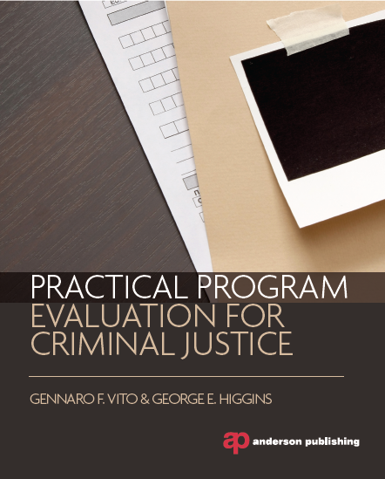
Chapter 1
Getting Started with
Program Evaluation

Slide 2
Introduction
The Aim of Program Evaluation
Effectiveness of Crime Prevention Programs
Accountability
Valid Indicators of Performance
The Role of Evaluation Research
Provide Evidence about the Effects of Programs and Policies

Slide 3
The Administrator and The Evaluator
The Program Administrator
Must be Committed to Research
The Evaluator
Must Guide the Conduct of the Research Process
Both Actors Must Work Together to Achieve Success

Slide 4
The Administrator and The Evaluator
Three Major Aspects of the Demand for Evaluation Research:
The Social Problem
The Service Agencies
The Public
Monitoring the Program is Essential for Program Results
Two Monitoring Approaches
External
Internal

Slide 5
Strengths and Weaknesses of Program Evaluation
Both a Political and Scientific Process
Evaluation Research is Unique in 7 Ways
Use for Decision Making
Program-Derived Questions
Judgmental Quality
Action Setting
Role Conflicts
Publication
Allegiance

Slide 6
Strengths and Weaknesses of Program Evaluation
Determining the Effectiveness of a Program is the Crucial Factor for the Evaluator
Program Operations Drive the Evaluation and its Design
Must Have a Balance between the Needs of the Evaluation and of the Program

Slide 7
Strengths and Weaknesses of Program Evaluation
The Ultimate Goal of Evaluation is to Guide Rational Policy
“Evidence-Based” Best Practices
Focus Upon the Rationality of a Program
Search for “What Works”

Slide 8
Evidence Based Practices
The Systematic Review
“Use Rigorous Methods to Locate, Appraise and Synthesize Findings from Criminal Justice Program Evaluation Studies.”
Example: Braga (2001) Hot Spot Policing

Slide 9
The Maryland Report
The Maryland Report was Set Up to Identify Criminal Justice Programs that are Most Effective
“Maryland Scale of Scientific Methods”
Three Primary Factors
Control of Other Variables
Measurement Error
Statistical Power

Slide 10
The Maryland Report
Identified Programs in Three Categories
What Works
Family and Parent Training
Coaching of High-Risk Youth in “Thinking Skills”
Nuisance Abatement Action on Landlords
Crime “Hot Spots”
What’s Promising
Proactive Drunk Driving Arrests
Community Policing Programs
Mailing Arrest Warrants to Domestic Violence Suspects
Gang Monitoring by Community Workers and Probation and Parole Officers

Slide 11
The Maryland Report
Identified Programs in Three Categories
3. “What Doesn’t Work”
Gun “Buy Back” Programs
D.A.R.E.
“Scared Straight” Programs

Slide 12
Meta-Analysis
Meta-Analysis
Sophisticated Approach to Reviewing the Literature on a Particular Intervention
The effect indicates how many hits on average are related to the dependent variable. It can also reflect the relationships between the independent and dependent variables.
The key strategy is to identify all available studies on a policy or program and code their findings and methodologies into objective categories and then conduct quantitative analysis.

Slide 13
Meta-Analysis
Provides Several Distinct Differences over Traditional Reviews of the Literature
Provides a “Single Precise Estimate” of the Effect Size
Can Obtain the Effect Size of the Relationship Across Different Methodologies
Can Consider a Subject Over Time

Slide 14
Meta-Analysis
When Meta-Analysis Should be Performed
Clarify the Relationship between an Intervention and its Effectiveness when Published Studies of It Have Generated “Mixed” Results
Can Asses Whether a Policy or Program “Works” Across Time and Place by Examining the Literature on the Intervention and Generating an Effect Size

Slide 15
The Campbell Collaboration (Crime and Justice Group)
The Collaboration was Established to Prepare, Maintain, and Disseminate Evidence-Based Research on the Effects of Interventions
Crime and Justice Group Aims to Prepare and Maintain Systematic Reviews of Crime Programs and Policies

