Slide 1
ITS 835 enterprise risk management Chapter 25
ERM - Uses of Efficient Frontier Analysis in Strategic Risk Management

Slide 2
introduction
Strategic risk management framework
Modern portfolio theory
Practical application of risk measurement for insurance
Sample case study
Intended uses

Slide 3
Strategic risk management framework
Enables organization to discover risks
Across organizational boundaries
Continuous cycle
Considers interactions of multiple risks
Combines risk appetite and risk tolerance
Defines exploitable risks

Slide 4
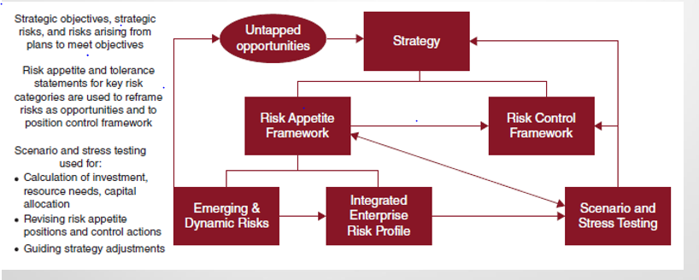
Strategic risk management

Slide 5
Modern portfolio theory
Mathematical model – from 1950s
Risk is standard deviation
When portfolio is weighted combination of assets
Rp – return of portfolio
Ri –return of asset i
Wi –weighting of asset i

Slide 6
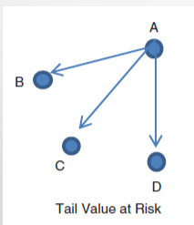
Practical Application of Risk Measurement for Insurance
Purpose is to optimize insurance placements
And risk limits
Tail value at risk of loss –TVaRL
Expected value of loss, given that an event has occurred

Slide 7
Sample case study
Three basic risks
Earthquake exposure to buildings
Workers’ compensation insurance
General liability insurance

Slide 8
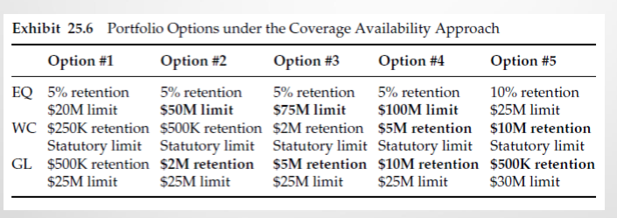
Portfolio options

Slide 9
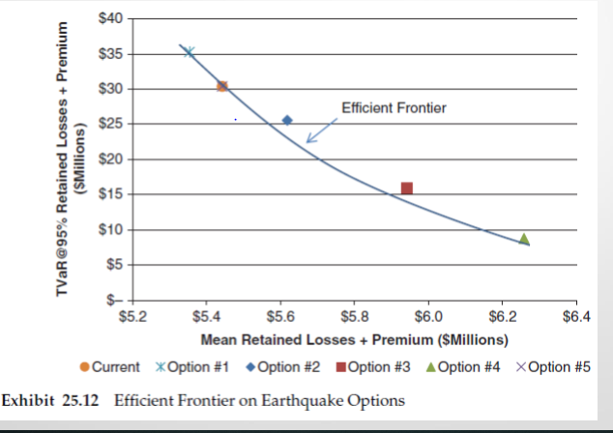
Earthquake options

Slide 10
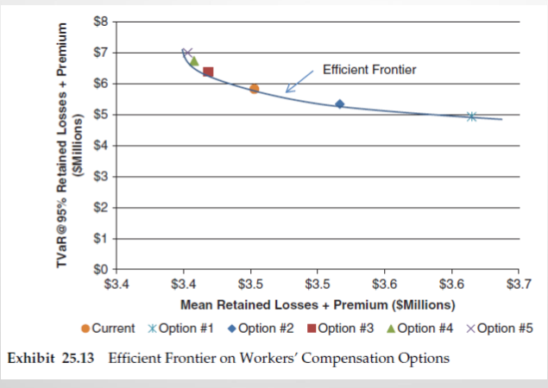
Workers’ compensation options

Slide 11
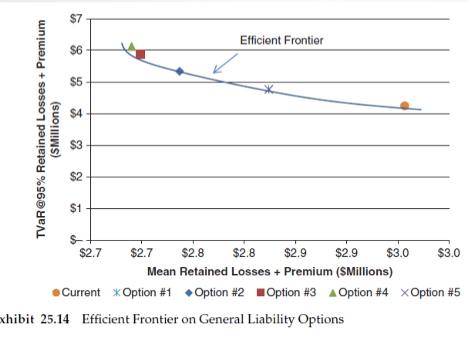
General liability options

Slide 12
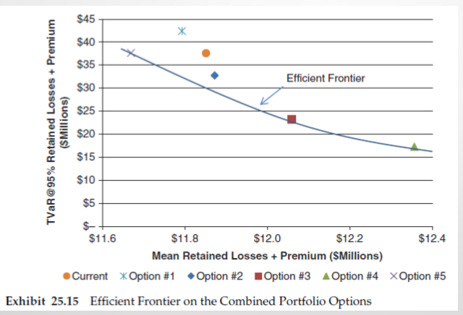
Combined portfolio options

Slide 13
Intended uses
Help large organizations
Risk management
Portfolio management
Insurance and non-insurance risks
Best fit
Established ERM

