Slide 1
CHAPTER 8: JOB DEMANDS, HEALTH AND WELL-BEING FOR A CHANGING POPULATION

Slide 2
CHAPTER 8: JOB DEMANDS, HEALTH AND WELL-BEING FOR A CHANGING POPULATION
General requirements for humans in systems
Job demands must match the work capacity of employees
Work should provide the optimal level of physical activity
Shift systems must minimise disruption of sleep
At least 6-hours of uninterrupted sleep every 24 hours and 2 additional hours of rest.
Facilities for healthy eating and exercise should be provided

Slide 3
ENERGY COSTS OF PHYSICAL ACTIVITIES
1 MET = 4.184 kJ.kg⁻¹.h⁻¹ = RMR 9.1
where the RMR is the resting metabolic rate (average rate when a person sits resting in a chair).

Slide 4
MET Values for Common Activities
Cycling (<15km/hr) 4 METS
Light home exercise 3.5 METS
Weight lifting (gym) 8 METS
Shoveling snow 6 METS
Light factory work 3 METS
Walking (<3km/hr) 3 METS
Tennis (singles) 8 METS
Tennis (doubles) 5 METS
Squash 12 METS

Slide 5
Metabolic Demands and Food Consumption
Most of the energy in food comes from fats, carbohydrates and protein (and also from alcohol).
Carbohydrates consist of starches, sugars and cellulose (which humans cannot use as an energy source)
Fat has the highest energy density at 37kj/g, followed by proteins and carbohydrates at 17 kj/g
Starches are broken down into sugar in the gut and all dietary carbohydrate is absorbed into the body in the form of glucose
Fat is broken down into fatty acids prior to absorption.
Both fatty acids and glucose can be used as a source of energy. A healthy diet also contains essential vitamins and minerals, which are not used as a source of energy.

Slide 6
Diet
Several aspects of the modern diet appear to make food energy too readily available and too easy to consume
The glycemic index (GI) of food is a measure of its effect on raising blood sugar after it has been eaten
Foods with a high glycemic index contain carbohydrates that are digested easily, causing blood sugar levels to rise quickly
The fat and protein content of foods lowers the glycemic index
Milk and dairy products have a low glycemic index because they contain fat and protein whereas potato, white rice, corn syrup and fructose have a high glycemic index
Many corn-based breakfast cereals have high GI, whereas oatmeal in a natural form has a low GI.

Slide 7
Insulin
Insulin is a ‘fat-sparing’ hormone
As blood sugar levels rise after a meal, insulin is secreted to enable the glucose to be either metabolized in the muscles or stored as glycogen or fat
People who eat diet rich in foods with a high GI may develop insulin resistance where the body no longer responds to insulin and blood sugar levels remain high causing long-term damage to the arteries

Slide 8
Type II Diabetes
Type II Diabetes usually occurs in adulthood due to a combination of factors including genetic predisposition, high BMI, lack of exercise and age. As the islets of Langerhans in the pancreas no longer produce sufficient insulin when the blood sugar rises after a meal or the tissues no longer respond to insulin. The main symptoms of Type II diabetes are:
urinating more often than usual, particularly at night
feeling very thirsty
feeling very tired
unexplained weight loss
itching around the penis or vagina, or frequent episodes of thrush
cuts or wounds that heal slowly
blurred vision (caused by the lens of the eye becoming dry)
Even low level physical activity can have beneficial effects not because it ‘burns calories’ but because it helps maintain normal metabolic function, including the ability of cells to oxidize fatty acids as a source of energy while maintaining sensitivity to insulin providing proper control of blood glucose levels.

Slide 9
Defining Overweight and Obesity
Obesity is not a disease but it does increase the likelihood of ill-health. Obese workers take more sick days, have longer sick leave and incur greater productivity losses than non-obese workers. The ‘Body Mass Index’ (BMI) is often used to classify individuals as either ‘healthy weight’, ‘overweight ’or ‘obese’ where:
BMI = Mass(kg)/Height² (m)
A BMI >18.49 and <25 is regarded as healthy, 25-29.9 as overweight and 30+ as obese. One of the main drawbacks of BMI as a measure of obesity is that it ignores an individual’s fat-free mass with the result that very muscular people (‘mesomorphs’) are misclassified as overweight or obese.

Slide 10
Health Risk Table
BMI |  | Waist circumference (cm)
 |  | Men < 94 | Men 94-101.9 | Men ≥ 102
 |  | Women <80 | Women 80-87.9 | Women ≥ 88
Underweight | < 18.5 | Should be informed of risk of underweight
Healthy weight | 18.5-24.9 | None | None | Increased
Overweight | 25.0-29.9 | None | Increased | High
Obese Class I | 30.0-34.9 | Increased | High | Very High
Obese Class II | 35.0-39.9 | High | Very High | Extreme
Obese Class III | ≥40 | Very High | Extreme | Extreme

Slide 11
Role of Psychosocial Stress
Sources of Stress
Physical and psycho-social job demands
Symptoms of Stress
Individual symptoms
Raised blood pressure
Depressed mood
Increased anxiety
Irritability
Increased risk of cardio-vascular disease
Role in the organisation
Relationships at work
Individual
Organisational symptoms
High absenteeism
High staff turnover
Poor morale
Reduced safety
Reduced operational capability
Career development
Organisational climate

Slide 12
Mechanism of Stress
Psychological stress exacerbates problems of blood glucose control
In physically undemanding but mentally stressful jobs cortisol levels are elevated
Cortisol is a hormone which acts to increase blood sugar levels
It counteracts the effects of insulin
Cortisol levels are sometimes raised in highly stressed people, such that they develop insulin resistance and have chronically elevated blood glucose levels because the absorption of glucose into the tissues is impeded by the raised cortisol levels
In healthy people, the action of cortisol is to facilitate the conduct of physically demanding work.

Slide 13
Sleep
A good night’s sleep can be defined as a period of uninterrupted sleep though all stages of sleep a sufficient number of times
For most adults, 6-8 hours seems to be required
Lack of sleep causes a sleep debt, analogous to hunger, the more deprived of sleep we are, the greater the debt and the longer we need to sleep to restore normal function
Disturbances during sleep may disrupt the normal cycling through the different sleep stages and result in insufficient REM or deep sleep
It is thought that chronic sleep deprivation is linked to the development of a number of conditions, including Type II diabetes

Slide 14
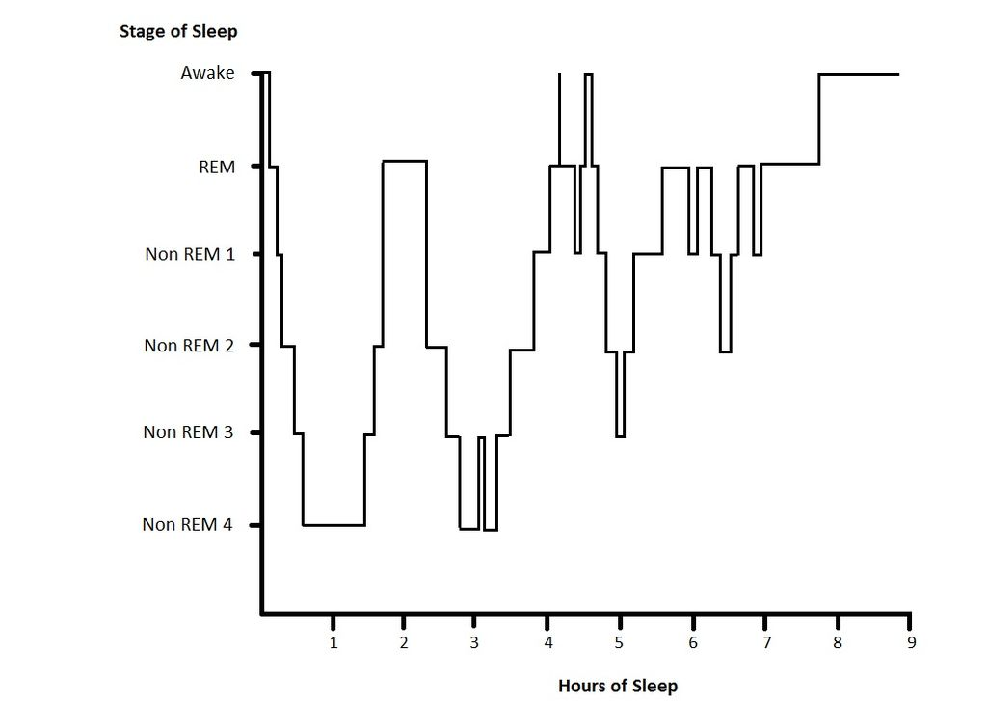
Stages of Sleep

Slide 15
Applications
Build movement into sedentary jobs
Exercise breaks for VDT workers
Standing and moving after lunch
Fitting the job to the obese worker
Don’t design an ‘obesogenic’ workplace

Slide 16
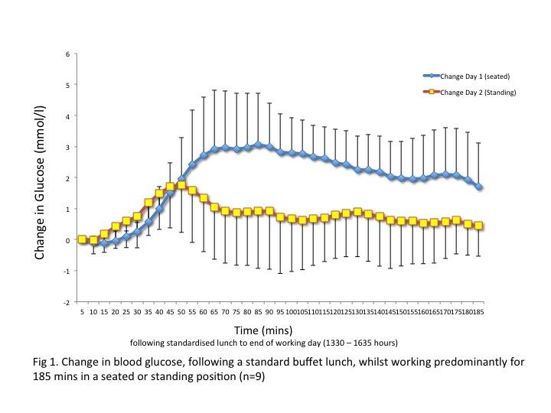
Improved Glycaemic Control when standing After Lunch

Slide 17
Problems of Obese Workers
Difficulty wearing uniforms
Difficulty wearing personal protective equipment
Difficulty in moving around at work
Problems attending training courses
Lack of fit with office furniture

Slide 18
Characteristics of the ‘Obesogenic’ Workplace
Easy access to unhealthy food options – i.e. fast food, takeaways, vending machines
Lack of facilities for preparing food i.e. Microwave oven, cooker etc.
Lack of facilities for storing healthy food – i.e. refrigerator
Lack of healthy food options in canteen
Lack of nutritional information in canteen or vending machine food
Lack of break- lunch areas causing employees to eat at their workstations, desks, cars etc.
Occupational stress
Long working hours
Shift work

Slide 19
Characteristics of the ‘Obesogenic’ Workplace
Continuous sedentary working behaviour - spending a lot of time seated
Work schedule - not allowing enough time for lunch breaks
Lack of onsite physical activity facilities
Lack of Stairs at work
Stairs at the workplace not accessible and not properly illuminated
Continuous sedentary working behaviour - spending a lot of time seated
Work schedule - not allowing enough time for lunch breaks
Lack of cycle storage facilities
Active access to the workplace discouraged by bad public transportation system
Limited availability of nearby (and safe) recreational areas, green spaces, parks, sports grounds etc.
Lack of management commitment to promoting workplace wellness

Slide 20
Characteristics of the ‘Obesogenic’ Workplace
Lack of a workplace health promotion policy
Lack of staff to implement workplace health promotion activities at the workplace
Lack of workplace health promotion programs and interventions promoting healthy nutrition and physical activity
Lack of awareness by employers concerning the adverse effects of obesity on job satisfaction, turn over and productivity
Low employee participation in workplace health promotion programs
Lack of incentives for employees participating in obesity prevention programs
High cost to employers for providing physical activity opportunities
Not enough space -at the workplace - high levels of congestion at the workplace
"Pressure to look slim and well-trained" at work (preventative effect)

Slide 21
Basic Conditions for a Good Night’s Sleep
Room should be dark and quiet (<50 dB(A)
Room temperature no greater than 18-20 degrees Celsius
Avoid tea, coffee and alcohol before sleeping
Avoid large meals before retiring
Keep a regular sleep/wake schedule
Exercise regularly but not immediately before retiring
Develop rituals or activities to separate work from sleep

Slide 22
Shiftwork
Adaptation to a new shift system takes place over at least a week and must be allowed for.
Where possible minimize the change in working hours. If it is 4 hours or less, workers will be able to accommodate to the change with few problems
Rapidly rotating system of three 8-hour shifts may be the best compromise Day 1: early morning shift (e.g. 04:00 to 12:00), Day 2: day/evening shift (e.g. 12:00 to 20:00), Day 3: night shift (20:00-04:00).
12-hour workdays with a compressed week popular but may lead to fatigue and cause sleep problems and increase accident risk

Slide 23
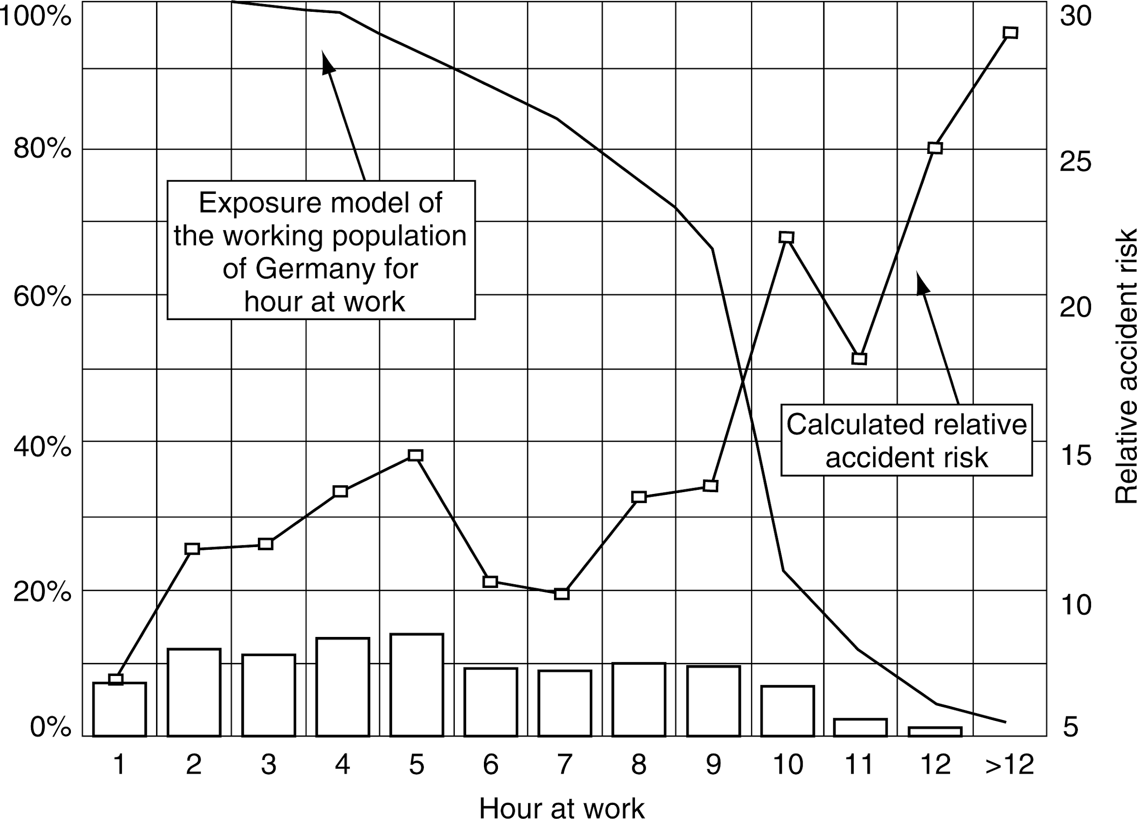
Hours of Work and Safety

Slide 24
Night Shifts in Rotating Shift Systems
Permit no more than four consecutive night shifts
Allow at least two days off after a night shift
Starting Times
Start after 7:00 AM, where possible
No more than four consecutive early shifts (starting before 7:00 AM)
Shorten length of early shifts to avoid fatigue later on in the day.
Never combine early and late shifts on consecutive days (e.g. late nights followed by early starts).

Slide 25
Assessing Fitness: Harvard Step Test
The subject steps up and down onto a 50cm high step every two seconds for 5 minutes (or until exhaustion if exhaustion occurs under 5 minutes). Stepping is paced by a metronome. After 5 minutes, or exhaustion if the subject cannot continue) the subject sits and the heart rate is taken at one minute intervals for 30 seconds from 1, 2 and 3 minutes. A ‘fitness index’ is calculated as follows:
Fitness = T_{e}x100/h_{b} x2 9.1
Where:
T_{e}= Time to exhaustion in seconds
h_{b}= sum of the heart beats over the three intervals
The fitness index is interpreted as follows:
Excellent >96
Good - 83-96
Average – 68-82
Low average – 54-67
Poor < 54

Slide 26
Heart Rate Monitor
Monitor is fitted at the beginning of the shift
Heart rate can be linked to activities
Rapid reduction in heart rate after work indicated good recovery

Slide 27
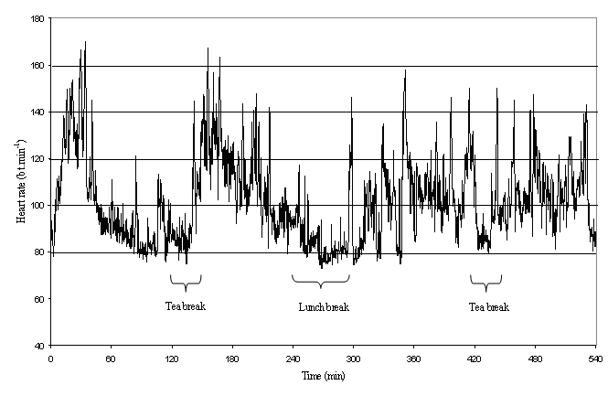
Heart Rate Over a Shift

Slide 28
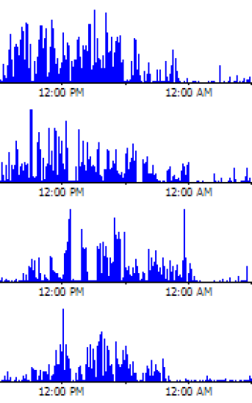
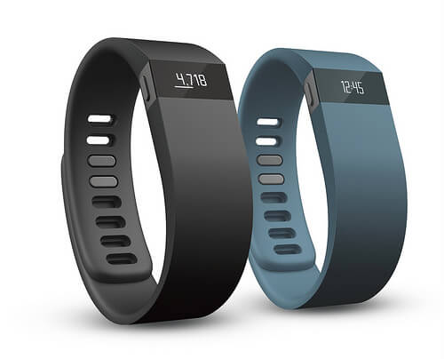
Actimeters: Physical Activity Monitoring

Slide 29
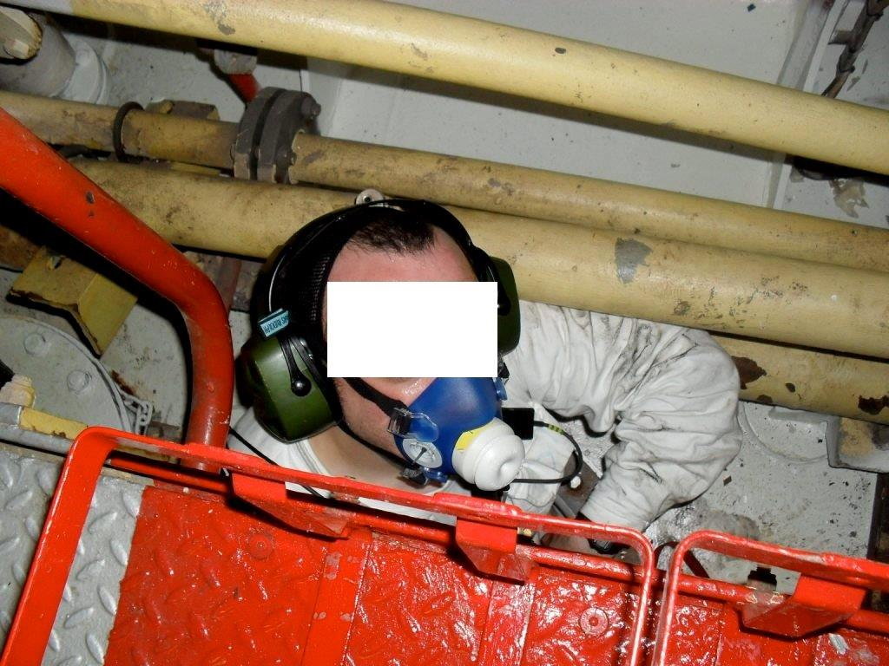
Measuring Oxygen Consumption at Work

Slide 30
Self Assessment of Work Ability
Items of the Work Ability Index
Current work ability compared with the lifetime best 0–10
Work ability in relation to the demands of the job 2–10
Number of current diseases diagnosed by a physician 1–7
Estimated work impairment due to diseases 1–6
Sick leave during the past year (12 months) 1–5
Own prognosis of work ability 2 years from now 1–7
Mental resources 1–4

Slide 31
Self Assessment of Physical Activity
Physical Activity at Work
I am mainly sedentary and do not walk around much at work
I walk around quite a bit at work but do not carry loads or run
Most of the time I walk and often climb stairs or ladders and carry loads
I have heavy physical work and carry heavy burdens often
Physical Activity during Leisure Time
I am mainly sedentary. I read, watch TV or go to the movies
I go for a walk, cycle a little and am active for 4 hours/week
I am active – I run, play sports like tennis at least 3 hours per week or garden
I am a competitive sports player (swimming, soccer, handball) or run long distances Several times per week

Slide 32
Research Issues
Escalating health care costs in developed countries have provided a stimulus for the investigation of factors influencing the health of the working population
Since work constitutes the major portion of an individual's waking life, it seems logical to evaluate the activities carried out at work and to suggest ways of incorporating health promoting features into working life
Fitness programs and in-house gymnasia are obvious examples as are stress management programs.

Slide 33
Summary
The 40 hour, 5-day week is the norm in most countries.
Shiftwork has well-documented negative health effects but the effects of working overtime are less clear.
Fifty hours of work per week on a regular basis seems to be the upper limit – more than this and efficiency and output drops
In low-technology jobs the problems of avoiding excessive physical stress remain
In high-technology jobs, the challenge is to avoid psychological stress by increasing employee control over work and introducing a more participatory style of management and by finding ways of increasing the physical activity of the, predominantly, sedentary workers

